Slide 1




PFAS in Nevada
Rural Water Conference
March 10, 2026
Presented by
Nevada Division of Environmental Protection
Bureau of Safe Drinking Water
Laurie Gehlsen
Enforcement Supervisor
ndep.nv.gov l @NevDCNR

Slide 2
Objectives
Introduction to PFAS
Sources of Contamination
Health Impacts
Unregulated Contaminant Monitoring Rule 5 (UCMR 5)
Rules & Regulations Update
Nevada’s Action Plan
Emerging Contaminant Funding
Current & Upcoming Actions
Compliance Options
Questions
Notes:
Green is “repeat” general information – Blue is updated information specific to Nevada.

Slide 3
What are PFAS?
PFAS = Per- and Polyfluoroalkyl Substances
PFAS are manufactured chemicals that have been used in industry and consumer products since the 1940s.
Because of their widespread use and their persistence in the environment, many PFAS are found in the blood of people and animals all over the world. There are thousands of different PFAS, some of which have been more widely used and studied than others.
Notes:
PFAS is an umbrella term for a large family of per- and polyfluoroalkyl substances that have been widely used in different consumer products since the 1940’s.
Their presence in the environment has become widely spread since then and these chemicals are now known to have an affect on human health and the environment.
The products manufactured that contain PFAS are commonly and widely used to make products resistant to water, heat, and stains.

Slide 4
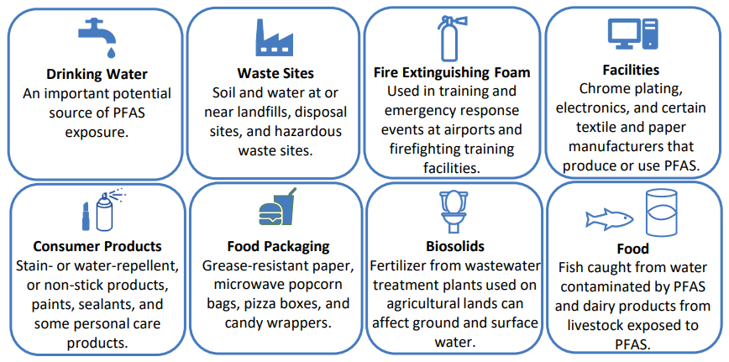
Sources of PFAS
Notes:
Drinking Water: roughly 20% of our PFAS intake is estimated through consuming contaminated water - NATIONWIDE.
Most U.S. production of long-chain PFAS (e.g. PFOS, PFOA, & PFNA) was phased out and generally replaced with alternative PFAS compounds such as GenX, PFBS, and PFHxS.
Currently PFOA and PFAS are the most widely studied of these compounds as they have been manufactured longer than the rest.
They were detected in up to 98% of humans that participated in representative U.S. general population studies according to the EPA.
This percentage is on the slow decline due to steps taken by EPA to mitigate the use of these contaminants in the U.S.
Regulatory agencies are starting to take direct actions to help mitigate PFAS within public drinking water facilities through technical assistance and funding.

Slide 5



Sources of PFAS
Used in the manufacture of:
  non-stick cookware
  stain blocking treatments for upholstery and carpet
  waterproof clothing
  firefighting foam
  surfactants
Trade names you may be familiar with:
  Teflon®
  Stainmaster®
  Scotchgard®
  Gore-Tex®
Notes:
Current research has shown that people can be exposed to PFAS by:
Working in occupations such as firefighting or chemicals manufacturing and processing.
Drinking water contaminated with PFAS.
Eating certain foods that may contain PFAS, including fish.
Swallowing contaminated soil or dust.
Breathing air containing PFAS.
Using products made with PFAS or that are packaged in materials containing PFAS.

Slide 6
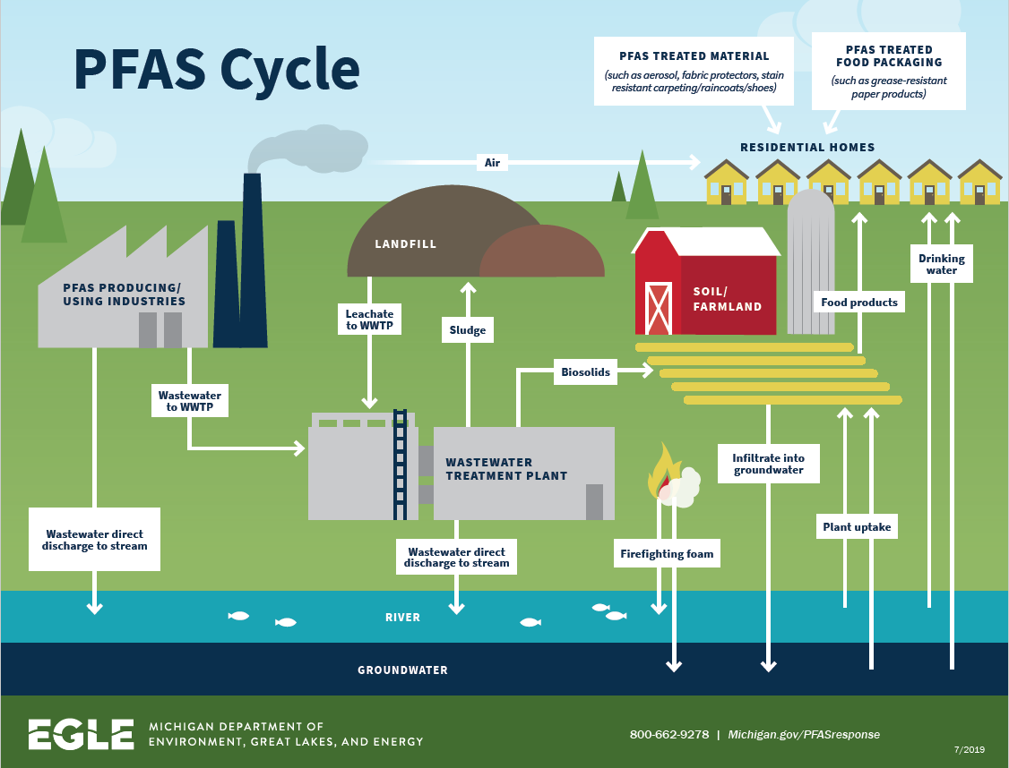
Notes:
PFAS is cyclic due to its persistence in the environment and in industries as a stable compound as we discussed.
Concentrations within reservoirs will continue to increase unless PFAS mitigation of effluent increases.
Continued federal restrictions on PFAS manufacturing and use will help decrease its concentration in the environment. The less we use these chemicals over time, the less contribution to it’s presence in the environment.
Today’s focus will remain on PFAS and its effects on drinking water sources at public water systems in Nevada.

Slide 7
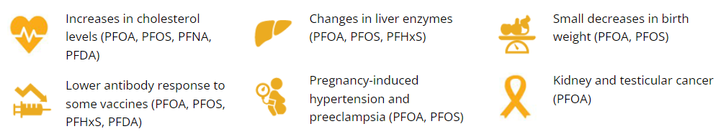
Some Health Effects can Include
Notes:
As the Bureau of SDW, our goal is to help mitigate regulated contaminants in public water systems as oral consumption of PFAS chemicals is one of the ways in which they can accumulate within the human body and can impact one’s health.
These are some of the processes or parts of the body that they can affect.
EPA’s proposed rule goes into more specifics of the proposed contaminants if you are interested in learning more.
Current peer-reviewed scientific studies have shown that exposure to certain levels of PFAS may lead to:
Reproductive effects such as decreased fertility or increased high blood pressure in pregnant women.
Developmental effects or delays in children, including low birth weight, accelerated puberty, bone variations, or behavioral changes.
Increased risk of some cancers, including prostate, kidney, and testicular cancers.
Reduced ability of the body’s immune system to fight infections, including reduced vaccine response.
Interference with the body’s natural hormones.
Increased cholesterol levels and/or risk of obesity.
PFAS (oral) exposure is observed to have health effects on the following:
Cancer
Liver
Growth, development, and/or reproduction
Hormone levels
Kidney(s)
Immune System
Lipid Levels
Nervous System
The risk of health effects associated with PFAS depends on
Exposure factors (e.g., dose, frequency, route, and duration)
Individual factors (e.g., sensitivity and disease burden)
Other determinants of health (e.g., access to safe water and quality healthcare)

Slide 8
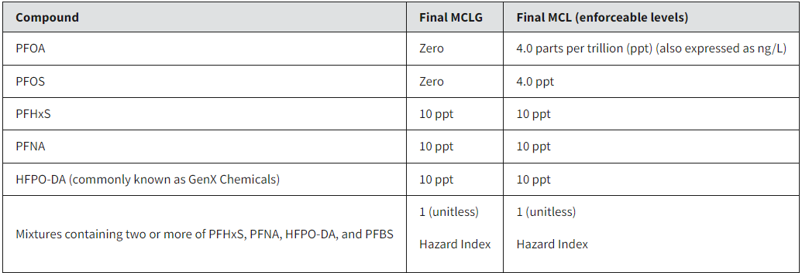
PFAS Regulations
The final rule for these six contaminants was released by EPA on April 10, 2024.
MCL: Maximum Contaminant Level
Ppt: parts per trillion ~nanograms per liter (ng/L).
Notes:
PFAS are categorized as chronic contaminants and therefor will be regulated as a running annual average (RAA).
In developing this proposed rule, EPA used the same standardized monitoring framework (SMF) as they currently use for regulated Synthetic Organic Contaminants (SOC’s).
The Hazard Index method of regulation is new to Safe Drinking Water and I’ll explain how it is calculated on the next slide but is determined by a calculation of four PFAS contaminants and their health advisory levels.

Slide 9
PFAS Regulation Trigger Levels
National Primary Drinking Water Regulation Crosswalk released by EPA in October,2024.
40 CFR 141.902(a)(5)
Compound | Trigger level
PFOA | 2.0 parts per trillion (ppt) (also expressed as ng/L)
PFOS | 2.0 ppt
PFHxS | 5.0 ppt
PFNA | 5.0 ppt
HFPO-DA | 5.0 ppt
Hazard Index PFAS (HFPO-DA,PFBS, PFHxS, PFNA) | 0.5 (unitless)
Based on initial monitoring results, for each sampling point at which a regulated PFAS listed in § 141.61(c) is detected at a level greater than or equal to the trigger level, the system must monitor quarterly for all regulated PFAS beginning April 26, 2027, in accordance with paragraph (b)(2) of this section.
40 CFR 141.902(a)(6)
MCL: Maximum Contaminant Level
Ppt: parts per trillion ~nanograms per liter (ng/L).

Slide 10
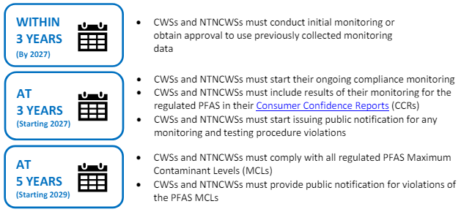
Initial Monitoring Requirements
To establish monitoring frequency
Notes:
As the Bureau of SDW, our goal is to help mitigate regulated contaminants in public water systems as oral consumption of PFAS chemicals is one of the ways in which they can accumulate within the human body and can impact one’s health.
These are some of the processes or parts of the body that they can affect.
EPA’s proposed rule goes into more specifics of the proposed contaminants if you are interested in learning more.
Current peer-reviewed scientific studies have shown that exposure to certain levels of PFAS may lead to:
Reproductive effects such as decreased fertility or increased high blood pressure in pregnant women.
Developmental effects or delays in children, including low birth weight, accelerated puberty, bone variations, or behavioral changes.
Increased risk of some cancers, including prostate, kidney, and testicular cancers.
Reduced ability of the body’s immune system to fight infections, including reduced vaccine response.
Interference with the body’s natural hormones.
Increased cholesterol levels and/or risk of obesity.
PFAS (oral) exposure is observed to have health effects on the following:
Cancer
Liver
Growth, development, and/or reproduction
Hormone levels
Kidney(s)
Immune System
Lipid Levels
Nervous System
The risk of health effects associated with PFAS depends on
Exposure factors (e.g., dose, frequency, route, and duration)
Individual factors (e.g., sensitivity and disease burden)
Other determinants of health (e.g., access to safe water and quality healthcare)

Slide 11
Rule Implementation Important Dates
Within three years of rule promulgation (2024 – 2027):
• Initial monitoring must be complete - Starting three years following rule promulgation (2027 – 2029):
• Results of initial monitoring must be included in Consumer Confidence Reports (i.e., Annual Water Quality Report)
• Regular monitoring for compliance must begin, and results of compliance monitoring must be included in Consumer Confidence Reports
• Public notification for monitoring and testing violations Starting five years following rule promulgation (2029)
• Comply with all MCLs
• Public notification for MCL violations

Slide 12
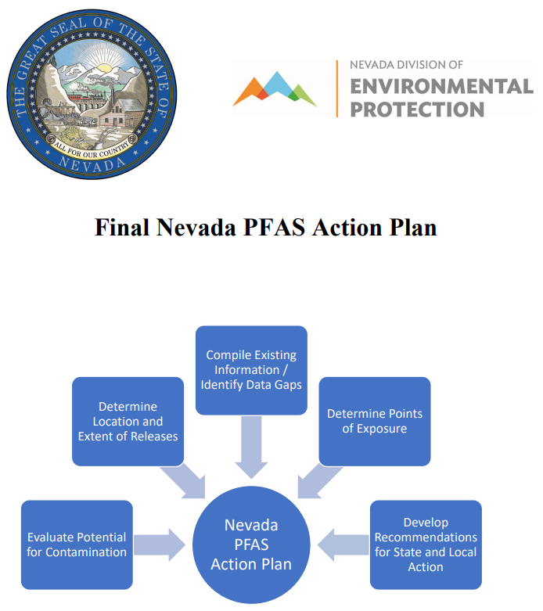
Action Plan
Developed by a working group dedicated to study issues relating to environmental contamination resulting from PFAS in Nevada under Assembly Bill (AB) 97.
Notes:
UCMR 3 data summary
Nevada’s PFAS Action Plan was developed by a working group dedicated to addressing these emerging contaminants. Developing the PFAS Action Plan allowed NDEP to bring stakeholders from multiple agencies, academia, and national organizations to the table to review research and discuss potential sources of PFAS Contamination. The final Action Plan was released to the public in June of 2022 and will be updated as regulations are implemented. Through sharing of knowledge, it was determined that Nevada has no known manufacturing of PFAS com
Action Plan Objectives:
1. Evaluate the potential for environmental contamination in the State resulting from PFAS
2. Determine the location and extent of potentially significant discharges or releases of PFAS in the State
3. Compile information relating to existing federal, State and local actions and identify data gaps to monitor, contain and clean up environmental contamination resulting from PFAS
4. Determine the potential points of exposure to PFAS for residents of the State
5. Develop recommendations for state and local action to prevent releases, monitor drinking water sources, and contain and clean up environmental contamination resulting from PFAS
pounds, so PFAS environmental impacts are most likely due to their ubiquitouss use.
In 2022 and 2023 and using the PFAS Action Plan, NDEP has focused resources in 4 key areas:
Research and pursuit of federal grant funding options for NDEP’s work, as well as funding to benefit regulated drinking water systems who will have to address PFAS
Sampling for PFAS in Nevada waters and wastewater,
Staying abreast of analytical methods and certified laboratories for PFAS Analysis, and
Working with utilities in response to PFAS sample results.

Slide 13
PFAS & Emerging Contaminants Approach
Investigate
PFAS Sampling & Analysis
Source Water Activities: PFAS Hydrogeologic & Hydrologic Risk Assessment Development
Public Communication: Web-based Map of PFAS Results
Technical Assistance:
  PFAS Sample Collection Training
  Laboratory Equipment & Training
  Facilitate Consolidation Discussion
Research: PFAS Monitoring
Prepare
Educate
Respond
Protect
Investigate
Notes:
Working towards procurement of direct contractors to provide technical assistance to pws’s w/ pfas.
*Lab: bring pfas capacity to NV labs
PFAS Priority Sampling & Analysis in Nevada
(start & stop dates of contract)
(amendment)
(when next contract is anticipated)
Technical Assistance
(Explain without naming funding/proposal/per process)
Risk Assessment Tool
(short summary here)

Slide 14
Nevada’s PFAS Timeline
What we know today
USEPA Final Drinking Water Rule Release
April 10, 2024, Final PFAS rule announced by EPA
PFAS Testing should be taking place
April 26, 2027, Compliance target date
Situation is fluid at the federal level - parts of the rules are being reconsidered.

Slide 15
Nevada’s PFAS Timeline
2013-2016
AB 97: PFAS Stakeholder Working Group
2022
NDEP Finalizes PFAS Action Plan
2023
USEPA Monitoring Begins
NDEP Continues Water Monitoring
2021
USEPA Early Monitoring
NV Drinking Water Samples all Non-Detect
USEPA Proposed Drinking Water Rule
2024/2025
NDEP Issuing Contracts & Subgrants
NDEP Begins Prioritized Water Monitoring
NDEP Develops Sample Prioritization Tool
USEPA Issues PFOA/PFOS Health Advisories
USEPA Issues Updated & New Health Advisories
Group was established
USEPA Final Drinking Water Rule Released – Las year.
NDEP & PWS Proactively Address PFAS Detections
Notes:
In Nevada, PFAS monitoring began in 2013 by US EPA as a part of their Unregulated Contaminant Monitoring Rule. From the 2013-2015 monitoring activity, there were no detections of PFAS in drinking water at the sites tested and at the analytical accuracy that laboratories could achieve at that time.
Between 2016 and 2021, there was a significant amount of effort made nationally to address PFAS. Some national efforts included: enhancing laboratory methods to analyze more types of PFAS and detect their presence at lower levels; finding options for treating PFAS; researching public health risks; and work toward developing federal regulations.
Following passage of Nevada Assembly Bill 97 (in 2021) and using US EPA PFAS grant funding, NDEP created and managed the PFAS Stakeholder Working Group to engage a wide variety of individuals and produce the PFAS Action Plan in June 2022. The action plan aided NDEP in focusing future efforts.
In 2022 and 2023 and using the PFAS Action Plan, NDEP has focused resources in 4 key areas:
Research and pursuit of federal grant funding options for NDEP’s work, as well as funding to benefit regulated drinking water systems who will have to address PFAS
Sampling for PFAS in Nevada waters and wastewater,
Staying abreast of analytical methods and certified laboratories for PFAS Analysis, and
Working with utilities in response to PFAS sample results.
In response to the Federal Bipartisan Infrastructure Law, NDEP has applied for various grants and will continue to do so. Awarded BIL grants will be administered by different Bureaus within NDEP. It is notable that current grant awards to NDEP for addressing emerging contaminants, including PFAS, total over $61M.

Slide 16
Nevada’s PFAS Timeline Continued
2025
2025- April 26,2027
Initial monitoring
April 26,2027-April 26, 2029
Begin April 26, 2027
Begin April 26, 2029
2023-2025
April 26, 2029 – Ongoing Monitoring
Monitoring and Reporting Violations: Begin April 26, 2027
Fifth Unregulated Contaminant Monitoring Rule (UCMR5)
Sample Public Water Systems (PWS) for PFAS.
Trigger levels assessed
Each analyte in each sampling event assessed
Complete by April 26, 2027
MCL and trigger levels assessed
Running Annual Average (RAA) based on previous 4 quarters of data
MCL exceedances using RAA
Ongoing monitoring continues
MCL Violations Begin

Slide 17
Continued Preparation to Meet Regulatory Requirements
Investigate
Continue to Sample
Develop Risk Assessment Tool – info below
Respond
Drinking Water Mitigation
Technical Assistance
Prepare
Update PFAS Action Plan Annually
Build Lab Capacity
Protect
Source Water Protection
Educate
Provide information and resources to the public
Updated PFAS webpage

Slide 18
Nevada - Initial PFAS Samples
We have performed and collected PFAS Sample results - Locations & Sample Distribution
Prioritizes water protection areas that are in the vicinity of potential sources of PFAS
Notes:
Identified the places likely to be contaminated – BCA has a lot of information.

Slide 19
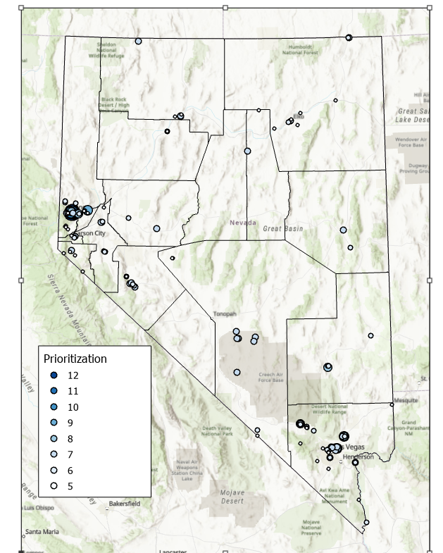
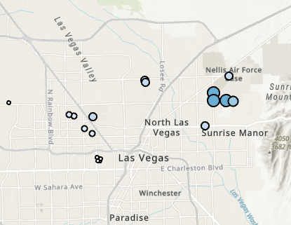
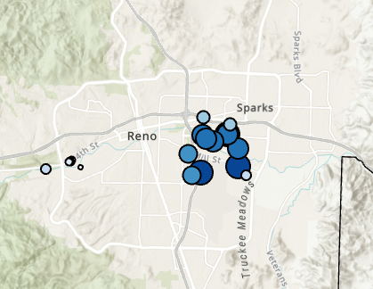
PFAS: Nevada Monitoring
Sampling Prioritization
- - - - - - - - - - - - - - - - - - - - - - - - - - - - - - - - - - - - - - - - - - - - -
Prioritizes water protection areas that are in the vicinity of potential sources of PFAS
Notes:
In 2022, Nevada had limited resources to begin reconnaissance sampling across the State to determine the extent of PFAS contamination. To maximize the money available, a sample prioritization tools was developed to determine if potential contaminant sources were present in drinking water protection areas. Potential contaminant sources included POTW Outfall, WWTP Outfall, Landfills, Air Permits, Hazardous Waste Treatment, Storage, and Disposal Facilities (TSDFs), LQG NAICS Present, SQG NAICS Present, Ski Resort, Firefighting, Airport, Department of Defense, Biosolids, LQG Mine, SQG Mine, PFAS Detection from Research Project, whether or not sampling was performed at the site historically. A score was given to each public water system drinking source in Nevada and ranked from highest to lowest. The contract included sites with a score of 5 or greater. The water bodies, for examples lakes and rivers, and waste water facilities in the drinking water protection areas were added to sampling list. There were 67 surface water body sites, 52 wastewater sites, and 167 drinking water sites identified for voluntary sampling.

Slide 20
Nevada’s PFAS Timeline
PFAS Sampling
NDEP Continues Water Monitoring
  Contract in place for testing – more slides below
NDEP Issuing Contracts & Subgrants to address PFAS
NDEP & PWS Proactively Address PFAS Detections
Technical assistance available upon request
Notes:
Situation is fluid – part of the rules are being deleted.

Slide 21
Broadbent Sampling & Analysis Contract
Sample PWS’s in Nevada, locations of potential new drinking water source(s) and/or water system(s) which may include individual private wells.
Environmental samples within source water protection areas, and any other source identified by NDEP as potentially impacting a public water system or drinking water source.
Notes:
Working towards procurement of direct contractors to provide technical assistance to pws’s w/ pfas.
*Lab: bring pfas capacity to NV labs
PFAS Priority Sampling & Analysis in Nevada
(start & stop dates of contract)
(amendment)
(when next contract is anticipated)
Technical Assistance
(Explain without naming funding/proposal/per process)
Risk Assessment Tool
(short summary here)

Slide 22
Broadbent Sampling & Analysis Contract
Broadbent or their representative will contact PWS to perform the tests
They are reaching out on NDEP’s behalf
You will get an email or a call informing you of the proposed PFAS tests
Notes:
Working towards procurement of direct contractors to provide technical assistance to pws’s w/ pfas.
*Lab: bring pfas capacity to NV labs
PFAS Priority Sampling & Analysis in Nevada
(start & stop dates of contract)
(amendment)
(when next contract is anticipated)
Technical Assistance
(Explain without naming funding/proposal/per process)
Risk Assessment Tool
(short summary here)

Slide 23
Broadbent Sampling & Analysis Contract
It is voluntary – no costs to the PWS
Data results may be used to meet initial monitoring
Highly recommend your PWS participates if asked – NOT MANDATORY
Notes:
Working towards procurement of direct contractors to provide technical assistance to pws’s w/ pfas.
*Lab: bring pfas capacity to NV labs
PFAS Priority Sampling & Analysis in Nevada
(start & stop dates of contract)
(amendment)
(when next contract is anticipated)
Technical Assistance
(Explain without naming funding/proposal/per process)
Risk Assessment Tool
(short summary here)

Slide 24

Compliance Options: Non-Treatment
Consolidation
  Interconnection between two or more public water systems
New Source
  Drill new well in PFAS clean area
Many Proven Treatment Options
Notes:
Not all bottled water companies are testing for PFAS.
There are options for residences to help mitigate pfas through filters/pou devices etc.
Mention NSF certification specs.
Photo: https://www.google.com/url?sa=i&url=https%3A%2F%2Fwww.zdrillerteam.com%2Fresidential-water-well-system-components%2F&psig=AOvVaw3sLFWSVyMJ92-oZ-HnJLUA&ust=1709752632996000&source=images&cd=vfe&opi=89978449&ved=0CBEQjRxqFwoTCNDyi5Lr3YQDFQAAAAAdAAAAABAD

Slide 25

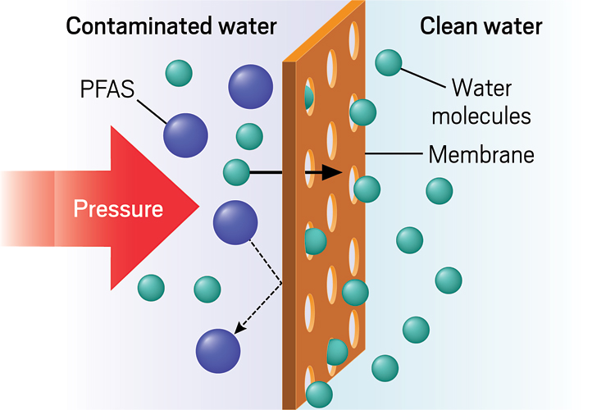
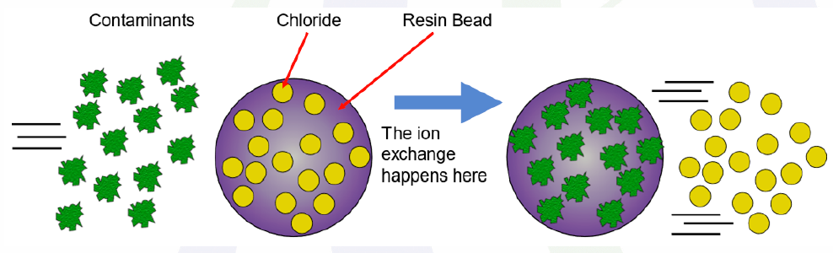
Compliance Options: Treatment
Granulated Activated Carbon (GAC)
  Better for long chains
Ion Exchange
  Better for short chains
Reverse Osmosis (RO)
  Not as effective as GAC or IX
Notes:
Things to consider are:
1. Contaminants being mitigated and co-contaminants to address concurrently.
2. Installation, operation, & maintenance costs to public water system and its customers.
- Will this change the type of system it is currently and require increased monitoring and/or an operator with a higher-grade certification?
- Can the customers manage any increased cost to the improvements?
3. Waste disposal issues, EPA has limited guidance on this currently.
- Life cycle of system and/or media.

Slide 26
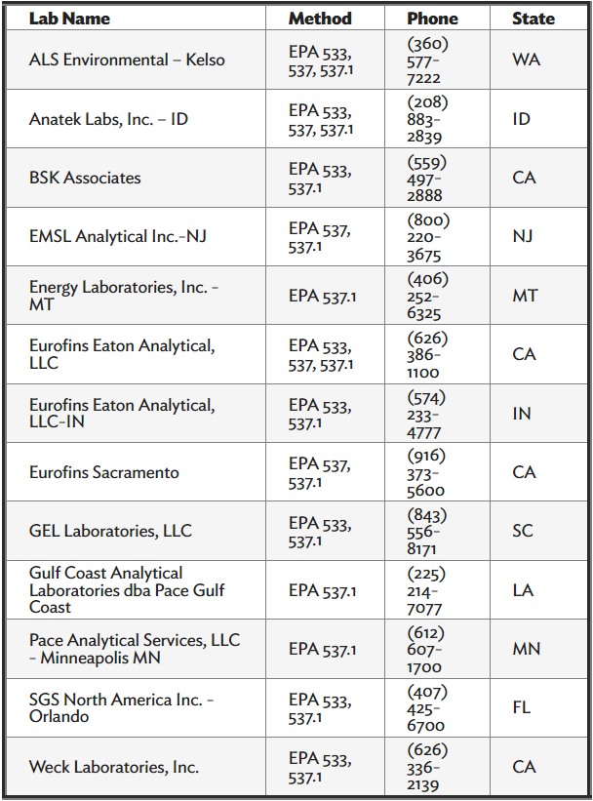
PFAS Certified Laboratories
Notes:
There are limited laboratories that are certified for laboratory testing of PFAS using EPA-approved methods.
There are currently no labs within the state of Nevada that can perform these methods with the potential to use those results for compliance.
Nevada does have several labs certified to conduct PFAS testing in neighboring states.
This list is on our PFAS webpage.

Slide 27
Other General Work Underway
PFAS Modeling Tool
  GIS Base modeling tool – Similar to ALOHA
    Tool incorporates MANY parameters
    Geomorphology
    Groundwater Flow
    Known contamination data
Predictive Dispersion
    Tool incorporates MANY parameters
    Current contamination information
Notes:
Not all bottled water companies are testing for PFAS.
There are options for residences to help mitigate pfas through filters/pou devices etc.
Mention NSF certification specs.

Slide 28
General Resources
Funding:
  State Revolving Fund
  Emerging Contaminants/Small or Disadvantaged Communities Grant
  Bipartisan Infrastructure Law
  United States Department of Agriculture
Resources used for projects is dependent on:
  Specifics of the water system
  Population size served
  Type of PWS or facility
  Project scope and/or cost
Notes:
NDEP is currently working on formal process for application/inquiries.
Funding application components
Procurement requirements
PER requirements
Rate requirements (base rate)
Scope of Work
Cost Schedule
Grant vs Subgrant
Pros and cons
*we are considering an application process similar SRF

Slide 29
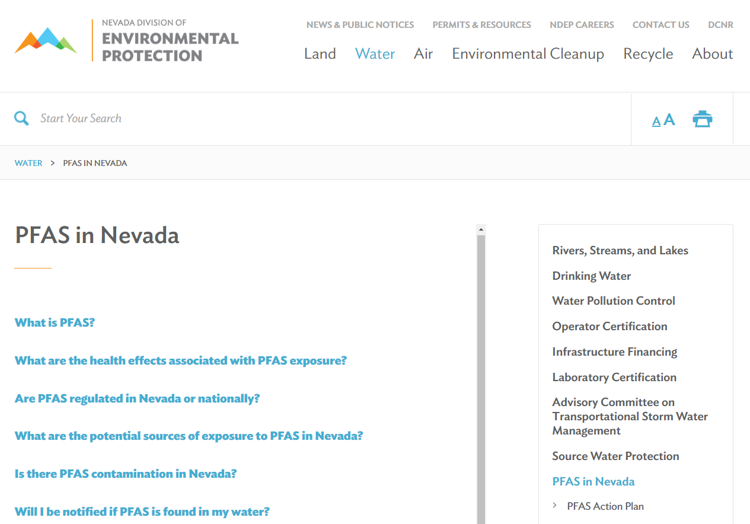
NDEP PFAS Resources & Information
Background
Health Effects
NDEP’s Action Plan
PFAS Data
Funding Options
Contact Information
Notes:
Goal is to provide the resources pws’s need.
Ask audience what they are concerned about or what their customers are concerned about so we can better provide and protect.

Slide 30

Questions?

Slide 31
Contact Info Business Card
Laurie Gehlsen
lgehlsen@ndep.nv.gov
(775)687-3598
Enforcement Supervisor
Bureau of Safe Drinking Water
Email: pfas.ndep@ndep.nv.gov
Webpage: www.ndep.nv.gov
website.nv.gov l @NevDCNR

