Slide 1


Nevada Division of Environmental Protection
Operator Certification Program
Program updates, lessons learned, and recommendations to enhance operator’s success at earning and keeping their certifications.
March 11, 2026
Presented by
Carlos Quiroz, Operator Certification Program Manager
1.

Slide 2
Bureau of Safe Drinking Water
Operator Certification Program Staff
Bureau Chief: TBD
Data Management/Supervisor:
Linh Kieu
Program Manager:
Carlos Quiroz-Aguilera
Admin Assistant:
Rachel Weingart

Slide 3

2025 By the Numbers
Photo taken and owned by NDCNR, permission granted to NDEP
553
Tests
153
Conversions & Reciprocities
932
Renewals & Reinstatements

Slide 4

General Overview
Application Lessons
PSI Lessons
Renewal Season Lessons

Slide 5

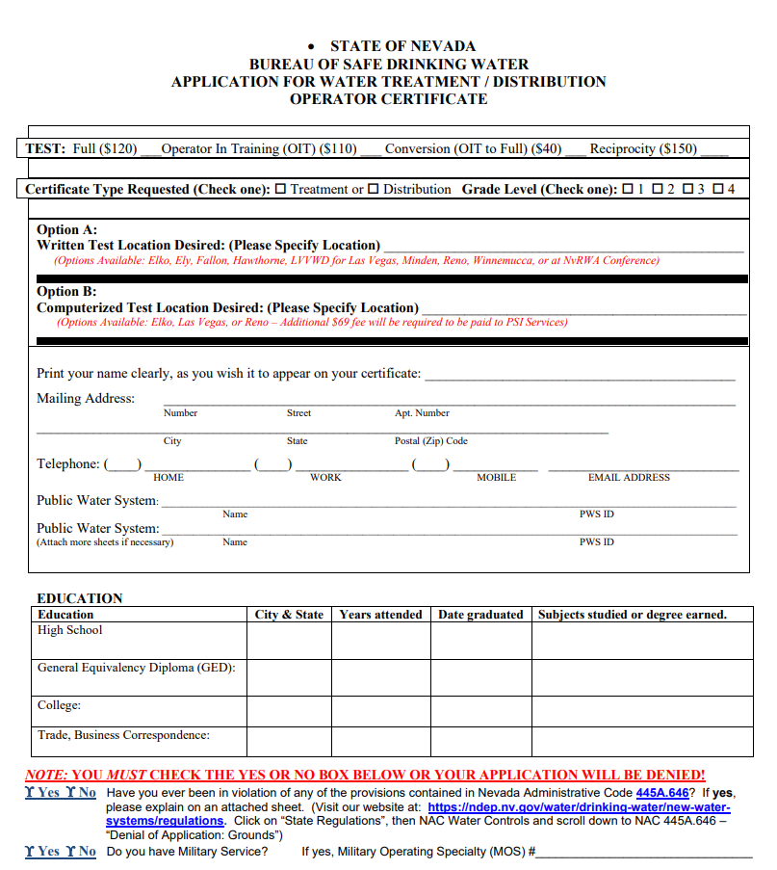
Application Lessons
Time of Year: Wait time can be affected by the time of the year and events in Calendar.
Top 3 Kickbacks: Most popular parts of the application to be forgotten or skipped by operators.
Accuracy: Information in application needs to be up to date and accurate.

Slide 6
Calendar
January | February | March | April
Renewals | Exam Deadline | Conference Forum
May | June | July | August
Exam Deadline | Forum |  | Tri-State Exam Deadline Forum
September | October | November | December
Renewals | Renewals | Renewals | Renewals Forum
Red/Yellow Months – Longer Turn around time.
Test expiration dependent on time of year.
Operator Forum Months stay relative consistent.
Submit written exam applications before due date.
Plan ahead if possible – Especially if Certification is required for position.
Reach out to Rachel or Myself for any issues.

Slide 7
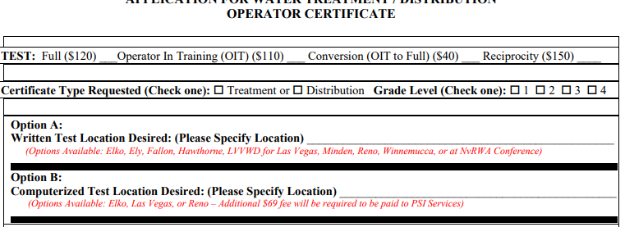
Top 3 Kickbacks
# 3
Supporting documents & reason for applying

Slide 8
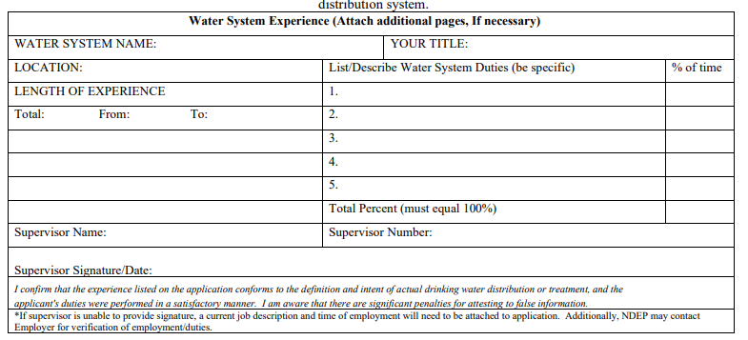
Top 3 Kickbacks
# 2
Supervisor Signature/Experience Verification

Slide 9
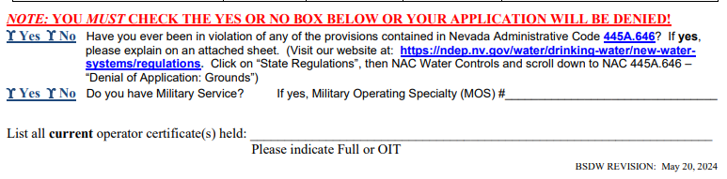
Top 3 Kickbacks
# 1
NAC Question

Slide 10
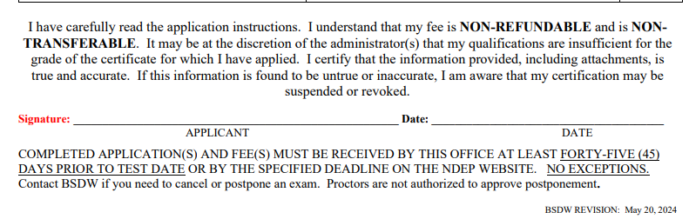
Accuracy
  Consequences – NAC 445A.646
  If the division determines an operator has engaged in any conduct which is grounds for disciplinary action
  Suspend or revoke the operator’s certification
  Place the holder of the certification on probation
  Take any other disciplinary action (deemed appropriate)
  Any action is separate from and may be in addition to any other civil or criminal action provided by statute or regulation.
  Please make sure to read and review the information in your application before you sign.

Slide 11

PSI Lessons
Rescheduling Exams
Medical Emergencies & Unexpected
PSI’s Computerized Examination Information:

Slide 12
Rescheduling Exams
Main notes from Op Cert Program:
Notify Operator Certification Program of any issues 7 days prior to scheduled exam
Exemptions are reviewed in a case-by-case basis
Primary reason for approval are due to medical emergencies
PSI’s Missed Appointments/ Cancellations:
*Candidate will forfeit the examination registration and all fees paid if….
Fails to contact PSI at least two business days prior to a scheduled test session
Candidate Wishes to reschedule a second time
Candidate appears 15 minutes late
Candidate fails to report for exam appointment
Candidate does not register within 90-day window.
  Computerized Exam Information Sheet can be found on NDEP’s website under “Operator Resources”

Slide 13
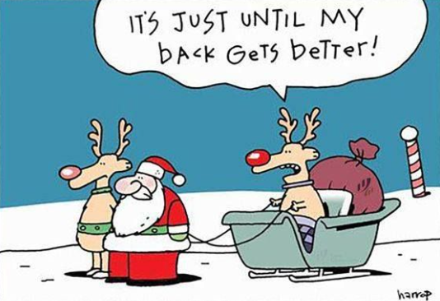
Renewal Season Lessons
Contact Hours – Wastewater
Safety Trainings
Contact Hours – Basic Rules
Reinstatements

Slide 14
Contact Hours
Wastewater Rules/Considerations
- Needs to be Pre-Approved
- Can grant half credit for trainings that fit criteria
- Criteria: Relevant to the operation and maintenance of water treatment or water distribution
The majority of on Demand Websites will offer both Drinking Water & Wastewater trainings.
- Verify you are taking Drinking Water Courses
- Check with conference organizers the type of approval that was granted

Slide 15
Contact Hours
Safety Training Update
  Can be approved for up to 2.5 Hours Maximum
  Limited to 2.5 Hours per renewal Season
  Can repeat training if desired but not allowed to use same certificate multiple times
  Can be approved for up to 2.5 or 5 Hours Maximum
  Limited to 2.5 Hours per Certification (Distribution/Treatment)
  Can repeat training if desired but not allowed to use same certificate multiple times unless splitting between two different certifications

Slide 16
Contact Hours/Reinstatements
Basic Rules:
1) Related to distribution or treatment of drinking water.
2) Need to be taken during within the certification timeframe.
3) Can’t be used multiple times for same certification (Example: reinstatement to renewal)
4) Same hours can’t be allocated to multiple certifications
Reinstatements:
We can only reinstate full certifications.
Reinstatements are accepted from January to the end June.
You can take courses if needed after original expiration date.
OITs lost means operator needs to retake the exam.
Submit your renewal on time.

Slide 17

Operator Certification Forum
Meet Quarterly for program updates, training opportunities, and policy discussion.
Participate in shaping the future for drinking water operators.
Great networking opportunity between Nevada public water system operators.

Slide 18
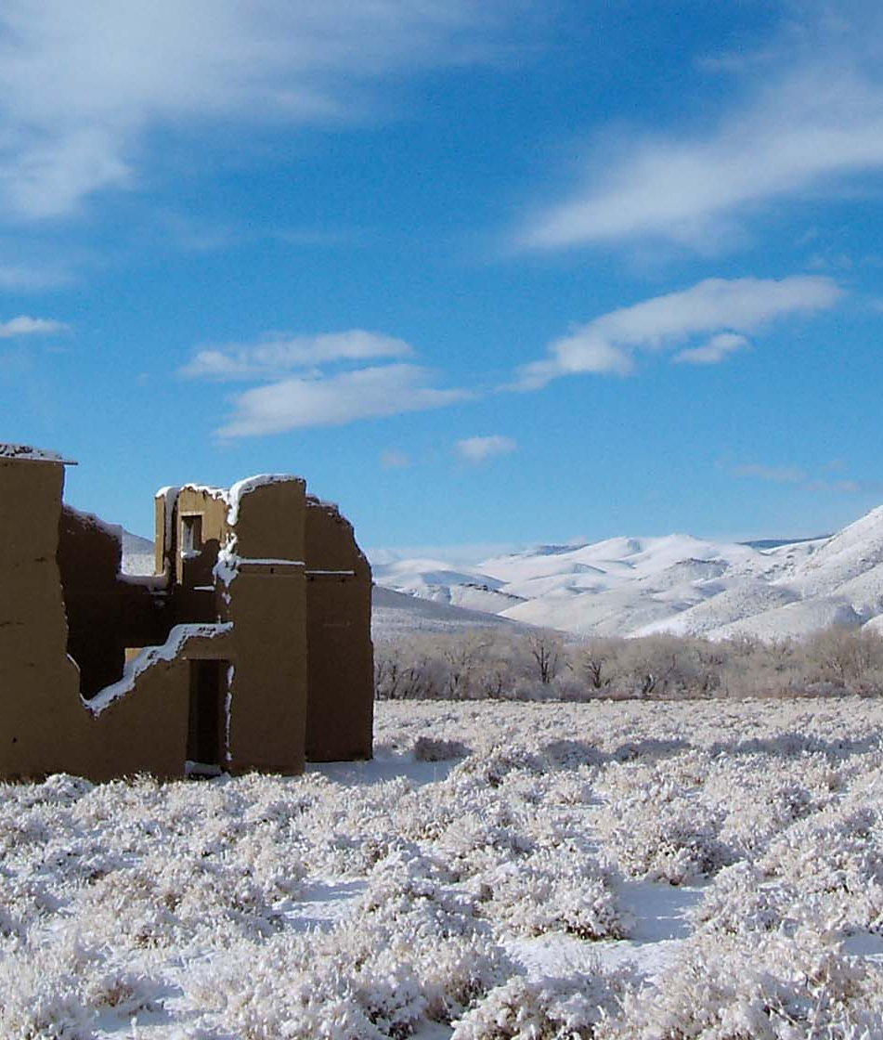
Thank You
Carlos Quiroz, ES III
Nevada Division of Environmental Protection
Phone: 775-684-9308
Email: CQUIROZ-AGUILERA@NDEP.NV.GOV

