Slide 1
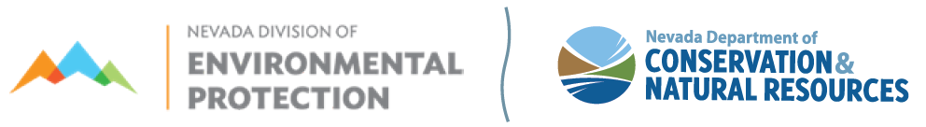
Clean Water SRF & Drinking Water SRF Priority List
Public Workshop
July 7, 2021
9:00 AM – 10:30 AM
To be held in person at: 901 S. Stewart Street, Carson City, Nevada
2nd Floor Tahoe Conference Room
To be held Virtually at: Lifesize: https://call.lifesizecloud.com/4155018
Call in from Mobile/Phone (audio only): United States: +1 (877) 422-8614
Meeting extension: 4155018#

Slide 2
Public Comments?

Slide 3
Workshop materials are available on our website
https://ndep.nv.gov/water/financing-infrastructure/state-revolving-fund-loans/clean-water-wastewater
https://ndep.nv.gov/water/financing-infrastructure/state-revolving-fund-loans/drinking-water
Slides are listed under the Project Priority List Section

Slide 4

Nevada
CWSRF Priority List—Effective July 2021

Slide 5
CWSRF Goals
Elimination or reduction of surface & groundwater pollution within NV
Protection of public health from threats created by:
  Inadequate treatment, collection & improper disposal of municipal wastewater
  Regulated pollutants from non-point sources
Attainment of water quality standards adopted by the SEC to
protect beneficial uses
Assure CWSRF program imposes minimal financial burden on eligible systems

Slide 6


Ranking Criteria
NAC 445A.765 – NAC 445A.768
Priority Classes – A, B, & C
(A&B) Water Quality Factor (pts: 5,5,1)
Project Readiness (pts: 10,7,5)
Asset Management (pts: 1,1,1)
Green Projects (pts: 5)
https://ndep.nv.gov/water/financing-infrastructure/state-revolving- fund-loans/clean-water-wastewater
Notes:
SM slide Project estimated cost – most recent - may be around 50k – August 2021-September 2021 Elise Slide to Follow

Slide 7
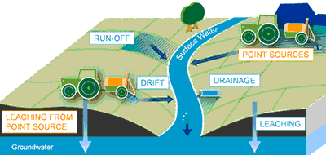
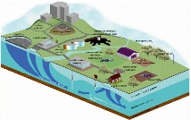
Projects necessary to eliminate documented public health hazards in:
(10 pts) Unsewered communities
(10 pts) Sewered communities where facilities have exceeded their useful life
Priority Class A
Projects that benefit public health and/or environment
  (8 pts) Projects to correct existing surface water quality standards violations
  (6 pts) Projects to correct violations of discharge permit limitations
(4 pts) Project to eliminate or prevent interference with existing beneficial use of groundwater where it has been determined that such an interference exists.
Water Quality Factor (5/5/1)
Ready to proceed (Approved Plans & Specs (10/7); Facility Plan (5))
Asset Management (Mapping/Rate Structure/Reserve Account)
Green Project
Notes:
SM slide Project estimated cost – most recent - may be around 50k – August 2021-September 2021 Elise Slide to Follow

Slide 8
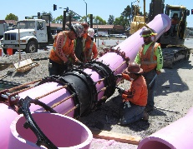
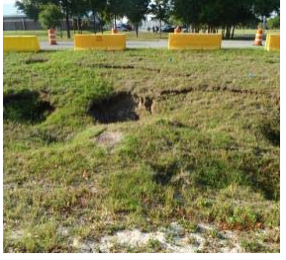
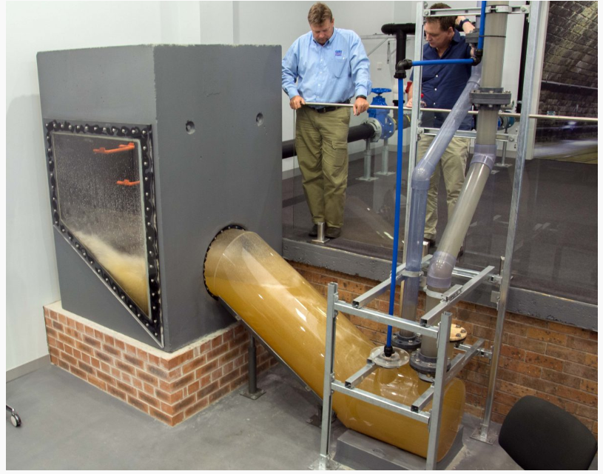
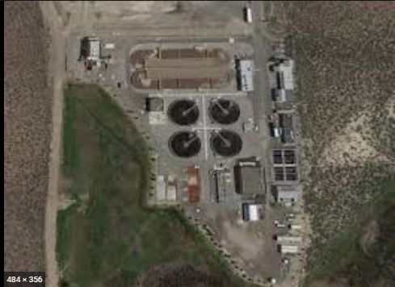
  (10 pts) Projects necessary to:
      increase reliability or sustainability
      reuse wastewater
      sustain compliance with water quality standards & maintain beneficial uses
  (8 pts) System rehabilitation (e.g., I/I correction, pump stations)
  (4 pts) Current facility loading exceeds 75% or 85% capacity
Priority Class B
Projects to Increase reliability and sustainability
Water Quality Factor (5/5/1)
Ready to proceed (Approved Plans & Specs (10/7); Facility Plan (5))
Asset Management (Mapping/Rate Structure/Reserve Account)
Green Project
Notes:
SM slide Project estimated cost – most recent - may be around 50k – August 2021-September 2021 Elise Slide to Follow
https://www.marshall.edu/cegas/geohazards/2016pdf/S4/2_Geohazards%20-%20GWS%20Presentation%20-%20Polyurethane%20Grout.pdf ; https://www.hydroinnovations.com.au/blog/pia-industry-innovation-award/

Slide 9
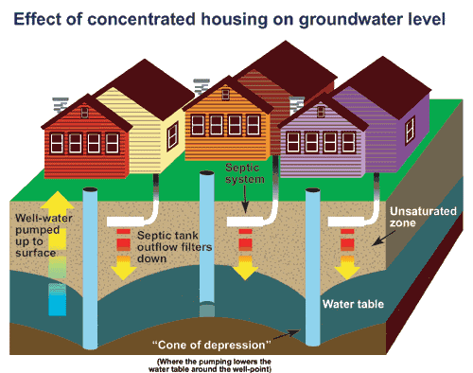
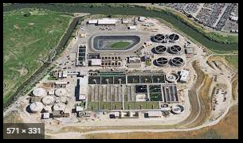
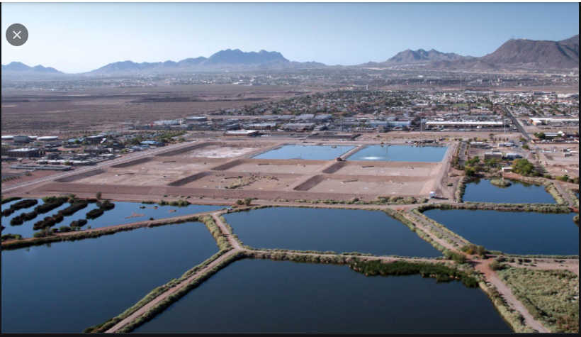
  (10 pts) Projects which provide wastewater treatment and/or collection in:
      Existing unsewered communities where no public health hazards or water standards violations have been demonstrated
      Provide wastewater collection systems to unsewered portions of sewered communities
    (5 pts) All other treatment works or pollution control projects.
Priority Class C
Projects meeting other clean water needs
Ready to proceed (Approved Plans & Specs (10/7); Facility Plan (5))
Asset Management (Mapping/Rate Structure/Reserve Account)
Green Project
Notes:
SM slide Project estimated cost – most recent - may be around 50k – August 2021-September 2021 Elise Slide to Follow
https://www.marshall.edu/cegas/geohazards/2016pdf/S4/2_Geohazards%20-%20GWS%20Presentation%20-%20Polyurethane%20Grout.pdf ; https://www.hydroinnovations.com.au/blog/pia-industry-innovation-award/

Slide 10
Water Quality Factor
Applies to Priority Class A & B only
Considers current impairments to surface & groundwater
  (5 pts) Not supporting – at least one of the water quality standards for the beneficial use was not met
  (5 pts) Groundwater impairment that affects water quality
  (1 pt) Fully supporting; however, project is needed to maintain attainment of water quality standards

Slide 11
Project Readiness
Applies to ALL Classes
  (10 pts) Project Plans and Specifications approved by NDEP – Ready to Bid
  (7 pts) Facility plan approved by NDEP & final plans/specification to be completed in 6 months
  (5 pts) Facility plan approved by NDEP

Slide 12
Asset Management
Applies to ALL Classes
  (1 pt) System is mapped & assets are cataloged/evaluated
  (1 pt) System has a rate structure that supports O&M
  (1 pt) System has allocated funds for rehabilitation/replacement of aging infrastructure

Slide 13
Green Projects
(5 pts) Project incorporates:
  Water & energy efficiency upgrades;
  On-site clean power production;
  Reuse of effluent;
  Establishment or restoration of permanent riparian buffers, other vegetative buffers, floodplains, or wetlands;
  Project to manage wet weather & restore hydrology by infiltration, evapotranspiration, or harvesting & use of storm water; or
  Green storm water infrastructure

Slide 14

Final Ranking
A→B→C
Within Each Priority Class of A, B, C
*Total Points X (State MHI/project area MHI ) → Rank ; “D” Status
?! Project that benefits most population will receive higher priority
* May include any other points per current IUP

Slide 15
Draft July 2021 Clean Water Priority List
Priority
Applicant
Permit #
Population Served
Project Description
Total Points
Ratio of State MHI to Project MHI
Revised Points
D¹
Estimated Cost
Funded?

Slide 16
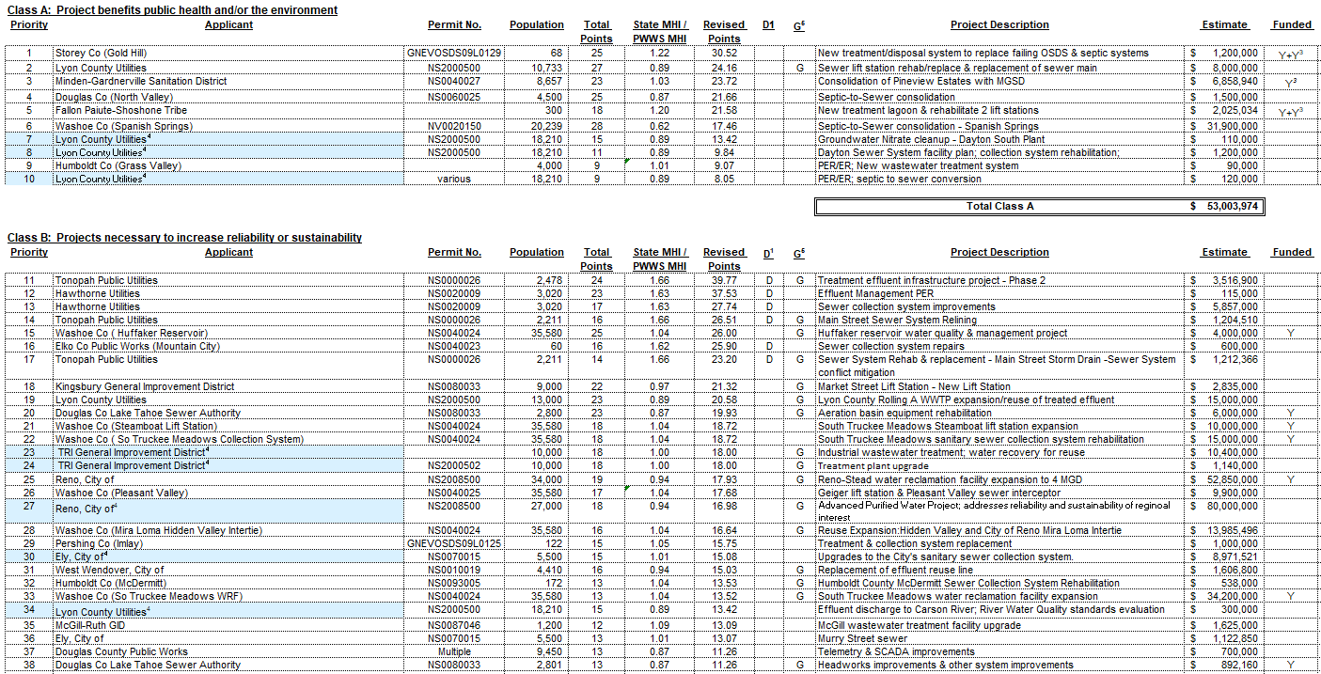
Nevada Clean Water State Revolving Fund Priority List – Effective July 2021

Slide 17
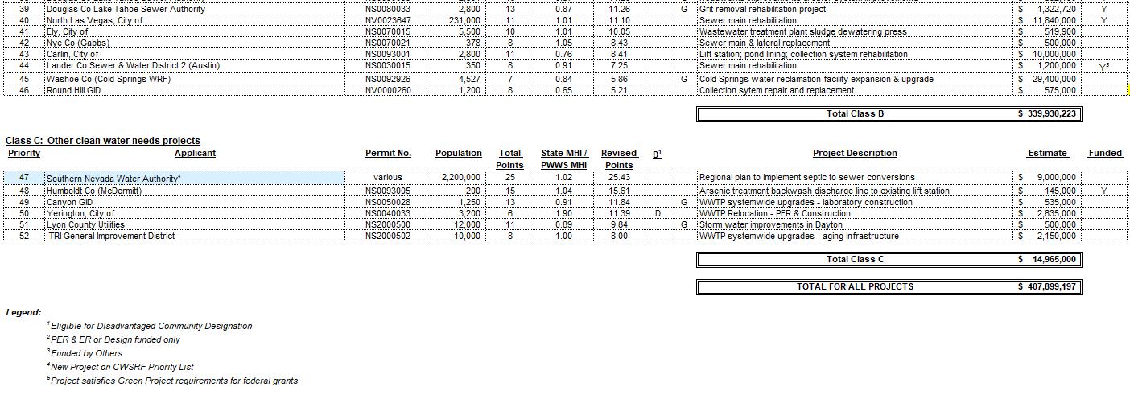
Nevada Clean Water State Revolving Fund Priority List – Effective July 2021

Slide 18
CW Priority List Statistics and Information
AS OF: June 21, 2021
Statistics subject to change frequently
NDEP may bypass a project on the priority list if NDEP determines the project is not ready to proceed, fails to file a letter of intent, or the applicant requests action to be deferred. (NAC 445A.67675)
Projects ready to proceed may bypass projects with a higher point score that are not ready to proceed
Written notice is given to systems being bypassed

Slide 19
CW Priority List

Slide 20
CW Priority List

Slide 21
CW Priority List

Slide 22
CW Priority List

Slide 23
CW Priority List Statistics

Slide 24
CW Priority List Statistics

Slide 25
Public Comments?

Slide 26
Nevada
DWSRF Priority List—Effective July 2021

Slide 27

DWSRF Priority List Goals
Establish Priority Ranking to finance the construction of projects that facilitate compliance with Safe Drinking Water Act and regulations adopted pursuant thereto
Assist Eligible Public Water Systems:
  Public & private community public water systems
  Non-profit, non-transient public water systems – federally non-profit only
  Non-profit, transient public water systems – federally non-profit only
Notes:
Explain Well locations & problem wells (1&2) - Gold Country PWS motivated to approach the problem exploring broad spectrum of solutions; alternative source, alternative distribution; mitigation of groundwater TN; consolidation etc could be part of alternatives; January 2021 Humboldt County Board meeting

Slide 28
Eligible Public Water System Types & Ownership Type
Community public water systems (PWS: 15 service connections & regularly serves 25 or more persons)
    Public water systems that supply water to 25 or more year-round residents (same population). These PWS could be publicly or privately owned.
  Non-Community public water systems only if publicly owned or owned by nonprofits (federally recognized as non-profits)
Non-profit, non-transient PWS :
Public water systems that are not community PWS but regularly supply water to at least 25 of the same people at least 6 months per year. Factories, Offices
    Non-profit, transient PWS:
    Public water systems that provide water in a place such as a public park or a public campground where people do not remain for long periods of time, or public places open only seasonally.

Slide 29

Ranking Criteria
NAC 445A.67566 – NAC 445A.67573
Priority Classes – I,II,III, and IV
  Class I – Projects that address:
Acute health risks: Demonstrated illness attributable to the public water system
Significant non-compliance
Court ordered compliance
Class II – Projects that address:
Chronic health concerns – documented non-compliance with primary & secondary drinking water standards
Class III – Projects that address deteriorated, substandard, or inadequate conditions in a public water system
Class IV – Refinancing of debt incurred after July 1, 1993

Slide 30
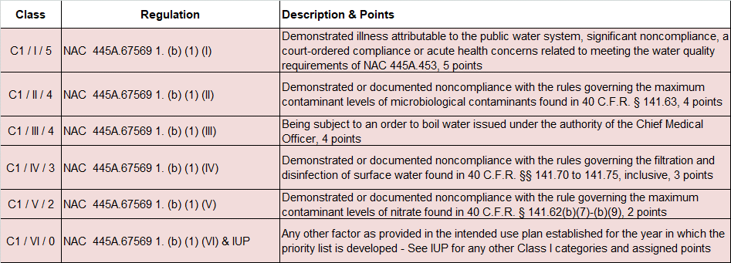

Slide 31
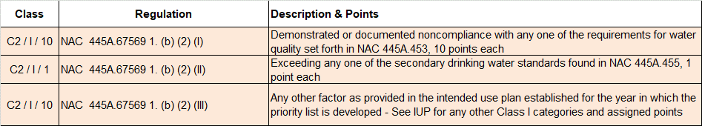

Slide 32
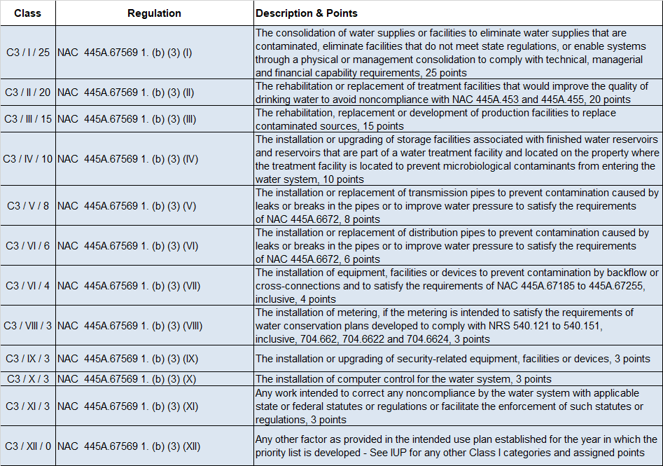

Slide 33
Notes:
Refinancing still need to check the boxes for SRF rules and regulations – eligible projects

Slide 34
Asset Management
Applies to ALL Classes
  (1 pt) System is mapped & assets are cataloged/evaluated
  (1 pt) System has a rate structure that supports O&M
  (1 pt) System has allocated funds for rehabilitation/replacement of aging infrastructure

Slide 35
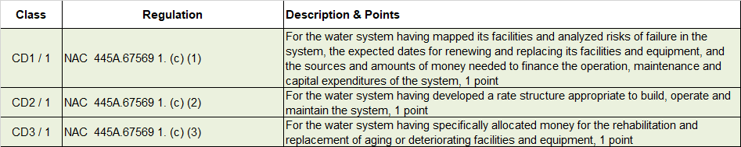

Slide 36
Final Ranking
I→II→III→IV
Points Assigned are Cumulative Within Each Priority Class
*Total Points X (State MHI/project area MHI ) → Rank & “D” Status
?! Project that benefits most population will receive higher priority
* May include any other points per current IUP

Slide 37
Current Intended Use Plans (IUP)!
Clean Water IUP:
https://ndep.nv.gov/uploads/water-financing-srf-wastewater-docs/2021_CW_FINAL_Intended_Use_Plan.pdf
Drinking Water IUP:
https://ndep.nv.gov/uploads/water-financing-srf-drinkingwater-docs/2021_DWSRF_final_Intended_Use_Plan.pdf

Slide 38
Supporting Disadvantaged Communities
  For the purposes of funding/grants/subsidized loans allocations: Nevada State uses MHI Ratio. If State MHI/System MHI if >1.25 then “D”
NAC 445A.67567(8): special conditions for “D”
Besides MHI ratio, Nevada adopted a point system (Pl. See IUP for details)
Notes:
To comply with safe drinking water act and the regulations adopted pursuant thereto and to protect public health.
TMF capacity or designed to attain TMF capacity ->Capable (NRS 445A.807)
Construction (NRS 445A.215) and Project (initial construction, or renovation, or modification, or expansion – NRS 445A.230)

Slide 39
Draft July 2021 Drinking Water Priority List
Priority Class
Water System Name
PWS ID#
Population Served
Number of Service Connections
Total Points
  Project Description & Class
  Documented WQ Issues
  Project readiness
Ratio of State MHI to PWS MHI
  Revised Points & Rank
  D¹
Ownership
Estimated Cost
Funded?

Slide 40
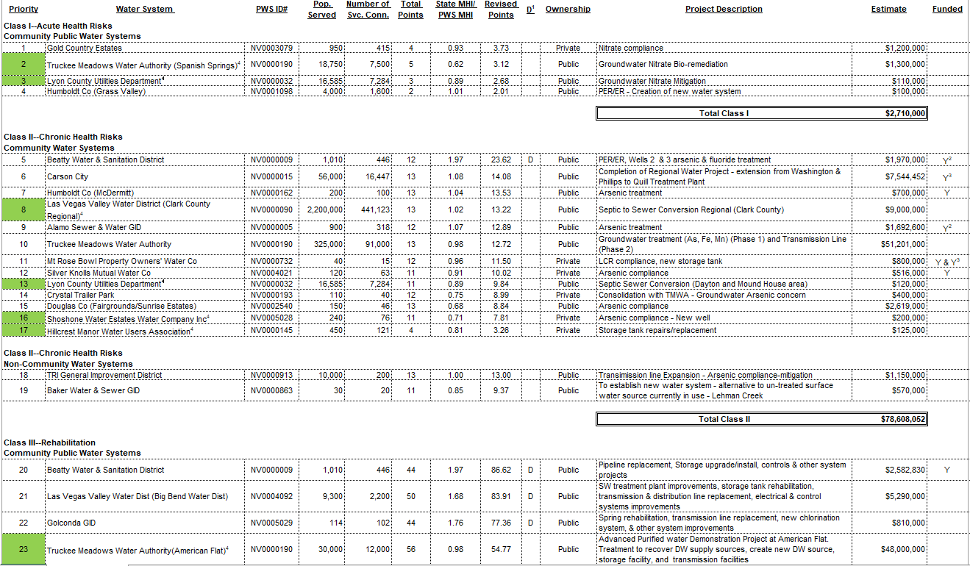
Drinking Water State Revolving Fund Priority List – Effective July 2021

Slide 41
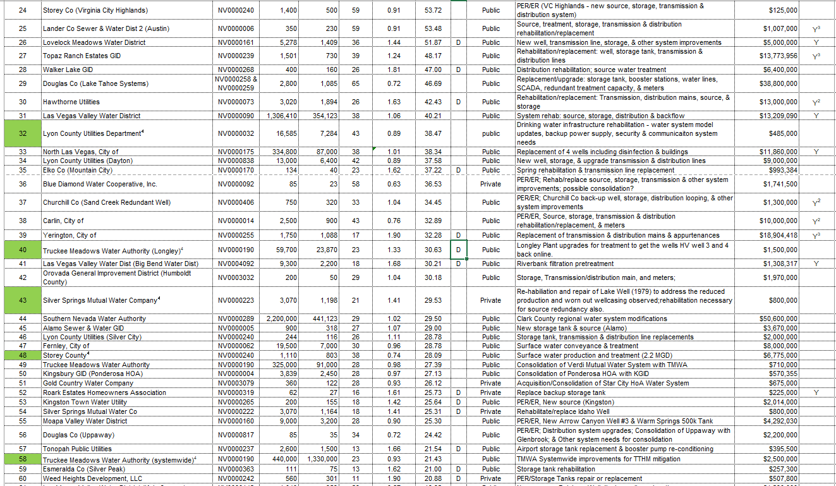
Drinking Water State Revolving Fund Priority List – Effective July 2021

Slide 42
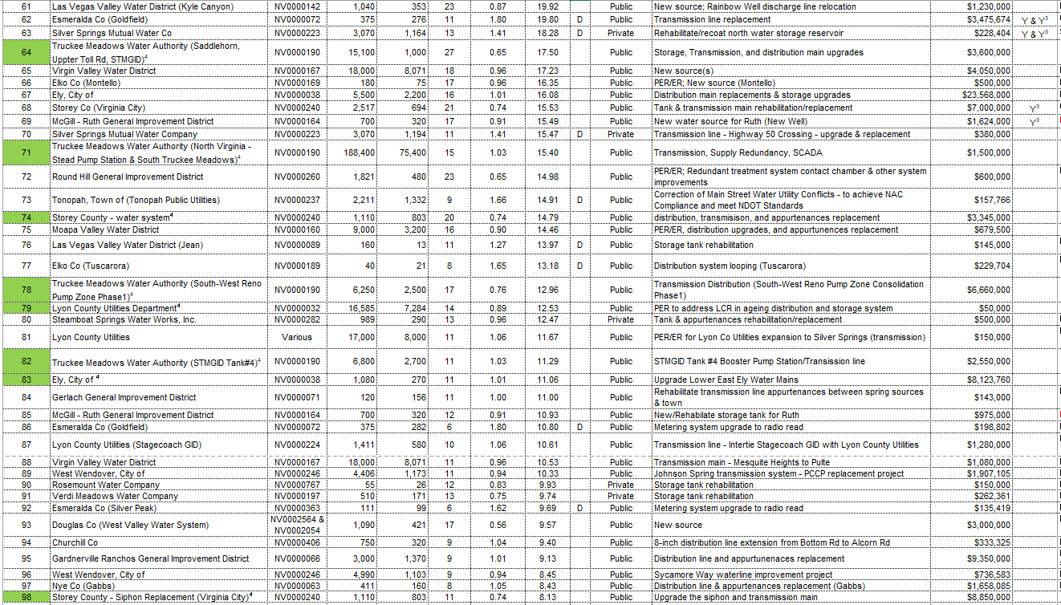
Drinking Water State Revolving Fund Priority List – Effective July 2021

Slide 43
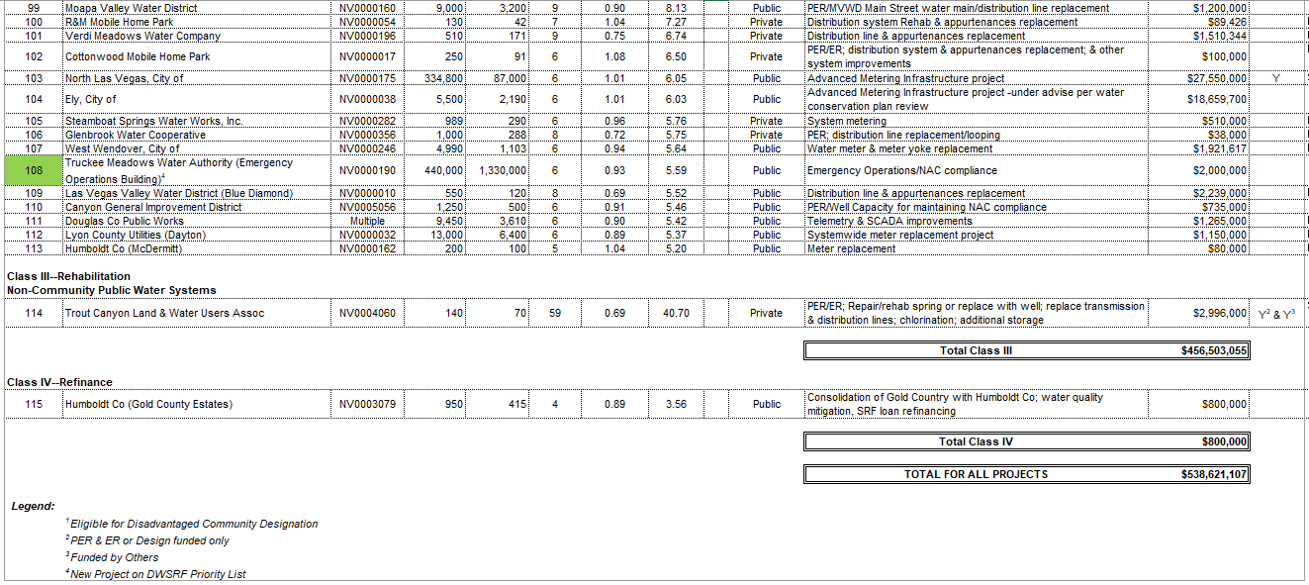
Drinking Water State Revolving Fund Priority List – Effective July 2021

Slide 44
DW Priority List Statistics and Information
AS OF: June 21, 2021
Statistics subject to change frequently
NDEP may bypass a project on the priority list if NDEP determines the project is not ready to proceed, fails to file a letter of intent, or the applicant requests action to be deferred. (NAC 445A.67573)
Projects ready to proceed may bypass projects with a higher point score that are not ready to proceed
Written notice is given to systems being bypassed

Slide 45
DW Priority List

Slide 46
DW Priority List

Slide 47
DW Priority List

Slide 48
DW Priority List

Slide 49
DW Priority List

Slide 50
DW Priority List

Slide 51
DW Priority List Statistics

Slide 52
DW Priority List Statistics

Slide 53
Public Comments?

Slide 54
Questions?
Contacts:
Jason Cooper
Program Manager
j.cooper@ndep.nv.gov
775.687.9531
Sharada Maligireddy, PE
Professional Engineer
smaligireddy@ndep.nv.gov
775.687.9331

