Slide 1



Sanitary Survey
Significant
Deficiencies
What are Significant Deficiencies, How can they be avoided, and how to resolve them.
February 28, 2025
March 10th, 2026
Presented by
Dustin Deitch
1.

Slide 2

What are Significant Deficiencies?

Slide 3

“SignificantDeficienciesare bad”

Slide 4

Significant Deficiencies
Examples
NAC 445A.4665
A defect in design, operation, or maintenance. A failure or malfunction of the water system, that the inspector determines poses an actual or potential threat to public health or to the integrity of the drinking water system
Unsanitary Source Conditions
Cross Connections
Unsanitary Storage / Distribution
Inadequate pressure
etc..

Slide 5
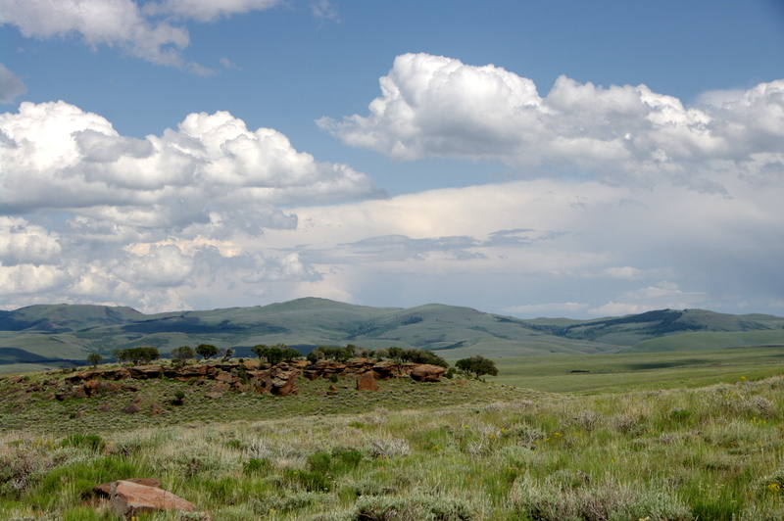
Examples
Some Examples of Significant Deficiencies
Lack of Atmospheric Vacuum Breakers (AVB)s on hose bibs.
Missing or damaged Sanitary well seal.
Evidence of flooding around groundwater well.
Chemical storage near a wellhead with no secondary containment.
System pressure falling below 20 psi under normal operations.
No certified operator of appropriate grade.
6.

Slide 6

How to Avoid Significant Deficiencies

Slide 7

Maintain Physical Infrastructure
Keep well pads sealed and repair leaks promptly.
Inspect Storage tank hatches / Paint / Rust spots
Protect Treatment equipment from weather and contamination
Implement Cross Connection Control
Install proper backflow assemblies where required.
Maintain testing records of backflow devices.
Prohibit unprotected auxiliary water source connections.
Maintain Documentation
Tank Inspection and cleaning records
Cross connection control plans (CCCP)
Operation and Maintenance Manuals (O&M manuals)
Emergency Response Plan

Slide 8


What Inspectors are really looking for
Is there a pathway for contamination?
Is treatment reliably controlled?
Is the operator aware and engaged?
Is there documentation?
Is there follow through?

Slide 9
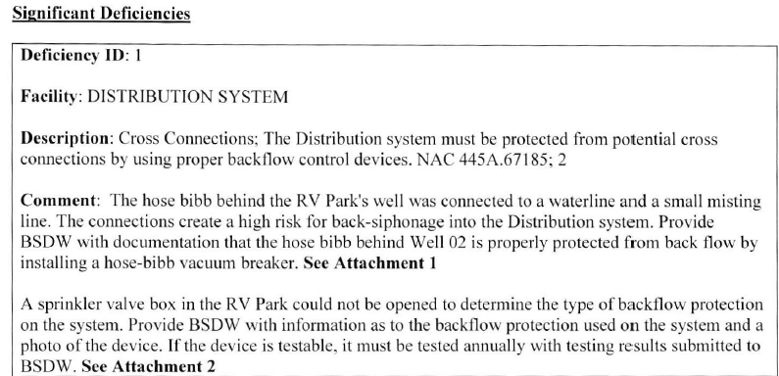

How to Resolve
Deficiencies
Each Sanitary Survey Letter will outline deficiencies the system received during the survey.
Part of the description will tell what needs to be done to resolve the deficiency.
(Seen in Figure to the right)
Follow the instructions within the description to resolve the deficiency.
Call your Facility Manager if there are any questions about how to get deficiency resolved.

Slide 10
Timeframe to Resolve
Must meet 3 deadlines below. Failure to do so may result in a treatment technique violation.
Within 30 Days
Consult with BSDW to discuss how to proceed
Within 120 Days
Correct the problem or have a NDEP approved corrective action plan (CAP).
Within 30 Days after fixing
Let us know that you have resolved the issues. Include photographs or other documentation

Slide 11
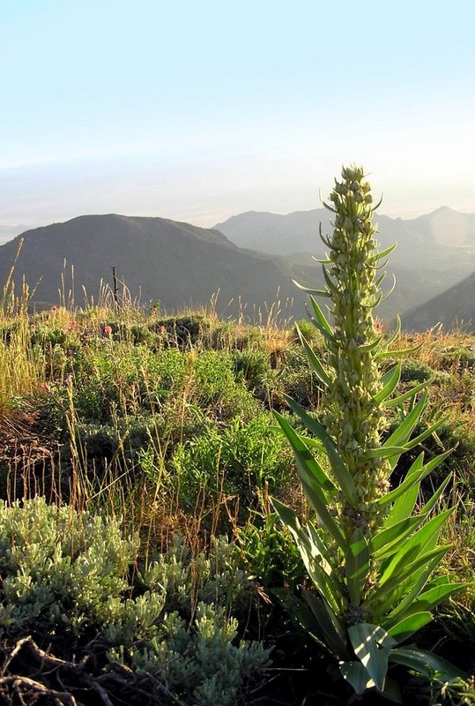
Corrective Action Plans
(CAPs)
A written plan submitted by a Public Water System (PWS) that describes how and when the system will correct a Significant Deficiency or other compliance issue identified during a sanitary survey or enforcement action.

Slide 12
What a CAP
Must Include
Description of Deficiency
Clear reference to the Sanitary Survey finding.
Proposed Corrective Action
Specific steps the system will take.
Timeline / Schedule
Expected date to resolve the deficiency.
Responsible Party
Operator, contractor, engineer, board, etc..
Supporting Documentation
Engineering Documents / Equipment Specs - (If Applicable).

Slide 13
Timeframe Expectations of CAPs
Submit a CAP withing 45 days of receiving the Significant Deficiency notification.
Correction is generally expected within 120 days, unless BSDW approves an alternate schedule.
Failure to follow the approved schedule will escalate system to a treatment technique violation / enforcement.

Slide 14
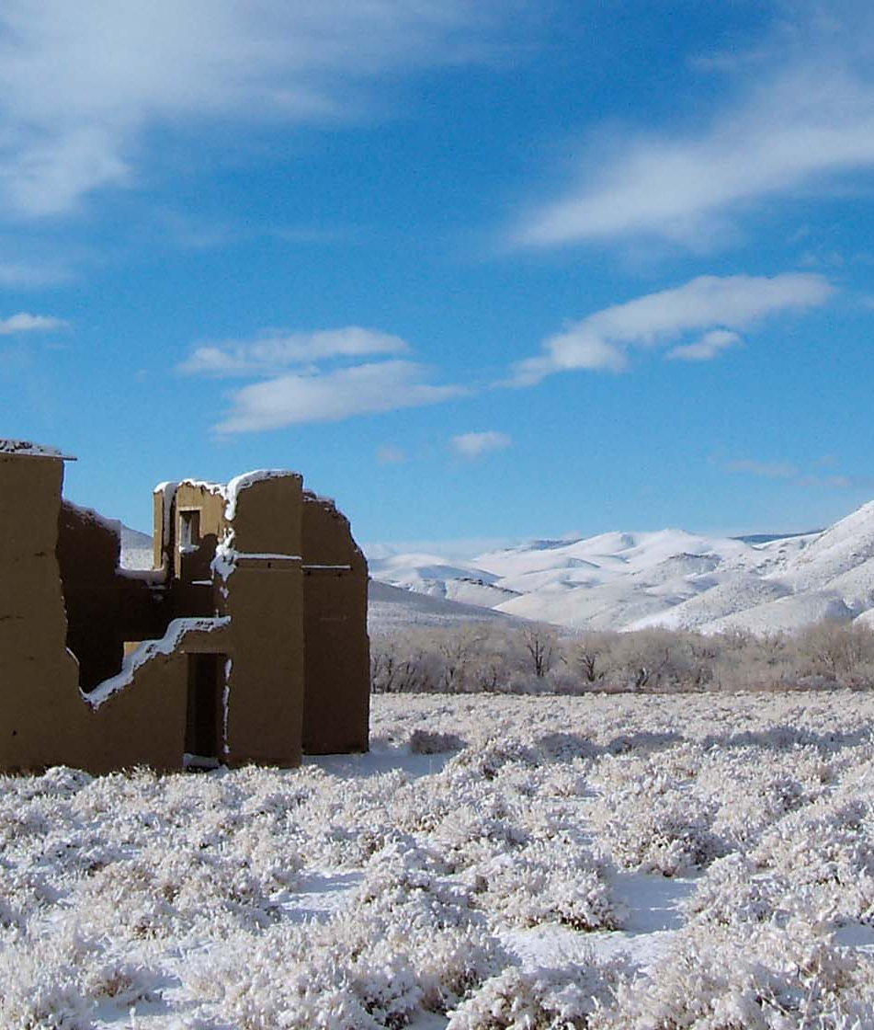
Thank You
Dustin Deitch
Nevada Division of Environmental Protection
Phone: 775-684-9517
Email: Ddeitch@Ndep.Nv.gov

