Slide 1



BSDW Overview/Updates
RCAC Water and Wastewater Conference
March 10, 2026
Presented by
Cassie Badhan, BSDW
February 28, 2025
1.

Slide 2

Bureau of Safe Drinking Water (BSDW)
“Our mission is to protect public health and the environment by providing oversight, guidance, and support, while fostering collaboration with safe drinking water partners.”
Main Line: 775-687-9521

Slide 3

Bureau Overview
Chief – Vacant
Administrative Services
Data Management and Operator Certification
Compliance
Enforcement
Engineering
Laboratory Certification

Slide 4

Administrative Services Branch
Raul Betancourt – Supervisor
Savannah Hash – Admin
Debra Winter – Admin (Front desk/main line)​
Sekquisha Jackson-Strivers – Admin
Paige Menicucci – Temp Admin

Slide 5

Data Management and Operator Certification Branch
Linh Kieu – Supervisor​
Carlos Quiroz-Aguilera – Operator Certification
Rachel Weingart – Operator Certification Admin
Rheanna Morgan – Vulnerability Assessment​
Lily Aragon – Data Management​
Cleo Koenig (Las Vegas) – CCR and PN
Vacant – Data entry and Admin

Slide 6
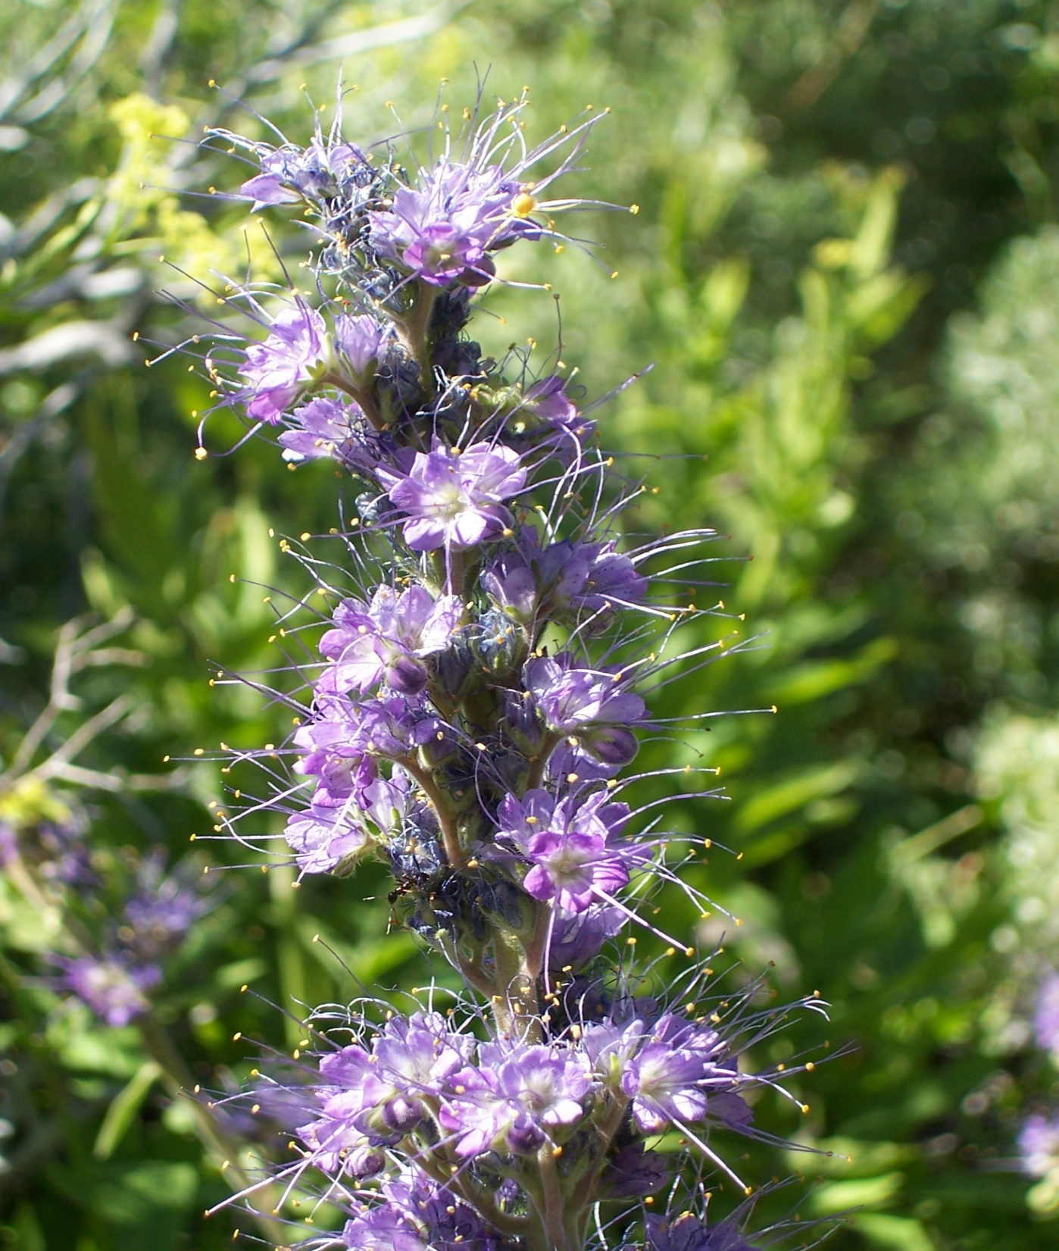
Compliance Branch
Alex Lanza, P.E. – Supervisor​​
Reggie Lang, P.E.​ – Review Engineer, Surface Water Rule, Disinfection Byproducts Rule, Area Wide Optimization Program​
Raj Solomon, P.E. (Las Vegas)​ – Review Engineer​​
Cassie Badhan​ – Lead and Copper​
Johnny Drahos​ – Coliform​
Dustin Dietch​ – Ground Water Rule​
Ericka Kay – Chemical Rule
Vacant (Las Vegas) – PFAS

Slide 7
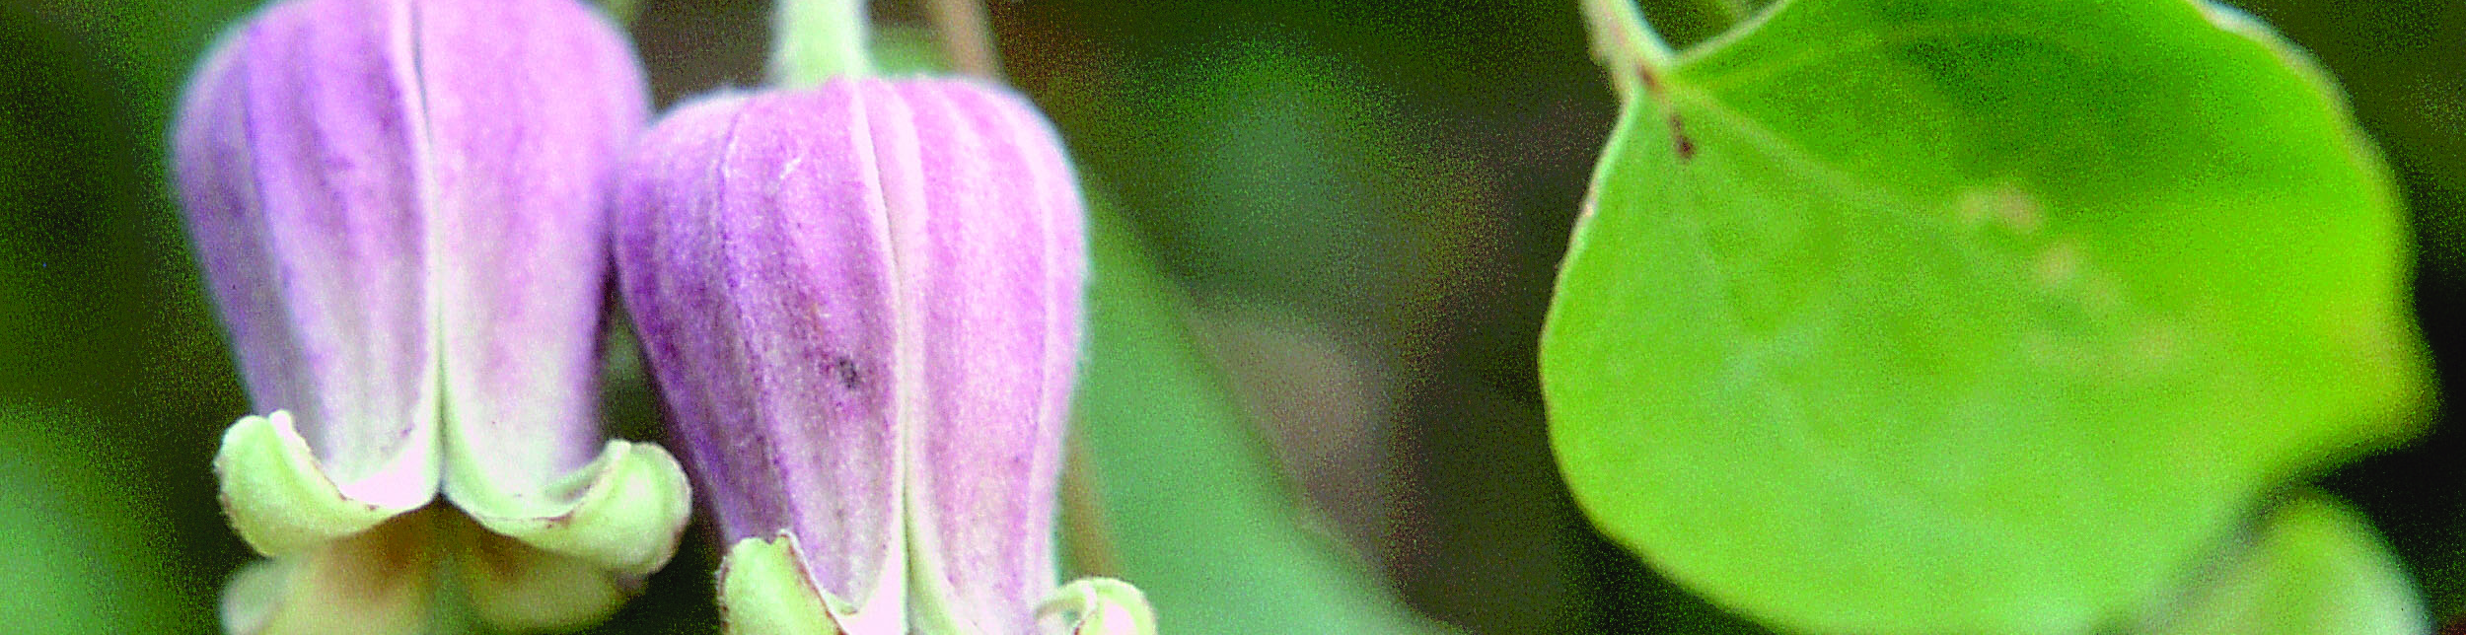
Enforcement Branch (New)
Laurie Gehlsen (Las Vegas) – Supervisor​​
Lynell Garfield​ – Enforcement

Slide 8
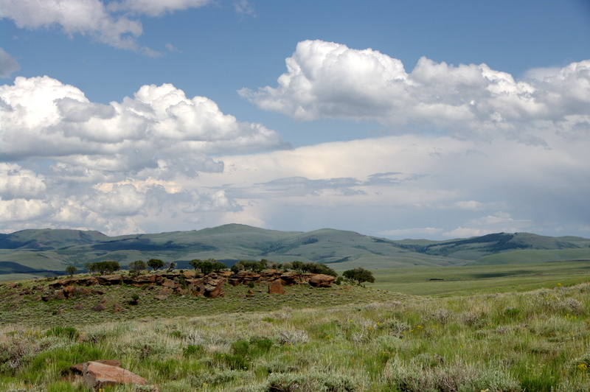
Engineering Branch
Brendon Grant, P.E. – Supervisor​
Art Marr, P.E. – Review Engineer​
Walter Slack, P.E. – Review Engineer​
Ryan Finley, P.E. – Review Engineer​
Karola Kennedy, E.I.T. – Review Engineer​
Angelito Accad, P.E. (Las Vegas) – Review Engineer​
Ethan Mason, E.I.T. – Source Water Protection​
Jason Hetrick – Engineering Technician​
Terri Svetich, P.E. - Contract – Manual Review
6.

Slide 9

Jasmine Curiel – Supervisor​
Corinne Hasenau – Lab Cert Officer
James Beckley – Lab Cert Officer​
John Shephard (Las Vegas) – Lab Cert Officer​
Erin Blanton (Las Vegas) – Lab Cert Officer​
Michael Antoine – Consultant​
Chris Lopez - Administration
Laboratory Certification Branch

Slide 10

Regulation Changes
Lead and Copper Rule Improvements (LCRI) – Compliance date of November 1, 2027, with some LCRR requirements already in effect
PFAS – Initial samples due by 2027 and other requirements starting 2029
Consumer Confidence Report (CCR) Revisions – Compliance date of 2027, with other requirements already in effect
Public Notice Rule (PN) Revisions – Some new PN requirements already in effect, some will start in 2029
Perchlorate – New proposed regulation

Slide 11
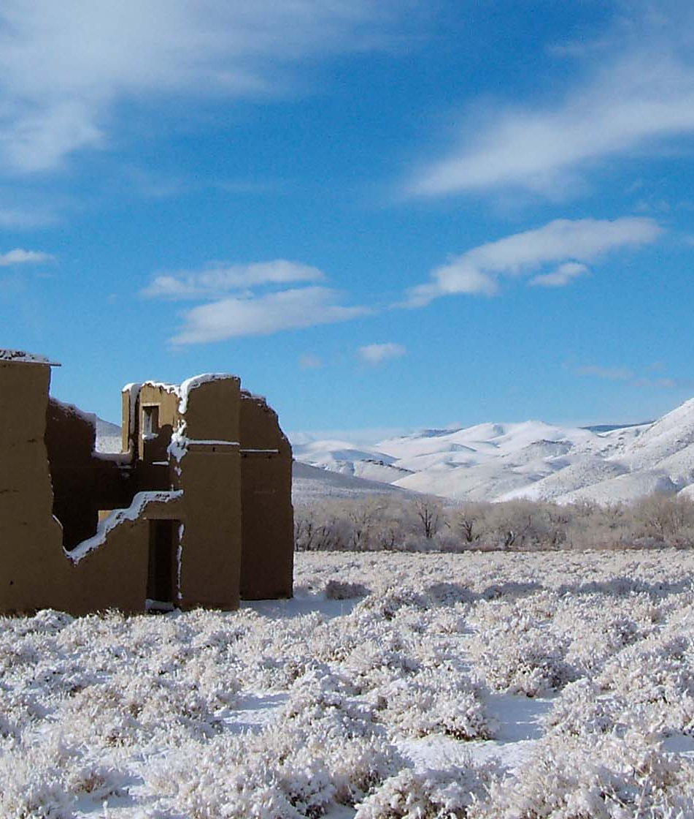
Questions?

Slide 12
Lead and Copper Rule
40 CFR 141.80-141.93
RCAC Water and Wastewater Conference
March 10, 2026
February 28, 2025
Presented by
Cassie Badhan, BSDW
1.

Slide 13
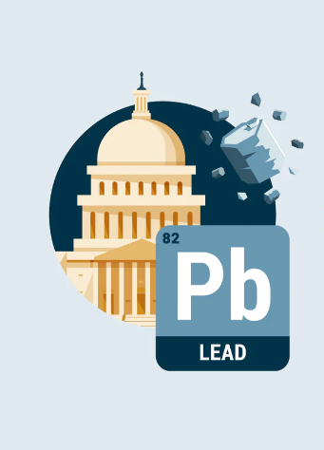
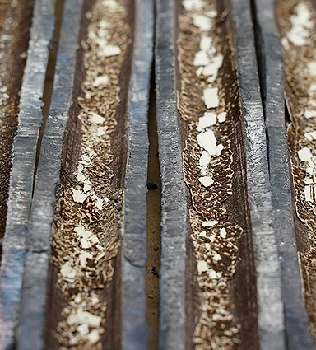
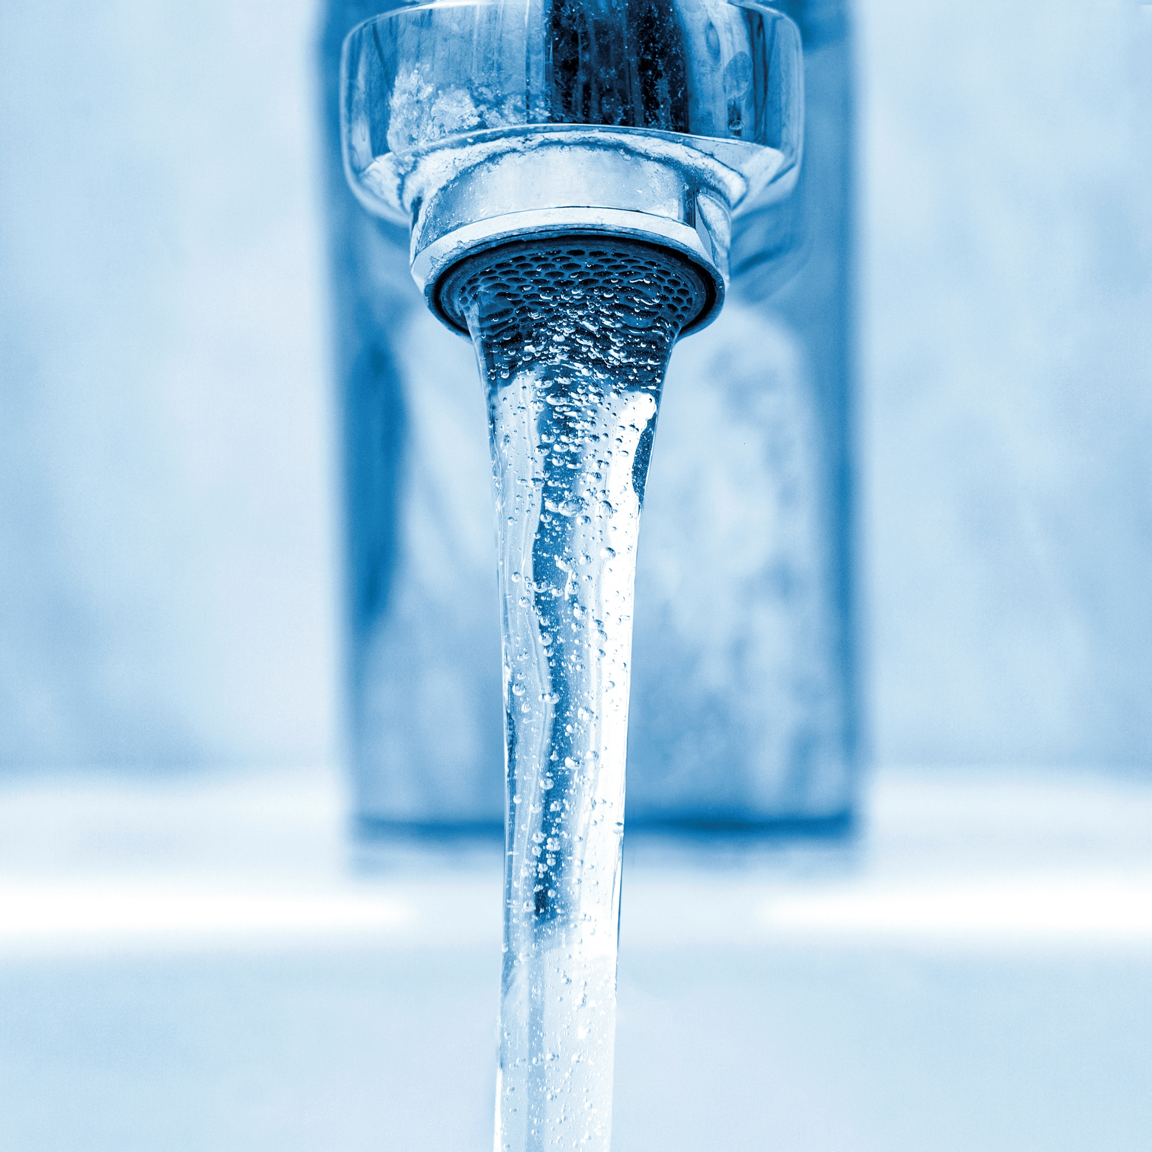
Lead and Copper Rule Timeline
October 16, 2024
November 1, 2027
2027 and Beyond
Lead and Copper Rule Revisions (LCRR)
Lead and Copper Rule Improvements (LCRI)
Line replacements, school and childcare testing, validations, etc.
7.

Slide 14
LCRR Requirements
Service Line Inventory
Notification of Known or Potential Lead Service Lines
Tier 1 PN for Lead ALE
Identify material for all service lines within the distribution system.
24-hour notice required.
Sent to customers with lead, GRR, and unknowns annually.
Required/started October 16, 2024

Slide 15

Disclaimer
The following presentation does not cover all of the new requirements of the Lead and Copper Rule Improvements (LCRI). Please review 40 CFR 141.80-141.93 for all requirements.
6.

Slide 16

LCR Sampling Requirements and Updates
Photo taken and owned by NDCNR, permission granted to NDEP

Slide 17
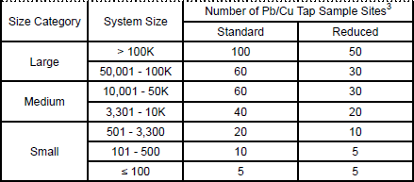
Lead and Copper Sampling
Sampling based on water system size
Sample locations based on Tiering structure
These locations should be in your approved sampling plan
Monitoring periods:
6 month (January-June and July-December)
June-September (annual, triennial, and 9 year)
First draw sample from tap that has not been used for at least 6 hours
6

Slide 18
Current Sample Site Tiering (LCR)
Community Water Systems
Non-Transient Non-Community
Tier 1
Single family structures that contain lead pipes, or copper pipes with lead solder installed between 1982 and 1989, and/or are served by lead service lines.
Tier 2
Buildings and multiple-family residences that contain lead pipes, or copper pipes with lead solder installed between 1982 and 1989, and/or are served by lead service lines.
Tier 3
Single family structures, constructed as a single-family residence and currently use as either a residence or business, that contain copper pipes with lead solder installed before 1983.
Other
Representative sites throughout the distribution system in which the plumbing materials used at the site would be commonly found at other sites served by the system.
Tier 1
Buildings that contain copper pipes with lead solder installed between 1982 and 1989, lead pipes, and/or are served by lead service lines.
Other
Representative sites throughout the distribution system in which the plumbing materials used at the site would be commonly found at other sites served by the system.
6

Slide 19
Sample Site Tiering (LCRI)
Tier 1
Single-family structures with premise plumbing made of lead and/or served by a lead service line
Tier 2
Buildings, including multiple-family residences, with premise plumbing made of lead and/or served by a lead service line
Tier 3
Sites that are served by a lead connector, served by GRR service line or premise plumbing. For community water systems (CWS), this only includes single-family structures.
Tier 4
Sites that contain copper pipes with lead solder installed before State’s applicable lead ban. For CWS, this only includes single-family structures.
Tier 5
Representative sites with plumbing materials commonly found throughout the distribution system.
6

Slide 20
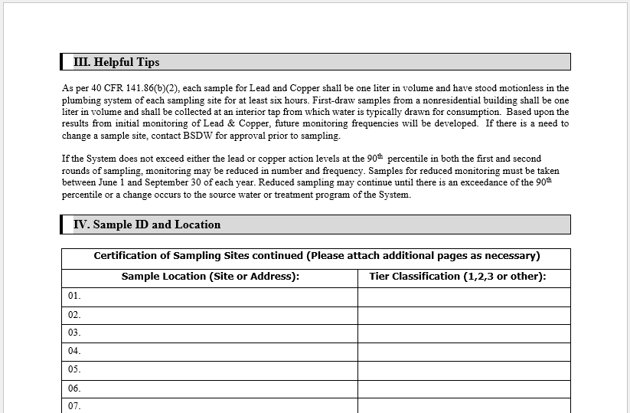
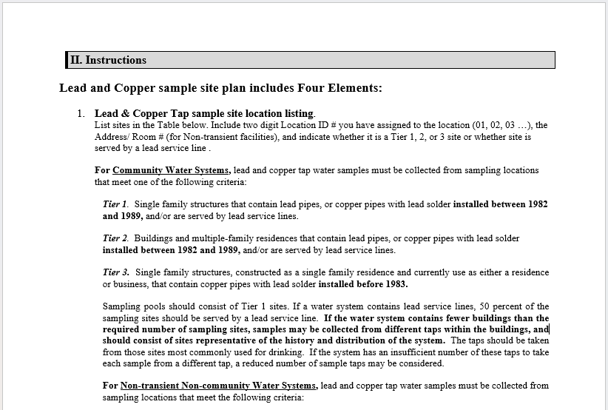
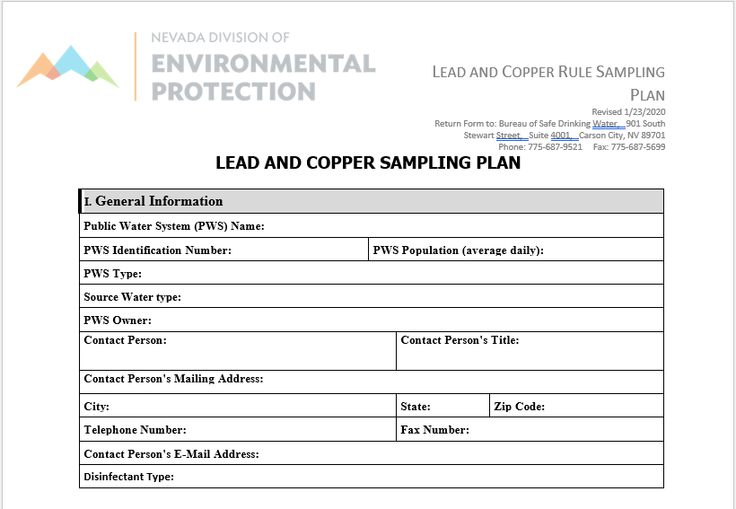
Lead and Copper Sample Plan
6

Slide 21
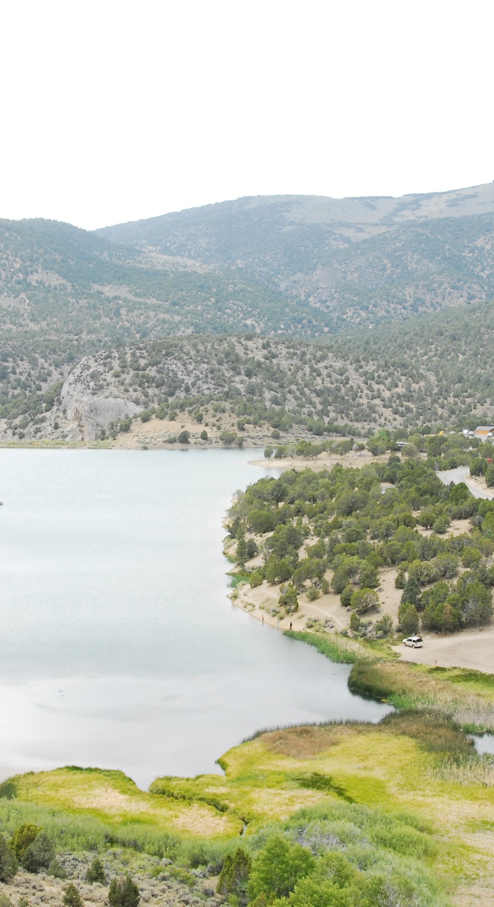
What to do After Getting Results?
Send a copy of the results to BSDW E-Data.
Systems are required to submit lab results within the first 10 days following the month in which the result is received, or the first 10 days following the end of the required monitoring period, whichever is shorter. (40 CFR 141.31(a)(1)-(2))
Review results and calculate your 90th percentile for lead and copper.
Send out consumer notice to customers who sampled or post at the locations where sample was collected.
Send certification to BSDW
13.

Slide 22
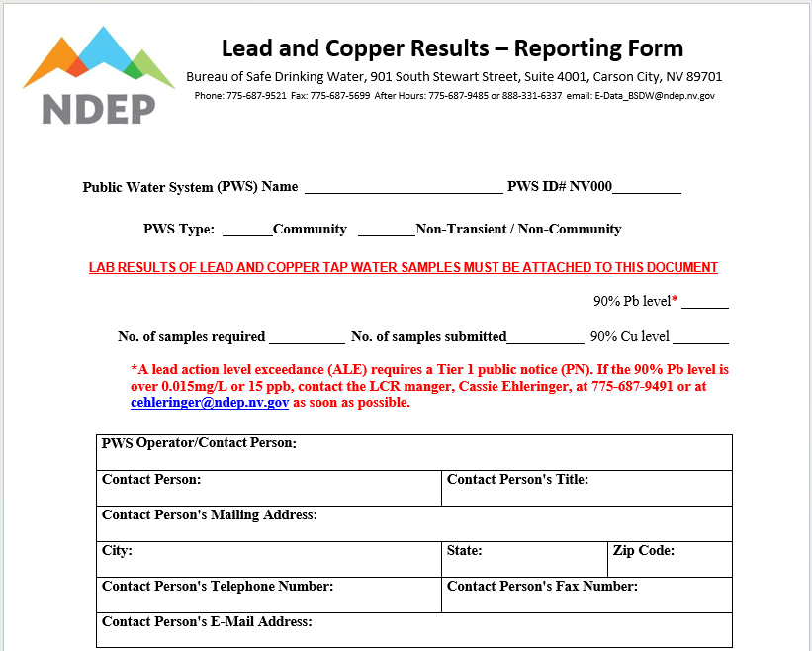
Lead and Copper Results – Reporting Form
Recently added to reporting form
6

Slide 23
Tier 1 Public Notification (PN) of Lead Action Level Exceedance (ALE)
An exceedance of the lead action level requires a Tier 1 PN
Effective October 16, 2024
Following Tier 1 PN requirements must be done within 24 hours:
Initiate consultation with the State;
Issue Tier 1 PN to persons served by the PWS;
Provide a copy of the notice to the State and the EPA.
State email: ndep.lead@ndep.nv.gov
EPA email: LeadALE@epa.gov

Slide 24
Lead ALE is reducing to 0.010 mg/L starting Nov. 1, 2027

Slide 25
Distribution System and Site Assessment
When an individual tap sample site exceeds 0.010 mg/L, a system must complete the following steps:
Step 1: CCT assessment
Step 2: Site assessment​
Step 3: Evaluate results and system treatment recommendation
Step 4: State approval of treatment recommendation
Step 5: Modifications to OCCT
Step 6: Follow-up sampling
Step 7: State OWQP designation
Step 8: Operate in compliance

Slide 26
Lead and Copper Sampling FAQ’s
Will my system be required to conduct standard monitoring after the LCRI compliance date?
Only systems with lead or GRR service line in their baseline service line inventory or if the 90th percentile for lead was greater than 0.010 mg/L in the most recent monitoring period.
Do I need to collect first- and fifth-liter samples after the LCRI compliance date?
Only systems with lead service lines are required to take first- and fifth-liter samples at sites that are served by the lead line.
What do I do if one or more of my approved sample sites are not available?
Alternative sample sites of the same tier can be swapped without State approval, but they need to be documented when submitting results. Please contact the LCR manager or your BSDW facility manager if there are any questions or there are no additional sample sites to use.
6

Slide 27
Lead and Copper Sampling Do’s and Don’ts
DO send customers sampling instructions.
DO let the sample tap stay stagnate for at least 6 hours.
DO sample from approved sample sites based on your lead and copper sample plan.
DO sample from locations that are commonly used for human consumption.
DO sample earlier in your monitoring period.
DO contact the LCR rule manager or your facility manager if you have any questions.
DO sample the correct number of sites.
DON'T always rely on the pervious lab report to find sample locations.
DON'T forget to sample during the correct monitoring period.
DON'T forget to send in your lab results.
DON'T forget to send out the consumer notice.
DON'T assume.
6

Slide 28
Other LCRI Requirements

Slide 29
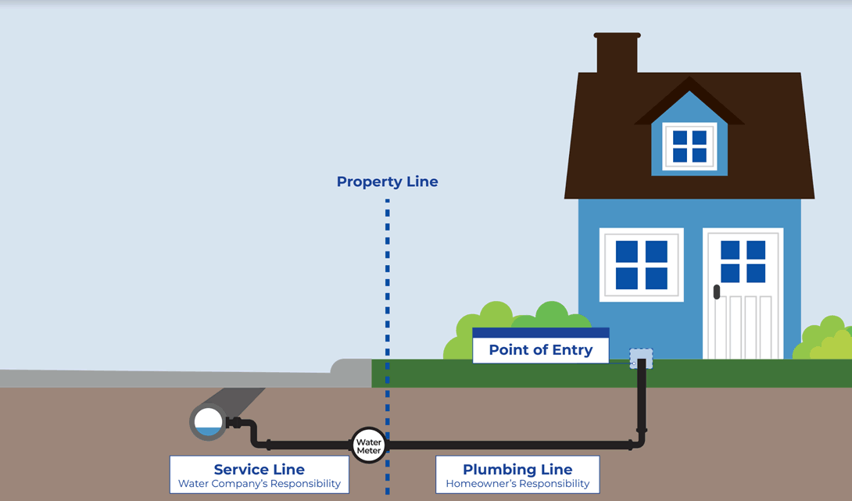
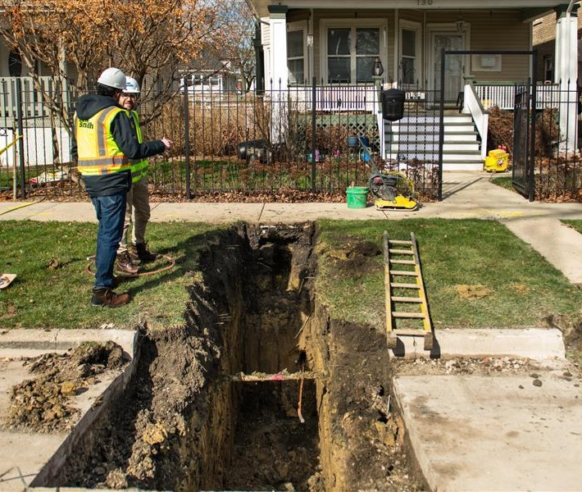
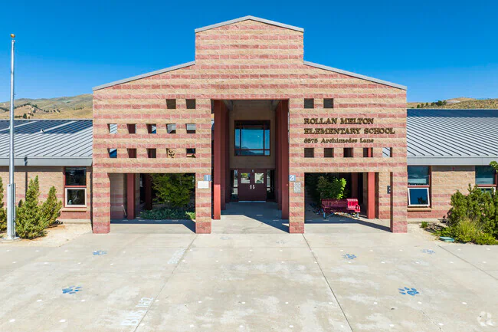
LCRI Items due November 1, 2027
Baseline Service Line Inventory
Replacement Plan
List of Schools and Childcare Facilities
6

Slide 30
Baseline Service Line Inventory
Due November 1, 2027
Includes all information of the initial service line inventory plus connector information ​
Connector classifications​
Lead ​
Non-lead​
Unknown​
No connector present​
Must be made publicly accessible​
Annual updates required unless all non-lead
Connector

Slide 31
Replacement Plan
Due November 1, 2027
10 years to replace all lead and GRR service lines and to identify unknowns
10% replacement rate across a cumulative period
The first cumulative period will not be calculated until the completion of the third program year
Must replace lead connectors when encountered
Must be publicly accessible
Available online for systems serving > 50,000
Annual updates to include any new information

Slide 32
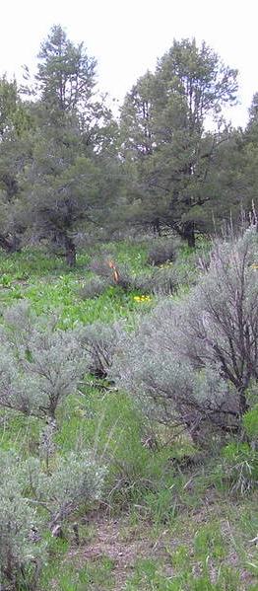
Lead Testing in Schools and Childcare Facilities
Due November 1, 2027
Schools and childcare facilities not required to be listed or tested:
Constructed or had full plumbing replacement on or after the date the State adopted the new definition of lead-free (December 22, 2014); and
Are not served by a lead, GRR, or unknown service line
Systems must contact all those identified and provide information about the health risks of lead in drinking water once a year
20% of identified elementary schools and 20% of identified childcare facilities must be sampled each year
Secondary schools sampled on request
Waivers available if school or childcare facilities that participated in alternative lead sampling programs

Slide 33
Validation of Non-lead
A set of non-lead service lines within the validation pool must be visually inspection at 2 points
Excluded from the validation pool:
Identified via exterior visual inspection at a minimum of 2 points
Identified using records that show the line was install after the State lead ban date (10/1/1989)
Previously replaced lead or GRR service lines
Randomly selected validation sites
7-year deadline from compliance date unless on a deferred or shorted replacement deadline established by the State
Size of Validation Pool | Number of Validations Required
<1,500 | 20% of validation pool
1,500 to 2,000 | 322
2,001 to 3,000 | 341
3,001 to 4,000 | 351
4,001 to 6,000 | 361
6,001 to 10,000 | 371
10,001 to 50,000 | 381
>50,000 | 384
6

Slide 34
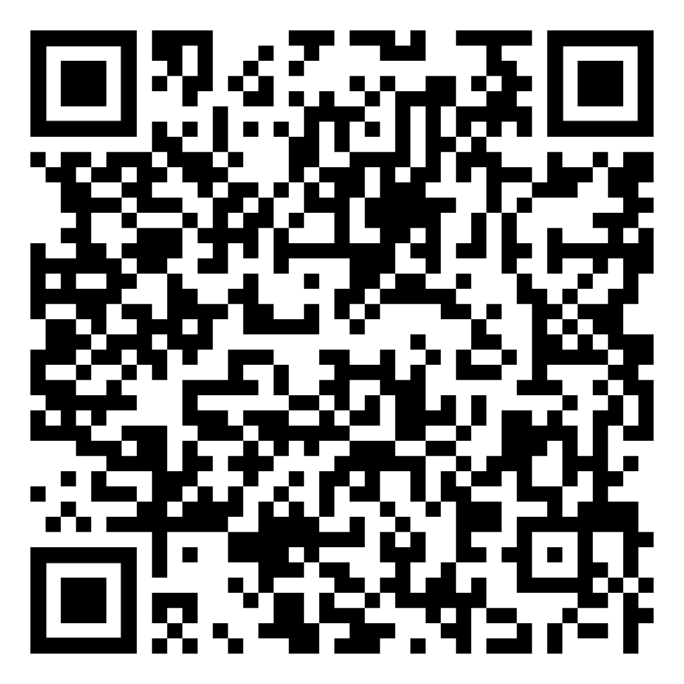
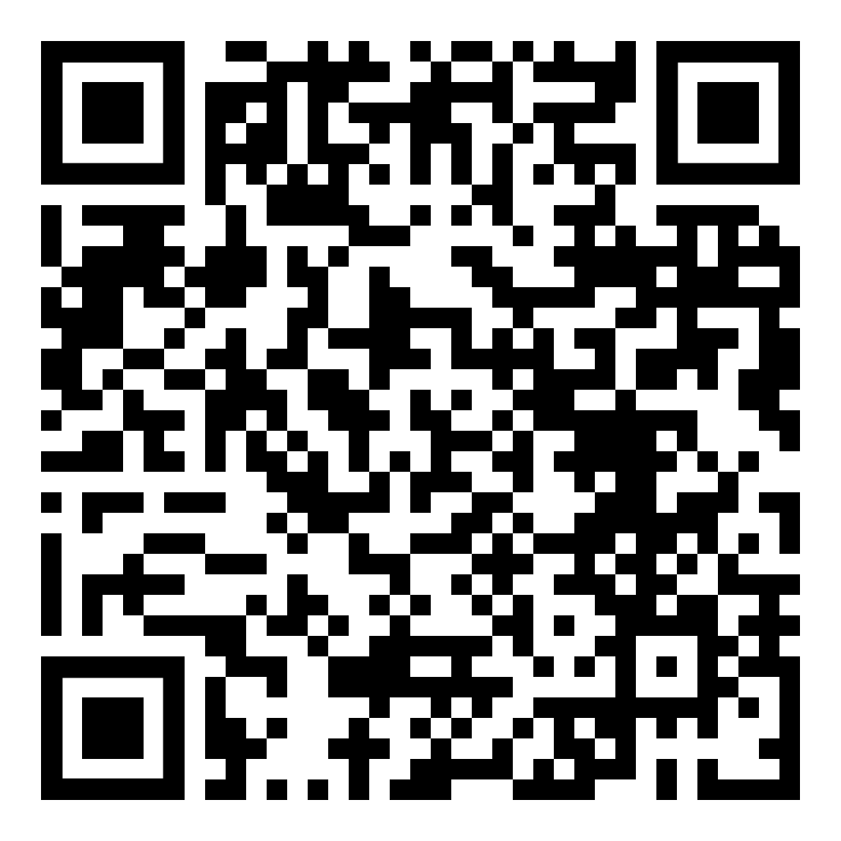
Resources for LCRR/LCRI
Templates and FAQs can be found on the NDEP and EPA Lead and Copper pages. See QR codes below.
NDEP Lead and Copper page
EPA Lead and Copper Rule Implementation Tool page

Slide 35
Questions?
Email: cbadhan@ndep.nv.gov
Phone: 775-687-9491

