Slide 1
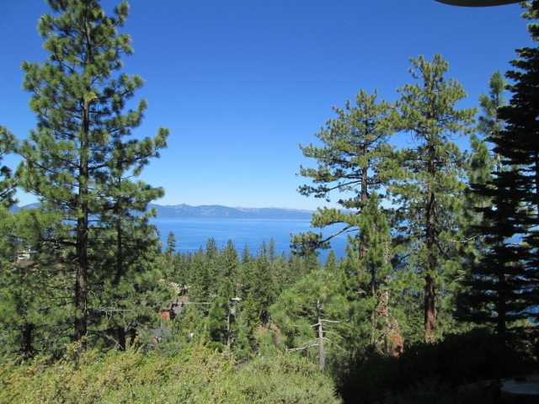
Bureau of Safe Drinking Water (BSDW)
October 30, 2023
Carson City, NV
Picture – use thin
white frame
LCB File #R130-22
Regulation Revision Workshop​
ndep.nv.gov

Slide 2
Agenda
BSDW Laboratory Certification Staff
Ways to participate and public comment
Review how regulations are created/revised
The State Environmental Commission (SEC)
The need for a fee increase
NAC 445A.066 (CWA & Mining)
NAC 445A.54296 (SDWA)
NAC 459.96986 (RCRA)
Public Comments and Questions
End of Workshop
Jennifer Carr
Administrator
Danilo Dragoni
Deputy Administrator
Jeffrey Kinder
Deputy Administrator
Rick Perdomo
Deputy Administrator
James Settelmeyer
Director

Slide 3
BSDW Laboratory Certification Branch
Andrea Seifert, P.E., Bureau Chief
aseifert@ndep.nv.gov (775) 687-9515
Jasmine Curiel, Program Supervisor
jcuriel@ndep.nv.gov (775) 687-9507
Michael Antoine, CEHP, Laboratory Certification Officer
mantoine@ndep.nv.gov (775) 687-9490
Corinne Hasenau, Laboratory Certification Officer
chasenau@ndep.nv.gov (775) 687-9309
Chloe Dodge, Laboratory Certification Officer
cdodge@ndep.nv.gov (775) 687-9535
Savannah Hash, Administrative Assistant
shash@ndep.nv.gov (775) 687-9445
Jennifer Carr
Administrator
Danilo Dragoni
Deputy Administrator
Jeffrey Kinder
Deputy Administrator
Rick Perdomo
Deputy Administrator
James Settelmeyer
Director

Slide 4
Ways to Participate
Questions and Comments: Today
Locations: Carson City, Bryan Building, Great Basin Room
Las Vegas Office, Red Rock Room
Virtually via Microsoft Teams
Meeting ID: 245 828 499 136 Passcode: YcY8At
Or call in (audio only)
+1 775-321-6111, United States, Reno
Phone Conference ID: 434 508 871#
By November 30, 2023, for NDEP consideration & inclusion in testimony to SEC
Written Comments:
Nevada Division of Environmental Protection
Bureau of Safe Drinking Water
901 South Stewart Street, Suite 4001
Carson City, NV 89701
E-mail your Comments (jcuriel@ndep.nv.gov)
SEC Hearing on December 5, 2023
Jennifer Carr
Administrator
Danilo Dragoni
Deputy Administrator
Jeffrey Kinder
Deputy Administrator
Rick Perdomo
Deputy Administrator
James Settelmeyer
Director

Slide 5
How Regulations are Added and/or Revised
The state agency (NDEP) drafts a regulatory petition.
The petition is sent to the Legislative Counsel Bureau (LCB) to review.
The agency hosts a public workshop.
The petition is reviewed and voted on by the State Environmental Commission (SEC) during a regulatory meeting (December 5, 2023).
The Legislative Commission reviews the regulation revisions for possible approval.
If approved, the petition becomes regulation.
Jennifer Carr
Administrator
Danilo Dragoni
Deputy Administrator
Jeffrey Kinder
Deputy Administrator
Rick Perdomo
Deputy Administrator
James Settelmeyer
Director

Slide 6
State Environmental Commission (SEC)
https://sec.nv.gov/about-us/
Jennifer Carr
Administrator
Danilo Dragoni
Deputy Administrator
Jeffrey Kinder
Deputy Administrator
Rick Perdomo
Deputy Administrator
James Settelmeyer
Director
Nevada's deciding body for rules, actions, and programs that
affect the quality of the environment.
A judiciary for the environment and the communities it supports
Make evidence-based decisions to ensure Nevada’s
Environmental laws are realized without fail
Ensure decisions made by NDEP follow the law
“We’re public servants and private citizens charged to keep Nevada’s
environmental rules fair, legal, and effective. Our committee holds
accountable the decisions, actions, and laws that affect Nevada's air,
water, and land.”
Photo – ideal for photos of foliage, trees, etc. (rather than landscape scenes)

Slide 7
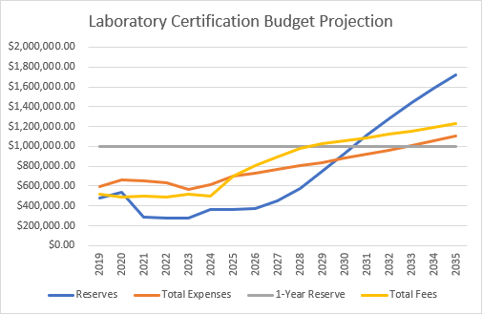
The Need for an LCP Fee Increase
Jennifer Carr
Administrator
Danilo Dragoni
Deputy Administrator
Jeffrey Kinder
Deputy Administrator
Rick Perdomo
Deputy Administrator
James Settelmeyer
Director
Photo – ideal for photos of foliage, trees, etc. (rather than landscape scenes)
Fees last increased in 2004 (Avg. Inflation rate 3.19%/year; cumulative price increase of 61%)
Increased annual application for certification fee to account for inflation
Increased method/analyte fees for certification to account for inflation
New fees for Cyanobacteria
New fees for the Nevada Mining Laboratory Approval Program
40% initial increase, 15% increase in year 2, 10% increase in years 3 & 4, 5% increase in year 5.
Optional 3% increase to the annual fees each year after

Slide 8
NAC 445A.066 (CWA and Mining)
NAC 445A.066 Fees for certification
1. Except as otherwise provided in [subsection] subsections 2[,] and 4, a laboratory must submit an annual fee of [$500] $700 with each application for certification.
[2. A laboratory which only performs analysis for microbiology is not required to pay the fee provided pursuant to subsection 1.]
2. [3.] Except as otherwise provided in subsection 4, in addition to the fee required pursuant to the provisions of subsections 1 and [4] 3, a laboratory must submit an annual certification fee for each category of [contaminant] analyte for which certification is requested. The categories of [contaminant] analytes and annual certification fees are:
Jennifer Carr
Administrator
Danilo Dragoni
Deputy Administrator
Jeffrey Kinder
Deputy Administrator
Rick Perdomo
Deputy Administrator
James Settelmeyer
Director

Slide 9
NAC 445A.066
CATEGORY OF CONTAMINANT
Aug. 1, Aug. 1, Aug. 1, Aug. 1, Aug. 1,
Non-potable Water Fees: 2024 2025 2026 2027 2028
Asbestos $560 $644 $708 $779 $818
Cyanide $350 $403 $443 $487 $511
Demands $490 $564 $620 $682 $716
Dioxin $763 $877 $965 $1062 $1115
Disinfectant Residuals $175 $201 $221 $243 $255
Extractable Organics $763 $877 $965 $1062 $1115
Herbicides $763 $877 $965 $1062 $1115
Microbiology $560 $644 $708 $779 $818
Microcystins, nodularins,
cylindrospermopsin and anatoxin- $1580 $1817 $1999 $2199 $2309
Minerals $560 $644 $708 $779 $818
Jennifer Carr
Administrator
Danilo Dragoni
Deputy Administrator
Jeffrey Kinder
Deputy Administrator
Rick Perdomo
Deputy Administrator
James Settelmeyer
Director

Slide 10
NAC 445A.066
CATEGORY OF CONTAMINANT
Year 1 Year 2 Year 3 Year 4 Year 5
Non-potable Water Fees (cont.): 2024 2025 2026 2027 2028
Nutrients $350 $403 $443 $487 $511
Oil and grease $350 $403 $443 $487 $511
Perchlorate $350 $403 $443 $487 $511
Pesticides $763 $877 $965 $1062 $1115
Phenolics $350 $403 $443 $487 $511
Polychlorinated biphenyls $763 $877 $965 $1062 $1115
Radiochemistry $763 $877 $965 $1062 $1115
Residue $490 $564 $620 $682 $716
Toxicity $560 $644 $708 $779 $818
Trace Metals $763 $877 $965 $1062 $1115
Jennifer Carr
Administrator
Danilo Dragoni
Deputy Administrator
Jeffrey Kinder
Deputy Administrator
Rick Perdomo
Deputy Administrator
James Settelmeyer
Director

Slide 11
NAC 445A.066
CATEGORY OF CONTAMINANT
Year 1 Year 2 Year 3 Year 4 Year 5
Non-potable Water Fees (cont.): 2024 2025 2026 2027 2028
Volatile organic chemistry $763 $877 $965 $1062 $1115
Any other individual analyte $280 $322 $354 $390 $409
Any other multianalyte method $560 $644 $708 $779 $818
For the annual period of certification beginning on August 1, 2029 , and for each annual period of certification thereafter, the Director of the State Department of Conservation and Natural Resources shall increase each fee set forth in this section by an amount that is equal to 3 percent of the fee for the immediately preceding annual period of certification. The Director may, during any individual annual period of certification, suspend an increase in a fee specified in this subsection.
Jennifer Carr
Administrator
Danilo Dragoni
Deputy Administrator
Jeffrey Kinder
Deputy Administrator
Rick Perdomo
Deputy Administrator
James Settelmeyer
Director

Slide 12
NAC 445A.066
CATEGORY OF CONTAMINANT
Year 1 Year 2 Year 3 Year 4 Year 5
Mining Fees: 2024 2025 2026 2027 2028
ASTM C1308-21 $560 $644 $708 $779 $818
ASTM D5744-18 $763 $877 $965 $1062 $1115
Cyanide Extraction $280 $322 $354 $390 $409
Meteoric water mobility $560 $644 $708 $779 $818
Oxidation-reduction potential $280 $322 $354 $390 $409
Trace metals $763 $877 $965 $1062 $1115
Any EPA 600 method $560 $644 $708 $779 $818
Any other individual analyte $280 $322 $354 $390 $409
Any other multianalyte method $560 $644 $708 $779 $818
For the annual period of certification beginning on August 1, 2029 , and for each annual period of certification thereafter, the Director of the State Department of Conservation and Natural Resources shall increase each fee set forth in this section by an amount that is equal to 3 percent of the fee for the immediately preceding annual period of certification. The Director may, during any individual annual period of certification, suspend an increase in a fee specified in this subsection.
Jennifer Carr
Administrator
Danilo Dragoni
Deputy Administrator
Jeffrey Kinder
Deputy Administrator
Rick Perdomo
Deputy Administrator
James Settelmeyer
Director

Slide 13
NAC 445A.066
3. Except as otherwise provided in subsection 4, in addition to the fees required pursuant to the provisions of subsections 1 and [3] 2, if a laboratory applies for certification for [a contaminant]an analyte in more than two of the approved methods of testing for that [contaminant] analyte, the laboratory must submit a fee of $ 280 for each additional approved method of testing.
[5] 4. For the annual period of certification beginning on August 1, 2029 , and for each annual period of certification thereafter, the Director of the State Department of Conservation and Natural Resources shall increase each fee set forth in this section by an amount that is equal to 3 percent of the fee for the immediately preceding annual period of certification. The Director may, during any individual annual period of certification, suspend an increase in a fee specified in this subsection.
The Director of the State Department of Conservation and Natural Resources shall post on the
Internet website of the Division the fees required pursuant to this section that are applicable for each annual certification period.
Jennifer Carr
Administrator
Danilo Dragoni
Deputy Administrator
Jeffrey Kinder
Deputy Administrator
Rick Perdomo
Deputy Administrator
James Settelmeyer
Director

Slide 14
NAC 445A.066
6. If a laboratory applies for certification for additional [contaminants] analytes after the
laboratory has been issued a certification for an annual period of certification, the fee for certification for each additional [contaminant] category of analyte is the fee provided for that [contaminant] category of analyte pursuant to the provisions of subsection [3.] 2. The fee must be prorated pursuant to subsection [6] 7 if the provisions of that subsection otherwise apply. If the Division conducts an evaluation for certification at the laboratory, the laboratory must pay, at the rate provided for state officers and employees generally, the actual travel and per diem expenses of the Division. If the laboratory is located outside of this State, the [expenses must be paid pursuant to the provisions of subsection 7.
6.] laboratory must pay the actual travel and per diem expenses of the employee of the Division who conducts the evaluation.
Jennifer Carr
Administrator
Danilo Dragoni
Deputy Administrator
Jeffrey Kinder
Deputy Administrator
Rick Perdomo
Deputy Administrator
James Settelmeyer
Director

Slide 15
NAC 445A.066
7. The fees are effective for 12 months beginning on August 1 of each year. If an application for certification to test for an analyte is submitted during that period, the fees for that certification must be prorated using the following formula:
Fee X .083 X the number of months remaining in the annual period of certification.
For the purpose of prorating fees, an application for certification to test for an analyte shall be deemed to have been submitted at the beginning of a month regardless of the date of the application. The prorated fee must be rounded to the next highest dollar. The fee provided pursuant to the provisions of subsection 1 must not be prorated.
[7. If an evaluation for certification of a laboratory that is located outside of this State is conducted, the laboratory must pay the actual travel and per diem expenses of the employee of the Division who conducts the evaluation.]
Jennifer Carr
Administrator
Danilo Dragoni
Deputy Administrator
Jeffrey Kinder
Deputy Administrator
Rick Perdomo
Deputy Administrator
James Settelmeyer
Director

Slide 16
NAC 445A.54296 (SDWA)
1. Except as otherwise provided in subsection 4, a laboratory must submit an annual fee of $700 with [E] each application for certification.[:]
[(a) Chemistry certification must include a fee of $500.]
[(b) Microbiology certification must include a fee of $600.]
2. Except as otherwise provided in subsection 4 , in addition to the fee specified in subsection 1, [the Bureau shall charge and collect the following fees:] a laboratory must submit an annual certification fee for each category of analyte for which certification is requested. The categories of analytes and annual certification fees are:
Jennifer Carr
Administrator
Danilo Dragoni
Deputy Administrator
Jeffrey Kinder
Deputy Administrator
Rick Perdomo
Deputy Administrator
James Settelmeyer
Director

Slide 17
NAC 445A.54296
CATEGORY OF CONTAMINANT
Year 1 Year 2 Year 3 Year 4 Year 5
Drinking Water Fees: 2024 2025 2026 2027 2028
Microbiology $560 $644 $708 $779 $818
Primary inorganic analytes $763 $877 $965 $1062 $1115
Radionuclide $763 $877 $965 $1062 $1115
Secondary inorganic analytes $763 $877 $965 $1062 $1115
Synthetic organic analytes $1526 $1755 $1930 $2123 $2230
Volatile organic analytes $763 $877 $965 $1062 $1115
Any other individual analyte $280 $322 $354 $390 $409
Any other multianalyte method $560 $644 $708 $779 $818
For the annual period of certification beginning on August 1, 2029 , and for each annual period of certification thereafter, the Director of the State Department of Conservation and Natural Resources shall increase each fee set forth in this section by an amount that is equal to 3 percent of the fee for the immediately preceding annual period of certification. The Director may, during any individual annual period of certification, suspend an increase in a fee specified in this subsection.
Jennifer Carr
Administrator
Danilo Dragoni
Deputy Administrator
Jeffrey Kinder
Deputy Administrator
Rick Perdomo
Deputy Administrator
James Settelmeyer
Director

Slide 18
NAC 445A.54296
3. The initial or annual renewal fee for certification to analyze any chemical [contaminant not] analyte is equal to the respective fee not set forth in subsection 2 is $[400]560, plus the per diem allowance and travel expenses provided for state officers and employees generally for each person who conducts an inspection that is required for certification of the laboratory. If the laboratory is located outside of this State, the laboratory must pay the actual travel and per diem expenses of the employee of the Division who conducts the inspection.
4. For the annual period of certification beginning on August 1, 2029 , and for each annual period of certification thereafter, the Director of the State Department of Conservation and Natural Resources shall increase each fee set forth in this section by an amount that is equal to 3 percent of the fee for the immediately preceding period of certification. The Director may, for any individual annual period of certification, suspend an increase in a fee specified in this subsection.
Jennifer Carr
Administrator
Danilo Dragoni
Deputy Administrator
Jeffrey Kinder
Deputy Administrator
Rick Perdomo
Deputy Administrator
James Settelmeyer
Director

Slide 19
NAC 445A.54296
5. The Director of the State Department of Conservation and Natural Resources shall post on the Internet website of the Division the fees required pursuant to this section that are applicable for each annual certification period.
6. If an application for certification to test for an analyte is received during the [fiscal year,] annual period of certification, the fees for that certification must be prorated by using the following formula:
Fee x .083 x the number of months remaining in the [fiscal year.] annual period of certification.
The month in which the application is submitted must not be counted as a month remaining in the [fiscal year.] annual period of certification. The prorated fee must be rounded to the next highest dollar. The fee for submitting an application for certification to test for an analyte must not be prorated.
Jennifer Carr
Administrator
Danilo Dragoni
Deputy Administrator
Jeffrey Kinder
Deputy Administrator
Rick Perdomo
Deputy Administrator
James Settelmeyer
Director

Slide 20
NAC 445A.54296
[5. In addition to any fees paid by a laboratory located outside this State, each such laboratory shall pay to the Bureau the costs incurred by the Bureau to conduct an inspection of the laboratory.
6.] 7. A fee for certification to analyze a specific [contaminant] analyte must be paid before a certificate may be issued.
[7.] 8. Any fee paid pursuant to the provisions of this section is nonrefundable.
Jennifer Carr
Administrator
Danilo Dragoni
Deputy Administrator
Jeffrey Kinder
Deputy Administrator
Rick Perdomo
Deputy Administrator
James Settelmeyer
Director

Slide 21
NAC 459.96986 (RCRA)
1. Except as otherwise provided in subsection [2,] 4, a laboratory must submit an annual fee of $[500]700 with each application for certification.
[2]. [A laboratory which only performs analysis for microbiology is not required to pay the fee provided pursuant to subsection 1.]
[3] 2. Except as otherwise provided in subsection 4, in addition to the fee required pursuant to the provisions of subsections 1 and [4] 3, a laboratory must submit an annual certification fee for each category of [contaminant] analyte for which certification is requested. The categories of [contaminant] analyte and annual fees are:
Jennifer Carr
Administrator
Danilo Dragoni
Deputy Administrator
Jeffrey Kinder
Deputy Administrator
Rick Perdomo
Deputy Administrator
James Settelmeyer
Director

Slide 22
NAC 459.96986
CATEGORY OF CONTAMINANT
Year 1 Year 2 Year 3 Year 4 Year 5
Resource Conservation Recovery Act (RCRA) Fees: 2024 2025 2026 2027 2028
Bulk asbestos analysis of hazardous waste $560 $644 $708 $779 $818
Characteristics of hazardous waste $490 $564 $620 $682 $716
Dioxins in hazardous waste $560 $644 $708 $779 $818
Herbicides $763 $877 $965 $1062 $1115
Immunoassay methods for hazardous waste $763 $877 $965 $1062 $1115
Infrared analysis of hazardous waste $763 $877 $965 $1062 $1115
Inorganic chemistry of hazardous waste $763 $877 $965 $1062 $1115
Liquid chromatography of hazardous waste $763 $877 $965 $1062 $1115
Microbiology $560 $644 $708 $779 $818
Miscellaneous screening methods
for hazardous waste $560 $644 $708 $779 $818
Pesticides $763 $877 $965 $1062 $1115
Jennifer Carr
Administrator
Danilo Dragoni
Deputy Administrator
Jeffrey Kinder
Deputy Administrator
Rick Perdomo
Deputy Administrator
James Settelmeyer
Director

Slide 23
NAC 459.96986
CATEGORY OF CONTAMINANT
Year 1 Year 2 Year 3 Year 4 Year 5
Resource Conservation Recovery Act (RCRA) Fees (cont.): 2024 2025 2026 2027 2028
Physical properties of hazardous waste $490 $564 $620 $682 $716
Polyaromatic hydrocarbons in hazardous waste $763 $877 $965 $1062 $1115
Polychlorinated biphenyls in hazardous waste $763 $877 $965 $1062 $1115
Radiochemistry of hazardous waste $763 $877 $965 $1062 $1115
Semi-volatile organic chemistry of hazardous waste $763 $877 $965 $1062 $1115
Toxicity bioassay of hazardous waste $560 $644 $708 $779 $818
Trace metals in hazardous waste $763 $877 $965 $1062 $1115
Volatile organic chemistry of hazardous waste $763 $877 $965 $1062 $1115
Any other individual contaminant $280 $322 $354 $390 $409
Any other individual multi-contaminant method $560 $644 $708 $779 $818
For the annual period of certification beginning on August 1, 2029 , and for each annual period of certification thereafter, the Director of the State Department of Conservation and Natural Resources shall increase each fee set forth in this section by an amount that is equal to 3 percent of the fee for the immediately preceding annual period of certification. The Director may, during any individual annual period of certification, suspend an increase in a fee specified in this subsection.
Jennifer Carr
Administrator
Danilo Dragoni
Deputy Administrator
Jeffrey Kinder
Deputy Administrator
Rick Perdomo
Deputy Administrator
James Settelmeyer
Director

Slide 24
NAC 459.96986
[4]3. Except as otherwise provided in subsection 4, in addition to the fees
required pursuant to the provisions of subsections 1 and [3]2, if a laboratory applies for certification for [a contaminant] an analyte in more than two of the approved methods of testing for that [contaminant,] analyte, the laboratory must submit a fee of $[200]280 for each additional approved method of testing.
[5]4. For the annual period of certification beginning on August 1, 2029, and for each annual period of certification thereafter, the Director of the State Department of Conservation and Natural Resources shall increase each fee set forth in this section by an amount that is equal to 3 percent of the fee for the immediately preceding period of certification. The Director may, for any individual annual period of certification, suspend an increase in a fee specified in this subsection.
Jennifer Carr
Administrator
Danilo Dragoni
Deputy Administrator
Jeffrey Kinder
Deputy Administrator
Rick Perdomo
Deputy Administrator
James Settelmeyer
Director

Slide 25
NAC 459.96986
5. The Director of the State Department of Conservation and Natural Resources shall post on the Internet website of the Division the fees required pursuant to this section that are applicable for each annual certification period.
6. If a laboratory applies for certification for additional [contaminants] analytes after the laboratory has been issued a certification for an annual period of certification, the fee for certification for each additional [contaminant] analyte is equal to the respective fee provided for that [contaminant] analyte pursuant to the provisions of subsection [3.] 2. The fee must be prorated pursuant to subsection [6] 7, if the provisions of that subsection otherwise apply. If the Division conducts an evaluation for certification at the laboratory, the laboratory must pay, at the rate provided for state officers and employees generally, the actual travel and per diem expenses of the Division.
Jennifer Carr
Administrator
Danilo Dragoni
Deputy Administrator
Jeffrey Kinder
Deputy Administrator
Rick Perdomo
Deputy Administrator
James Settelmeyer
Director

Slide 26
NAC 459.96986
If the laboratory is located outside of this State, the [expenses] laboratory must [be paid pursuant to the provisions of subsection 7. 6.] pay the actual travel and per diem expenses of the employee of the Division who conducts the evaluation.
7. The fees are effective for 12 months beginning on August 1 of each year. If an application for certification to test for an analyte is submitted during that period, the fees for that certification must be prorated using the following formula:
Fee X .083 X the number of months remaining in the annual period of certification.
[7. If an evaluation for certification of a laboratory that is located outside of this State is conducted, the laboratory must pay the actual travel and per diem expenses of the employee of the Division who conducts the evaluation.]
Jennifer Carr
Administrator
Danilo Dragoni
Deputy Administrator
Jeffrey Kinder
Deputy Administrator
Rick Perdomo
Deputy Administrator
James Settelmeyer
Director

Slide 27
NAC 459.96986
If the Division conducts an evaluation for certification at the laboratory, the laboratory must pay, at the rate provided for state officers and employees generally, the actual travel and per diem expenses of the Division. If the laboratory is located outside of this State, [expenses must be paid pursuant to the provisions of subsection 7] the laboratory must pay the actual travel and per diem expenses of the employees of the Division who conducts the evaluation.
[7. If an evaluation for certification of a laboratory that is located outside of this State is conducted, the laboratory must pay the actual travel and per diem expenses of the employee of the Division who conducts the evaluation.]
Jennifer Carr
Administrator
Danilo Dragoni
Deputy Administrator
Jeffrey Kinder
Deputy Administrator
Rick Perdomo
Deputy Administrator
James Settelmeyer
Director

Slide 28
Summary of Proposed Revisions
All fees will increase 40% from current level for 2024
NAC 445A.066 (CWA & mining)
NAC 445A.54296 (SDWA)
NAC 459.96986 (RCRA)
Certification fees increase 15% for 2025
All 3 Sections
10% increase per year for 2026/2027
All 3 Sections
5% increase for 2028
All 3 Sections
3% increase per year for 2029 and beyond
All 3 Sections
Additional Cyanobacteria category
NAC 445A.066 (CWA)
Removes exception for microbiology only labs
NAC 445A.066 (CWA)
NAC 459.96986 (RCRA)
Eliminates separate application fees for micro and chemistry
NAC 445A.54296 (SDWA)
Clarifying language/renumbering throughout
Jennifer Carr
Administrator
Danilo Dragoni
Deputy Administrator
Jeffrey Kinder
Deputy Administrator
Rick Perdomo
Deputy Administrator
James Settelmeyer
Director

Slide 29
General Clean-Up of NAC 445A
Section 6:
Replace references to the Bureau of Licensure and Certification with the Bureau of Safe Drinking Water.
Replace references to the Division of Public and Behavioral Health With the Division of Environmental Protection.
Replace references to the Department of Health and Human Services with the Department of Conservation and Natural Resources.
Section 7:
Replace a reference to National Environmental Laboratory Accreditation Conference-Constitution, Bylaws and Standards, EPA 600/R-98/151 with National Environmental Laboratory Accreditation Conference, 2003 NELAC Standard, EPA/600/R-04/003.
Replace the source of the above publication from the United States Environmental Protection Agency, Office of Research and Development, 401 M Street, S.W., Washington, D.C. 20460, or from the Environmental Protection Agency to the NELAC Institute, at the Internet address [http://www.epa.gov/ttn/nelac.] https://www.nelac-institute.org.
Jennifer Carr
Administrator
Danilo Dragoni
Deputy Administrator
Jeffrey Kinder
Deputy Administrator
Rick Perdomo
Deputy Administrator
James Settelmeyer
Director

Slide 30
General Clean-Up of NAC 445A
Section 8:
Replaces reference to the Bureau of Licensure and Certification with the Bureau of Safe Drinking Water.
Replaces reference to the source of the publications in subsections 1-28 from by mail from the National Technical Information Service, 5285 Port Royal Road, Springfield, Virginia 22161, or by telephone at (800) 553-6847. The publications may also be obtained from the National Technical Information Service at the Internet address http://www.ntis.gov/support/ordering.htm with free of charge, from the United States Environmental Protection Agency, National Service Center for Environmental Publications, at the Internet address https://www.epa.gov/nscep.
Removes order number and price for documents referenced in subsections 1-22 and 25-28.
Adds reference to Supplements 1 & 2 to the Fifth Edition of the Manual for the Certification of Laboratories Analyzing Drinking Water, EPA 815-F-08-066 & EPA 815-F-12-006. The publication is available free of charge, from the Environmental Protection Agency at the Internet address
https://www.epa.gov/dwlabcert/laboratory-certification-manual-drinking-water
to subsections 23 & 24.
Jennifer Carr
Administrator
Danilo Dragoni
Deputy Administrator
Jeffrey Kinder
Deputy Administrator
Rick Perdomo
Deputy Administrator
James Settelmeyer
Director

Slide 31
General Clean-Up of NAC 445A
Section 9:
Removes the source of the publications in subsections 1-4.
Replaces reference to the source of the publications in subsection 1 from United States Environmental Protection Agency, National Service Center for Environmental Publications and Information, 11029 Kenwood Road, Building 5, Cincinnati, Ohio 45242 with at the Internet address https://www.epa.gov/nscep.
Adds reference to the publication Method 1664, Revision B: n-Hexane Extractable Material (HEM; Oil and Grease) and Silica Gel Treated n-Hexane Extractable Material (SGT-HEM; Non-polar Material) by Extraction and Gravimetry, February 2010, EPA-821-R-10-001. The publication is available free of charge, from the Environmental Protection Agency at the Internet address https://www.epa.gov/nscep.
Removes publication number and price for referenced publication Test Methods for Evaluating Solid Waste, Physical/Chemical Methods, SW-846, 3rd edition, and Updates I, II, IIA, IIB, III , IIIA; adds updates IIIB, IV and V; Replaces the source of the reference in subsection 4 from United States Government Printing Office at the Internet address http://www.epa.gov/epaoswer/hazwaste/test/main.htm to Environmental Protection Agency at the Internet address https://www.epa.gov/hwsw846/sw-846-compendium.
Jennifer Carr
Administrator
Danilo Dragoni
Deputy Administrator
Jeffrey Kinder
Deputy Administrator
Rick Perdomo
Deputy Administrator
James Settelmeyer
Director

Slide 32
General Clean-Up of NAC 445A
Section 10:
Updates the source address of publications referenced in subsections 1 & 2.
Updates the price of publications referenced in subsections 1 & 2.
Adopts by reference the publication ASTM C1308-21, “Standard Test Method for Accelerated Leach Test for Measuring Contaminant Releases From Solidified Waste,” which is available from ASTM International, 100 Barr Harbor Drive, P.O. Box C700, West Conshohocken, Pennsylvania, 19428-2959, or at the Internet address http://www.astm.org, for the price of $60.
Adopts by reference the publication ASTM D5744-18 “Standard Test Method for Laboratory Weathering of Solid Materials Using a Humidity Cell,” which is available from ASTM International, 100 Barr Harbor Drive, P.O. Box C700, West Conshohocken, Pennsylvania, 19428-2959, or at the Internet address http://www.astm.org, for the price of $78.
Adopts by reference the publication ASTM E1915-20, “Standard Test Methods for Analysis of Metal Bearing Ores and Related Materials for Carbon, Sulfur, and Acid-Base Characteristics,” which is available from ASTM International, 100 Barr Harbor Drive, P.O. Box C700, West Conshohocken, Pennsylvania, 19428-2959, or at the Internet address http://www.astm.org, for the price of $78.
Jennifer Carr
Administrator
Danilo Dragoni
Deputy Administrator
Jeffrey Kinder
Deputy Administrator
Rick Perdomo
Deputy Administrator
James Settelmeyer
Director

Slide 33
General Clean-Up of NAC 445A
Section 10 (cont.):
Changes the reference to the most recent version of General Requirements for the Competence of Testing and Calibration Laboratories and replaces the source of the publication from Global Engineering Documents, 15 Inverness Way East, Englewood, Colorado 80112 to the American National Standards Institute, at the Internet address https://webstore.ansi.org.
Changes the reference to the most recent edition of Standard Methods for the Examination of Water and Wastewater, adds by toll-free telephone at (800) 926-7337, or at the Internet address http://www.awwa.org/store.aspx, and updates the price of the publication to $275 for members and $395 for nonmembers .
Section 11:
Adds reference to section 1 of this regulation.
Section 12:
Adds reference to section 1 and section 1.6.1 of this regulation. Removes references to 40 C.F.R. §§ 141.40(n)(11)], 141.142(b), 141.143(b) and adds references to 40 C.F.R. §§ 141.40(a)(3), 141.131(b), 141.402(c), 141.704, 141.852(a).
Changes the reference to Appendix E to Chapter 5 of the NELAC Standard to Section 5.5.4.5.2.
Jennifer Carr
Administrator
Danilo Dragoni
Deputy Administrator
Jeffrey Kinder
Deputy Administrator
Rick Perdomo
Deputy Administrator
James Settelmeyer
Director

Slide 34
General Clean-Up of NAC 445A
Section 13:
Adds reference to section 1 of this regulation.
Changes the categories for which a laboratory may be certified.
Adds Additional categories for which a laboratory may be certified.
Section 14:
Adds references to section 1 of this regulation.
Replaces Bureau with Division of Environmental Protection of the State Department of Conservation and Natural Resources.
Removes the definition of “Protocol”.
Changes the reference to the definition of “quality system” from Appendix B of chapter 5 to section 5.0 of the Standard.
Replace references to the Division of Public and Behavioral Health With the Division of Environmental Protection.
Replace references to the Department of Health and Human Services with the Department of Conservation and Natural Resources.
Sections 7, 8, 9, 10, 11, and 14 replace Board with Commission.
Jennifer Carr
Administrator
Danilo Dragoni
Deputy Administrator
Jeffrey Kinder
Deputy Administrator
Rick Perdomo
Deputy Administrator
James Settelmeyer
Director

Slide 35
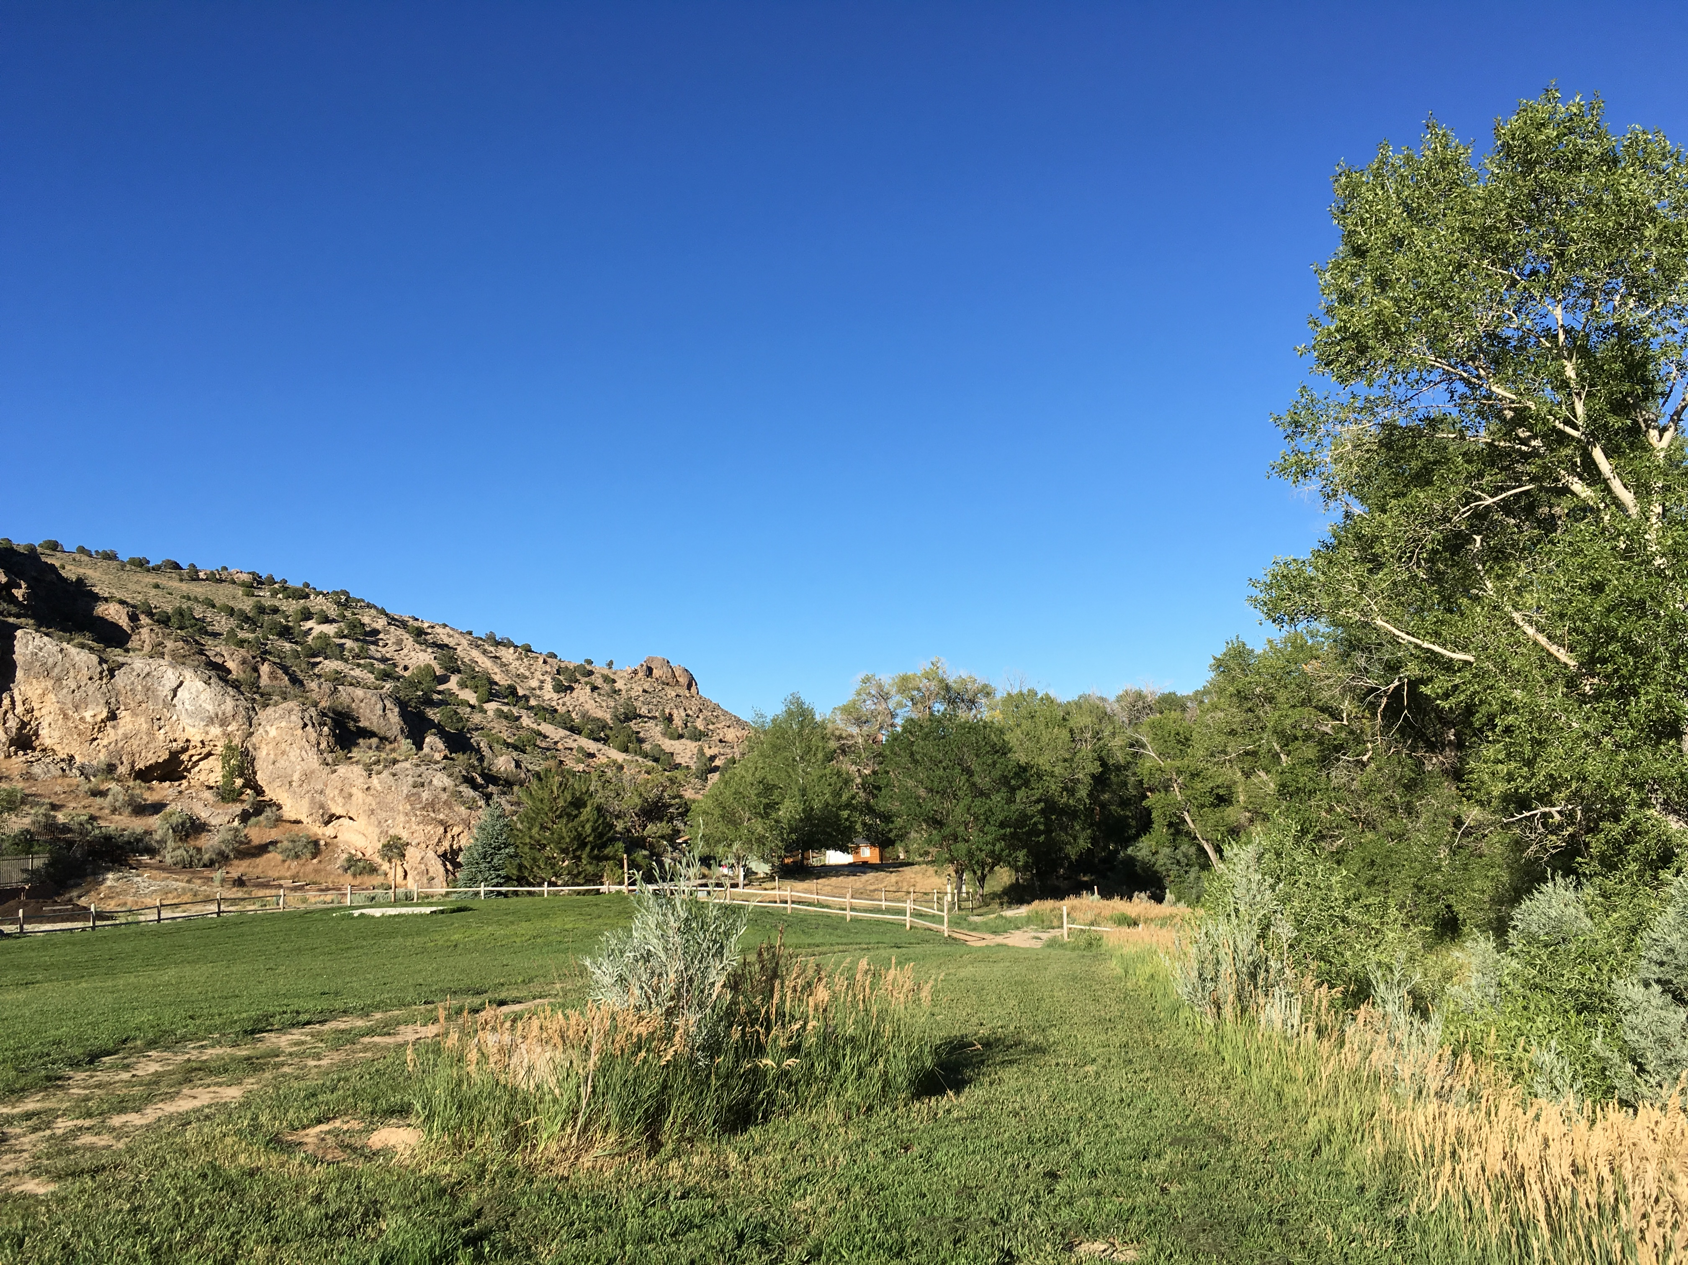
Questions/Comments
Jennifer Carr
Administrator
Danilo Dragoni
Deputy Administrator
Jeffrey Kinder
Deputy Administrator
Rick Perdomo
Deputy Administrator
James Settelmeyer
Director
Contact:
Jasmine Curiel, Program Supervisor
jcuriel@ndep.nv.gov

