Slide 1
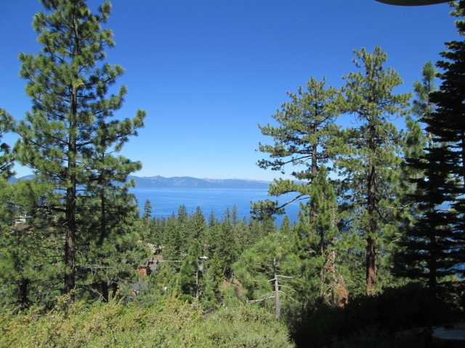
Bureau of Safe Drinking Water (BSDW)
December 16, 2022
Carson City, NV
Picture – use thin
white frame
LCB File #R130-22
Regulation Revision Workshop​
ndep.nv.gov

Slide 2
Agenda
BSDW Laboratory Certification Staff
Ways to participate and public comment
Review how regulations are created/revised
The State Environmental Commission (SEC)
The need for a fee increase
NAC 445A.066 (CWA & Mining)
NAC 445A.54296 (SDWA)
NAC 459.96986 (RCRA)
Public Comments and Questions
End of Workshop
Greg Lovato
Administrator
Jennifer Carr
Deputy Administrator
Jeffrey Kinder
Deputy Administrator
Rick Perdomo
Deputy Administrator
Jim Lawrence
Acting Director

Slide 3
BSDW Laboratory Certification Branch
Andrea Seifert, P.E., Bureau Chief
aseifert@ndep.nv.gov (775) 687-9515
Michael Antoine, CEHP, Laboratory Certification Officer
mantoine@ndep.nv.gov (775) 687-9490
Jasmine Curiel, Laboratory Certification Officer
jcuriel@ndep.nv.gov (775) 687-9507
Corinne Hasenau, Laboratory Certification Officer
chasenau@ndep.nv.gov (775) 687-9309
Chloe Dodge, Environmental Scientist 2
cdodge@ndep.nv.gov (775) 687-9535
Greg Lovato
Administrator
Jennifer Carr
Deputy Administrator
Jeffrey Kinder
Deputy Administrator
Rick Perdomo
Deputy Administrator
Jim Lawrence
Acting Director

Slide 4
Ways to Participate
Questions and Comments: Today
By December 23, 2022, for NDEP consideration & inclusion in testimony to SEC
Written Comments:
Nevada Division of Environmental Protection
Bureau of Safe Drinking Water
901 South Stewart Street, Suite 4001
Carson City, NV 89701
E-mail your Comments (mantoine@ndep.nv.gov)
SEC Hearing on January 19, 2023
Greg Lovato
Administrator
Jennifer Carr
Deputy Administrator
Jeffrey Kinder
Deputy Administrator
Rick Perdomo
Deputy Administrator
Jim Lawrence
Acting Director

Slide 5
How Regulations are Added and/or Revised
The state agency (NDEP) drafts a regulatory petition.
The petition is sent to the Legislative Counsel Bureau (LCB) to review.
The agency hosts a public workshop.
The petition is reviewed and voted on by the State Environmental Commission (SEC) during a regulatory meeting (January 19, 2023).
The Legislative Commission reviews the regulation revisions for possible approval.
If approved, the petition becomes regulation.
Greg Lovato
Administrator
Jennifer Carr
Deputy Administrator
Jeffrey Kinder
Deputy Administrator
Rick Perdomo
Deputy Administrator
Jim Lawrence
Acting Director

Slide 6
State Environmental Commission (SEC)
https://sec.nv.gov/about-us/
Greg Lovato
Administrator
Jennifer Carr
Deputy Administrator
Jeffrey Kinder
Deputy Administrator
Rick Perdomo
Deputy Administrator
Jim Lawrence
Acting Director
Nevada's deciding body for rules, actions, and programs that
affect the quality of the environment.
A judiciary for the environment and the communities it supports
Make evidence-based decisions to ensure Nevada’s
Environmental laws are realized without fail
Ensure decisions made by NDEP follow the law
“We’re public servants and private citizens charged to keep Nevada’s
environmental rules fair, legal, and effective. Our committee holds
accountable the decisions, actions, and laws that affect Nevada's air,
water, and land.”
Photo – ideal for photos of foliage, trees, etc. (rather than landscape scenes)

Slide 7
The Need for an LCP Fee Increase
Greg Lovato
Administrator
Jennifer Carr
Deputy Administrator
Jeffrey Kinder
Deputy Administrator
Rick Perdomo
Deputy Administrator
Jim Lawrence
Acting Director
Photo – ideal for photos of foliage, trees, etc. (rather than landscape scenes)
Fees last increased in 2004 (Avg. Inflation rate 3.19%/year; cumulative price increase of 60.75%)
Increased annual application for certification fee to account for inflation
Increased method/analyte fees for certification to account for inflation
New fees for Cyanobacteria
New fees for the Nevada Mining Laboratory Approval Program
5% per year increase 2024-2027
Optional 4% increase to the annual fees each year after

Slide 8
NAC 445A.066 (CWA and Mining)
NAC 445A.066 Fees for certification
1. [Except as otherwise provided in subsection 2, a] A laboratory must submit an annual fee of [$500] $700 with each application for certification.
[2. A laboratory which only performs analysis for microbiology is not required to pay the fee provided pursuant to subsection 1.]
2. [3.] In addition to the fee required pursuant to the provisions of [subsections] subsection 1 [and 4], a laboratory must submit an annual certification fee for each category of contaminant for which certification is requested. The categories of contaminants and annual fees are:
Greg Lovato
Administrator
Jennifer Carr
Deputy Administrator
Jeffrey Kinder
Deputy Administrator
Rick Perdomo
Deputy Administrator
Jim Lawrence
Acting Director

Slide 9
NAC 445A.066
CATEGORY OF CONTAMINANT
Year 1 Year 2 Year 3 Year 4 Year 5
Non-potable Water Fees: 2023 2024 2025 2026 2027
Minerals $560 588 617 648 680
Nutrients $350 368 386 405 425
Oil and grease $350 368 386 405 425
Perchlorate $350 368 386 405 425
Pesticides $763 801 841 883 927
Phenolics $350 368 386 405 425
Polychlorinated biphenyls wastewater $763 801 841 883 927
Radiochemistry $763 801 841 883 927
Residual chlorine $175 184 193 203 213
Residue $370 400 432 467 504
Greg Lovato
Administrator
Jennifer Carr
Deputy Administrator
Jeffrey Kinder
Deputy Administrator
Rick Perdomo
Deputy Administrator
Jim Lawrence
Acting Director

Slide 10
NAC 445A.066
CATEGORY OF CONTAMINANT
Year 1 Year 2 Year 3 Year 4 Year 5
Non-potable Water Fees (cont.): 2023 2024 2025 2026 2027
Semi-volatile organic chemistry $763 801 841 883 927
Toxicity bioassay $560 588 617 648 680
Trace Metals $763 801 841 883 927
Volatile organic chemistry $763 801 841 883 927
Any other multi-contaminant method $560 588 617 \648 680
Any other single contaminant method $350 368 386 405 425
Saxitoxins Phycological Services $763 801 841 883 927
Molecular Genetic Analyses $560 588 617 648 680
Microcystins/Nodularins $763 801 841 883 927
Microcystins/Nodularins,
Cylindrospermopsin, Anatoxin-a $1580 1588 1667 1750 1838
Greg Lovato
Administrator
Jennifer Carr
Deputy Administrator
Jeffrey Kinder
Deputy Administrator
Rick Perdomo
Deputy Administrator
Jim Lawrence
Acting Director

Slide 11
NAC 445A.066
CATEGORY OF CONTAMINANT
Year 1 Year 2 Year 3 Year 4 Year 5
Mining Fees: 2023 2024 2025 2026 2027
Any other individual contaminant – Cyanide $350 368 386 405 425
Any other individual contaminant-D7572- 11 $350 368 386 405 425
Any other individual contaminant-Metal $350 368 386 405 425
Any other individual contaminant-ORP $350 368 386 405 425
Any other multi-contaminant method-C1308-08 $560 588 617 648 680
Any other multi-contaminant method-D5744-12. $763 801 841 883 927
Any other multi-contaminant method-E1915 $560 588 617 648 680
Any other multi-contaminant method-EPA 600 $560 588 617 648 680
Any other multi-contaminant method-MWM $560 588 617 648 680
For the calendar year beginning on January 1, 2027, and for each calendar year thereafter, the Director shall increase each fee required by this subsection by an amount that is equal to 4 percent of the fee for the immediately preceding fiscal year. The Director of the Department of Conservation and Natural Resources or the Director’s designee may, for any individual fiscal year, suspend an increase in a rate or fee specified in this subsection.
Greg Lovato
Administrator
Jennifer Carr
Deputy Administrator
Jeffrey Kinder
Deputy Administrator
Rick Perdomo
Deputy Administrator
Jim Lawrence
Acting Director

Slide 12
NAC 445A.066
3. In addition to the fees required pursuant to the provisions of subsections 1 and [3] 2, if a laboratory applies for certification for a contaminant in more than two of the approved methods of testing for that contaminant, the laboratory must submit a fee of $ 280 for each additional approved method of testing.
[5] 4. If a laboratory applies for certification for additional contaminants after the laboratory has been issued a certification for an annual period of certification, the fee for certification for each additional contaminant is the fee provided for that contaminant pursuant to the provisions of subsection [3.] 2. The fee must be prorated pursuant to subsection [6] 5 if the provisions of that subsection otherwise apply. If the Division conducts an evaluation for certification at the laboratory, the laboratory must pay, at the rate provided for state officers and employees generally, the actual travel and per diem expenses of the Division. If the laboratory is located outside of this State, [the expenses must be paid pursuant to the provisions of subsection 7] the laboratory must pay the actual travel and per diem expenses of the employee of the Division who conducts the evaluation.
Greg Lovato
Administrator
Jennifer Carr
Deputy Administrator
Jeffrey Kinder
Deputy Administrator
Rick Perdomo
Deputy Administrator
Jim Lawrence
Acting Director

Slide 13
NAC 445A.54296 (SDWA)
1. A laboratory must submit an annual fee of $700 with [E] each application for certification.[:]
[(a) Chemistry certification must include a fee of $500.]
[(b) Microbiology certification must include a fee of $600.]
2. In addition to the fees specified in subsection 1, the Bureau shall charge and collect the following fees:
Greg Lovato
Administrator
Jennifer Carr
Deputy Administrator
Jeffrey Kinder
Deputy Administrator
Rick Perdomo
Deputy Administrator
Jim Lawrence
Acting Director

Slide 14
NAC 445A.54296
CATEGORY OF CONTAMINANT
Year 1 Year 2 Year 3 Year 4 Year 5
2023 2024 2025 2026 2027
Asbestos $560 588 617 648 681
Cyanide $350 368 386 405 425
Dioxin $763 801 841 883 927
Herbicides $763 801 841 883 927
Microbiology $560 588 617 648 681
Minerals $560 588 617 648 681
Nutrients $350 368 386 405 425
Perchlorate $350 368 386 405 425
Pesticides $763 801 841 883 927
Phenolics $350 368 386 405 425
Polyaromatic hydrocarbons $763 801 841 883 927
Greg Lovato
Administrator
Jennifer Carr
Deputy Administrator
Jeffrey Kinder
Deputy Administrator
Rick Perdomo
Deputy Administrator
Jim Lawrence
Acting Director

Slide 15
NAC 445A.54296
CATEGORY OF CONTAMINANT
Year 1 Year 2 Year 3 Year 4 Year 5
2023 2024 2025 2026 2027
PCP Screening $763 801 841 883 927
Synthetic organic compounds $763 801 841 883 927
Toxicity bioassay $560 588 617 648 681
Trace metals $763 801 841 883 927
Volatile organic compounds $763 801 841 883 927
Single analyte method $350 368 386 405 425
Multi-analyte method $560 588 617 648 681
Hardness $350 368 386 405 425
pH $350 368 386 405 425
Total Residual Chlorine $350 368 386 405 425
Chlorine dioxide $350 368 386 405 425
Greg Lovato
Administrator
Jennifer Carr
Deputy Administrator
Jeffrey Kinder
Deputy Administrator
Rick Perdomo
Deputy Administrator
Jim Lawrence
Acting Director

Slide 16
NAC 445A.54296
CATEGORY OF CONTAMINANT
Year 1 Year 2 Year 3 Year 4 Year 5
2023 2024 2025 2026 2027
Alkalinity $350 368 386 405 425
Dissolved Oxygen $350 368 386 405 425
Temperature $350 368 386 405 425
Conductivity $350 368 386 405 425
For the calendar year beginning on January 1, 2027, and for each calendar year thereafter, the Director shall increase each fee required by this subsection by an amount that is equal to 4 percent of the fee for the immediately preceding fiscal year. The Director of the Department of Conservation and Natural Resources or the Director’s designee may, for any individual fiscal year, suspend an increase in a rate or fee specified in this subsection.
Greg Lovato
Administrator
Jennifer Carr
Deputy Administrator
Jeffrey Kinder
Deputy Administrator
Rick Perdomo
Deputy Administrator
Jim Lawrence
Acting Director

Slide 17
NAC 445A.54296
3. The initial or annual renewal fee for certification to analyze any chemical contaminant not set forth in subsection 2 is $[400]560, plus the per diem allowance and travel expenses provided for state officers and employees generally for each person who conducts an inspection that is required for certification of the laboratory. If the laboratory is located outside of this State, the laboratory must pay the actual travel and per diem expenses of the employee of the Division who conducts the evaluation.
Greg Lovato
Administrator
Jennifer Carr
Deputy Administrator
Jeffrey Kinder
Deputy Administrator
Rick Perdomo
Deputy Administrator
Jim Lawrence
Acting Director

Slide 18
NAC 459.96986 (RCRA)
1. Except as otherwise provided in subsection 2, a laboratory must submit an annual fee of $[500]700 with each application for certification.
[2]. [A laboratory which only performs analysis for microbiology is not required to pay the fee provided pursuant to subsection 1.]
[3] 2. In addition to the fee required pursuant to the provisions of subsections 1 and [4] 3, a laboratory must submit an annual certification fee for each category of contaminant for which certification is requested. The categories of contaminants and annual fees are:
Greg Lovato
Administrator
Jennifer Carr
Deputy Administrator
Jeffrey Kinder
Deputy Administrator
Rick Perdomo
Deputy Administrator
Jim Lawrence
Acting Director

Slide 19
NAC 459.96986
CATEGORY OF CONTAMINANT
Year 1 Year 2 Year 3 Year 4 Year 5
Resource Conservation Recovery Act (RCRA) Fees 2023 2024 2025 2026 2027
Bulk asbestos analysis of hazardous waste $560 588 617 648 681
Characteristics of hazardous waste $490 515 540 567 596
Dioxins in hazardous waste $763 801 841 883 927
Herbicides $763 801 841 883 927
Immunoassay methods for hazardous waste $763 801 841 883 927
Infrared analysis of hazardous waste $763 801 841 883 927
Inorganic chemistry of hazardous waste $763 801 841 883 927
Liquid chromatography of hazardous waste $763 801 841 883 927
Microbiology $560 588 617 648 681
Miscellaneous screening methods
for hazardous waste $560 588 617 648 681
Pesticides $763 801 841 883 927
Greg Lovato
Administrator
Jennifer Carr
Deputy Administrator
Jeffrey Kinder
Deputy Administrator
Rick Perdomo
Deputy Administrator
Jim Lawrence
Acting Director

Slide 20
NAC 459.96986
CATEGORY OF CONTAMINANT
Year 1 Year 2 Year 3 Year 4 Year 5
Resource Conservation Recovery Act (RCRA) Fees 2023 2024 2025 2026 2027
Physical properties characterization
Of hazardous waste $763 801 841 883 927
Polyaromatic hydrocarbons in hazardous waste $763 801 841 883 927
Polychlorinated biphenyls in hazardous waste $763 801 841 883 927
Radiochemistry of hazardous waste $763 801 841 883 927
Semi-volatile organic chemistry of hazardous waste $763 801 841 883 927
Toxicity bioassay of hazardous waste $560 588 617 648 681
Trace metals in hazardous waste $763 801 841 883 927
Volatile organic chemistry of hazardous waste $763 801 841 883 927
Any other individual contaminant $763 801 841 883 927
Any other individual multi-contaminant method $763 801 841 883 927
Greg Lovato
Administrator
Jennifer Carr
Deputy Administrator
Jeffrey Kinder
Deputy Administrator
Rick Perdomo
Deputy Administrator
Jim Lawrence
Acting Director

Slide 21
NAC 459.96986
For the calendar year beginning on January 1, 2027, and for each calendar year thereafter, the Director shall increase each fee required by this subsection by an amount that is equal to 4 percent of the fee for the immediately preceding fiscal year. The Director of the Department of Conservation and Natural Resources or the Director’s designee may, for any individual fiscal year, suspend an increase in a rate or fee specified in this subsection.
Greg Lovato
Administrator
Jennifer Carr
Deputy Administrator
Jeffrey Kinder
Deputy Administrator
Rick Perdomo
Deputy Administrator
Jim Lawrence
Acting Director

Slide 22
NAC 459.96986
[4]3. In addition to the fees required pursuant to the provisions of subsections 1 and [3]2, if a laboratory applies for certification for a contaminant in more than two of the approved methods of testing for that contaminant, the laboratory must submit a fee of $[200]280 for each additional approved method of testing.
[5]4. If a laboratory applies for certification for additional contaminants after the laboratory has been issued a certification for an annual period of certification, the fee for certification for each additional contaminant is the fee provided for that contaminant pursuant to the provisions of subsection [3]2. The fee must be prorated pursuant to subsection [6]5 if the provisions of that subsection otherwise apply.
Greg Lovato
Administrator
Jennifer Carr
Deputy Administrator
Jeffrey Kinder
Deputy Administrator
Rick Perdomo
Deputy Administrator
Jim Lawrence
Acting Director

Slide 23
NAC 459.96986
. If the Division conducts an evaluation for certification at the laboratory, the laboratory must pay, at the rate provided for state officers and employees generally, the actual travel and per diem expenses of the Division. If the laboratory is located outside of this State, [expenses must be paid pursuant to the provisions of subsection 7] the laboratory must pay the actual travel and per diem expenses of the employees of the Division who conducts the evaluation.
Greg Lovato
Administrator
Jennifer Carr
Deputy Administrator
Jeffrey Kinder
Deputy Administrator
Rick Perdomo
Deputy Administrator
Jim Lawrence
Acting Director

Slide 24
Summary of Proposed Revisions
All fees will increase 40% from current level for 2023
NAC 445A.066 (CWA & mining)
NAC 445A.54296 (SDWA)
NAC 459.96986 (RCRA)
Certification fees increase 5%/year 2024-2027
All 3 Sections
4% increase at Director’s discretion for subsequent years
All 3 Sections
Additional Cyanobacteria category
NAC 445A.066 (CWA)
Removes exception for microbiology only labs
NAC 445A.066 (CWA)
NAC 459.96986 (RCRA)
Eliminates separate application fees for micro and chemistry
NAC 445A.54296 (SDWA)
Clarifying language/renumbering throughout
Greg Lovato
Administrator
Jennifer Carr
Deputy Administrator
Jeffrey Kinder
Deputy Administrator
Rick Perdomo
Deputy Administrator
Jim Lawrence
Acting Director

Slide 25
General Clean-Up of NAC 445A
Section 6:
Replace references to the Bureau of Licensure and Certification with the Bureau of Safe Drinking Water.
Replace references to the Division of Public and Behavioral Health With the Division of Environmental Protection.
Replace references to the Department of Health and Human Services with the Department of Conservation and Natural Resources.
Section 7:
Replace a reference to National Environmental Laboratory Accreditation Conference-Constitution, Bylaws and Standards, EPA 600/R-98/151 with National Environmental Laboratory Accreditation Conference, 2003 NELAC Standard, EPA/600/R-04/003.
Replace the source of the above publication from the United States Environmental Protection Agency, Office of Research and Development, 401 M Street, S.W., Washington, D.C. 20460, or from the Environmental Protection Agency to the NELAC Institute, at the Internet address [http://www.epa.gov/ttn/nelac.] https://www.nelac-institute.org.
Greg Lovato
Administrator
Jennifer Carr
Deputy Administrator
Jeffrey Kinder
Deputy Administrator
Rick Perdomo
Deputy Administrator
Jim Lawrence
Acting Director

Slide 26
General Clean-Up of NAC 445A
Section 8:
Replaces reference to the Bureau of Licensure and Certification with the Bureau of Safe Drinking Water.
Replaces reference to the source of the publications in subsections 1-28 from by mail from the National Technical Information Service, 5285 Port Royal Road, Springfield, Virginia 22161, or by telephone at (800) 553-6847. The publications may also be obtained from the National Technical Information Service at the Internet address http://www.ntis.gov/support/ordering.htm with free of charge, from the United States Environmental Protection Agency, National Service Center for Environmental Publications, at the Internet address https://www.epa.gov/nscep.
Removes order number and price for documents referenced in subsections 1-22 and 25-28.
Adds reference to Supplements 1 & 2 to the Fifth Edition of the Manual for the Certification of Laboratories Analyzing Drinking Water, EPA 815-F-08-066 & EPA 815-F-12-006. The publication is available free of charge, from the Environmental Protection Agency at the Internet address
https://www.epa.gov/dwlabcert/laboratory-certification-manual-drinking-water
to subsections 23 & 24.
Greg Lovato
Administrator
Jennifer Carr
Deputy Administrator
Jeffrey Kinder
Deputy Administrator
Rick Perdomo
Deputy Administrator
Jim Lawrence
Acting Director

Slide 27
General Clean-Up of NAC 445A
Section 9:
Removes the source of the publications in subsections 1-4.
Replaces reference to the source of the publications in subsection 1 from United States Environmental Protection Agency, National Service Center for Environmental Publications and Information, 11029 Kenwood Road, Building 5, Cincinnati, Ohio 45242 with at the Internet address https://www.epa.gov/nscep.
Adds reference to the publication Method 1664, Revision B: n-Hexane Extractable Material (HEM; Oil and Grease) and Silica Gel Treated n-Hexane Extractable Material (SGT-HEM; Non-polar Material) by Extraction and Gravimetry, February 2010, EPA-821-R-10-001. The publication is available free of charge, from the Environmental Protection Agency at the Internet address https://www.epa.gov/nscep.
Removes publication number and price for referenced publication Test Methods for Evaluating Solid Waste, Physical/Chemical Methods, SW-846, 3rd edition, and Updates I, II, IIA, IIB, III , IIIA; adds updates IIIB, IV and V; Replaces the source of the reference in subsection 4 from United States Government Printing Office at the Internet address http://www.epa.gov/epaoswer/hazwaste/test/main.htm to Environmental Protection Agency at the Internet address https://www.epa.gov/hwsw846/sw-846-compendium.
Greg Lovato
Administrator
Jennifer Carr
Deputy Administrator
Jeffrey Kinder
Deputy Administrator
Rick Perdomo
Deputy Administrator
Jim Lawrence
Acting Director

Slide 28
General Clean-Up of NAC 445A
Section 10:
Updates the source address of publications referenced in subsections 1 & 2.
Updates the price of publications referenced in subsections 1 & 2.
Adopts by reference the publication ASTM C1308-21, “Standard Test Method for Accelerated Leach Test for Measuring Contaminant Releases From Solidified Waste,” which is available from ASTM International, 100 Barr Harbor Drive, P.O. Box C700, West Conshohocken, Pennsylvania, 19428-2959, or at the Internet address http://www.astm.org, for the price of $60.
Adopts by reference the publication ASTM D5744-18 “Standard Test Method for Laboratory Weathering of Solid Materials Using a Humidity Cell,” which is available from ASTM International, 100 Barr Harbor Drive, P.O. Box C700, West Conshohocken, Pennsylvania, 19428-2959, or at the Internet address http://www.astm.org, for the price of $78.
Adopts by reference the publication ASTM E1915-20, “Standard Test Methods for Analysis of Metal Bearing Ores and Related Materials for Carbon, Sulfur, and Acid-Base Characteristics,” which is available from ASTM International, 100 Barr Harbor Drive, P.O. Box C700, West Conshohocken, Pennsylvania, 19428-2959, or at the Internet address http://www.astm.org, for the price of $78.
Greg Lovato
Administrator
Jennifer Carr
Deputy Administrator
Jeffrey Kinder
Deputy Administrator
Rick Perdomo
Deputy Administrator
Jim Lawrence
Acting Director

Slide 29
General Clean-Up of NAC 445A
Section 10 (cont.):
Changes the reference to the most recent version of General Requirements for the Competence of Testing and Calibration Laboratories and replaces the source of the publication from Global Engineering Documents, 15 Inverness Way East, Englewood, Colorado 80112 to the American National Standards Institute, at the Internet address https://webstore.ansi.org.
Changes the reference to the most recent edition of Standard Methods for the Examination of Water and Wastewater, adds by toll-free telephone at (800) 926-7337, or at the Internet address http://www.awwa.org/store.aspx, and updates the price of the publication to $275 for members and $395 for nonmembers .
Section 11:
Adds reference to section 1 of this regulation.
Section 12:
Adds reference to section 1 and section 1.6.1 of this regulation. Removes references to 40 C.F.R. §§ 141.40(n)(11)], 141.142(b), 141.143(b) and adds references to 40 C.F.R. §§ 141.40(a)(3), 141.131(b), 141.402(c), 141.704, 141.852(a).
Changes the reference to Appendix E to Chapter 5 of the NELAC Standard to Section 5.5.4.5.2.
Greg Lovato
Administrator
Jennifer Carr
Deputy Administrator
Jeffrey Kinder
Deputy Administrator
Rick Perdomo
Deputy Administrator
Jim Lawrence
Acting Director

Slide 30
General Clean-Up of NAC 445A
Section 13:
Adds reference to section 1 of this regulation.
Changes the categories for which a laboratory may be certified.
Adds Additional categories for which a laboratory may be certified.
Section 14:
Adds references to section 1 of this regulation.
Replaces Bureau with Division of Environmental Protection of the State Department of Conservation and Natural Resources.
Removes the definition of “Protocol”.
Changes the reference to the definition of “quality system” from Appendix B of chapter 5 to section 5.0 of the Standard.
Replace references to the Division of Public and Behavioral Health With the Division of Environmental Protection.
Replace references to the Department of Health and Human Services with the Department of Conservation and Natural Resources.
Sections 7, 8, 9, 10, 11, and 14 replace Board with Commission.
Greg Lovato
Administrator
Jennifer Carr
Deputy Administrator
Jeffrey Kinder
Deputy Administrator
Rick Perdomo
Deputy Administrator
Jim Lawrence
Acting Director

Slide 31
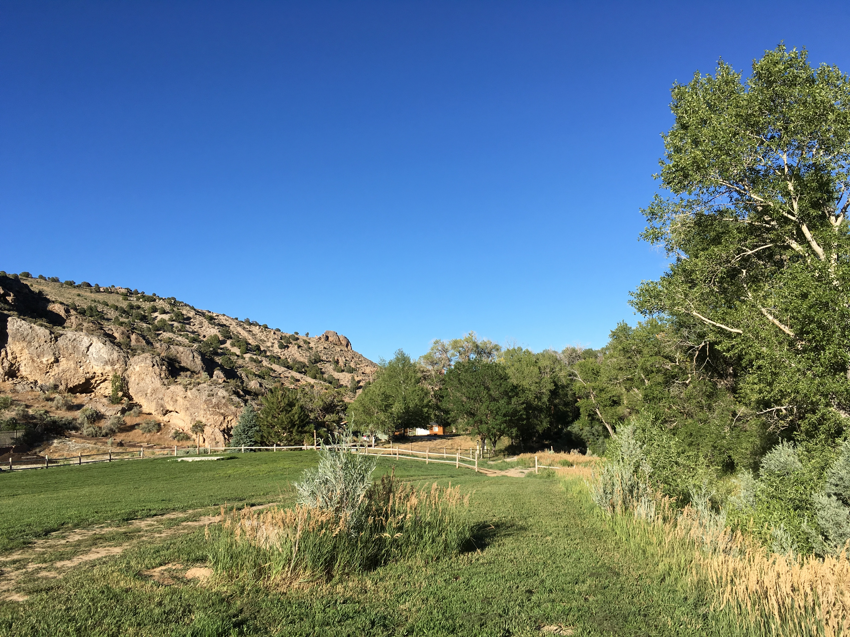
Questions/Comments
Greg Lovato
Administrator
Jennifer Carr
Deputy Administrator
Jeffrey Kinder
Deputy Administrator
Rick Perdomo
Deputy Administrator
Jim Lawrence
Acting Director
Contact:
Michael Antoine, Laboratory Certification Officer
mantoine@ndep.nv.gov

