Slide 1


Nevada Division of
Environmental Protection
RCAC Conference
Area Wide Optimization Program
AWOP
March 10, 2026
Presented by
Reggie Lang, PE
1.

Slide 2
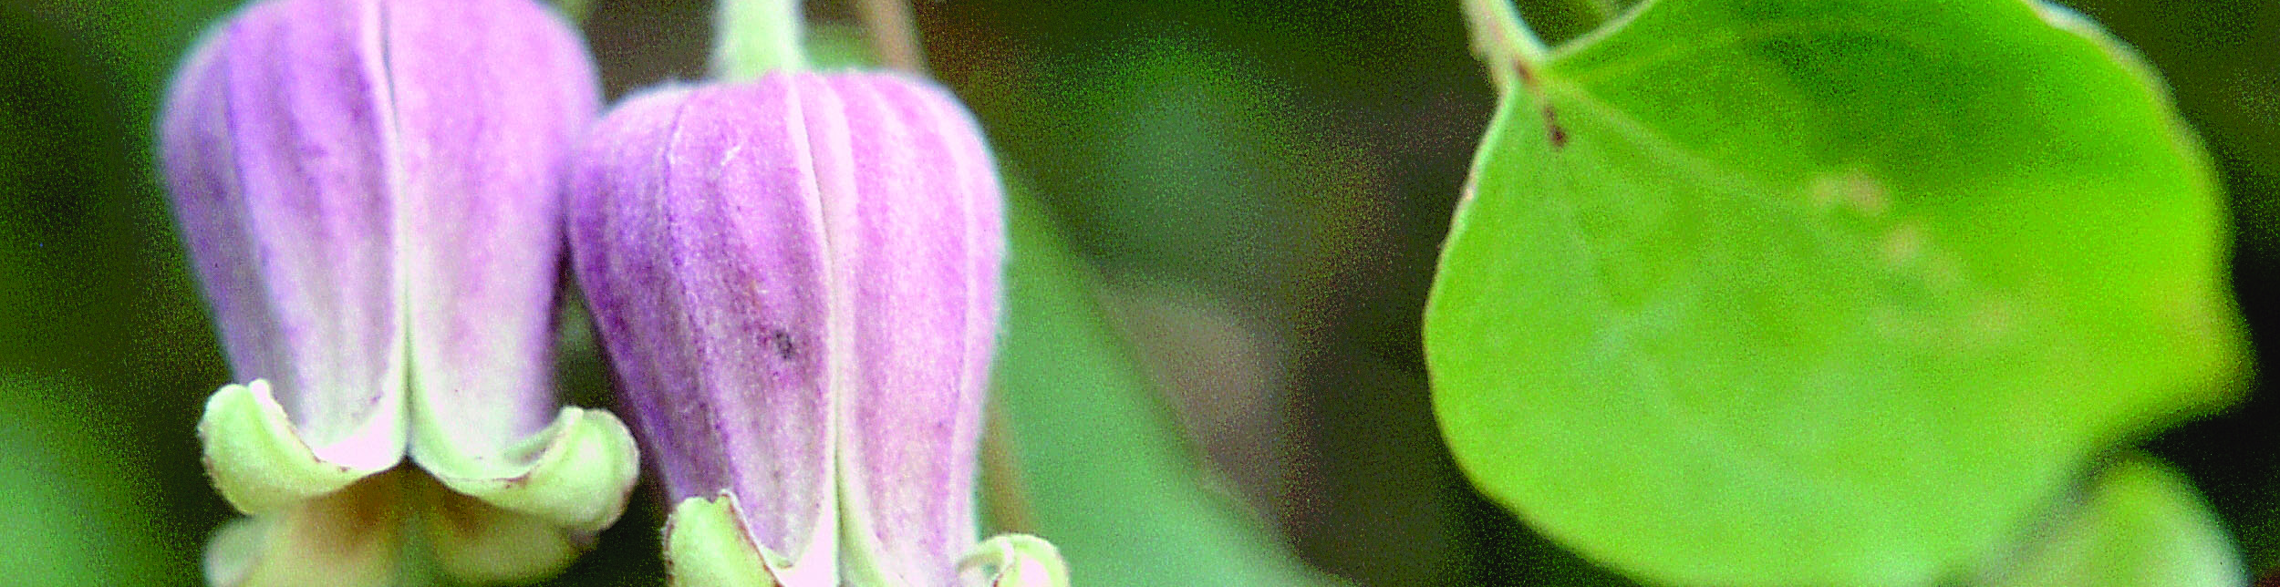
NDEP Mission
Our Mission is to preserve and enhance the environment of the State in order to protect public health, sustain healthy ecosystems, and contribute to a vibrant economy.

Slide 3
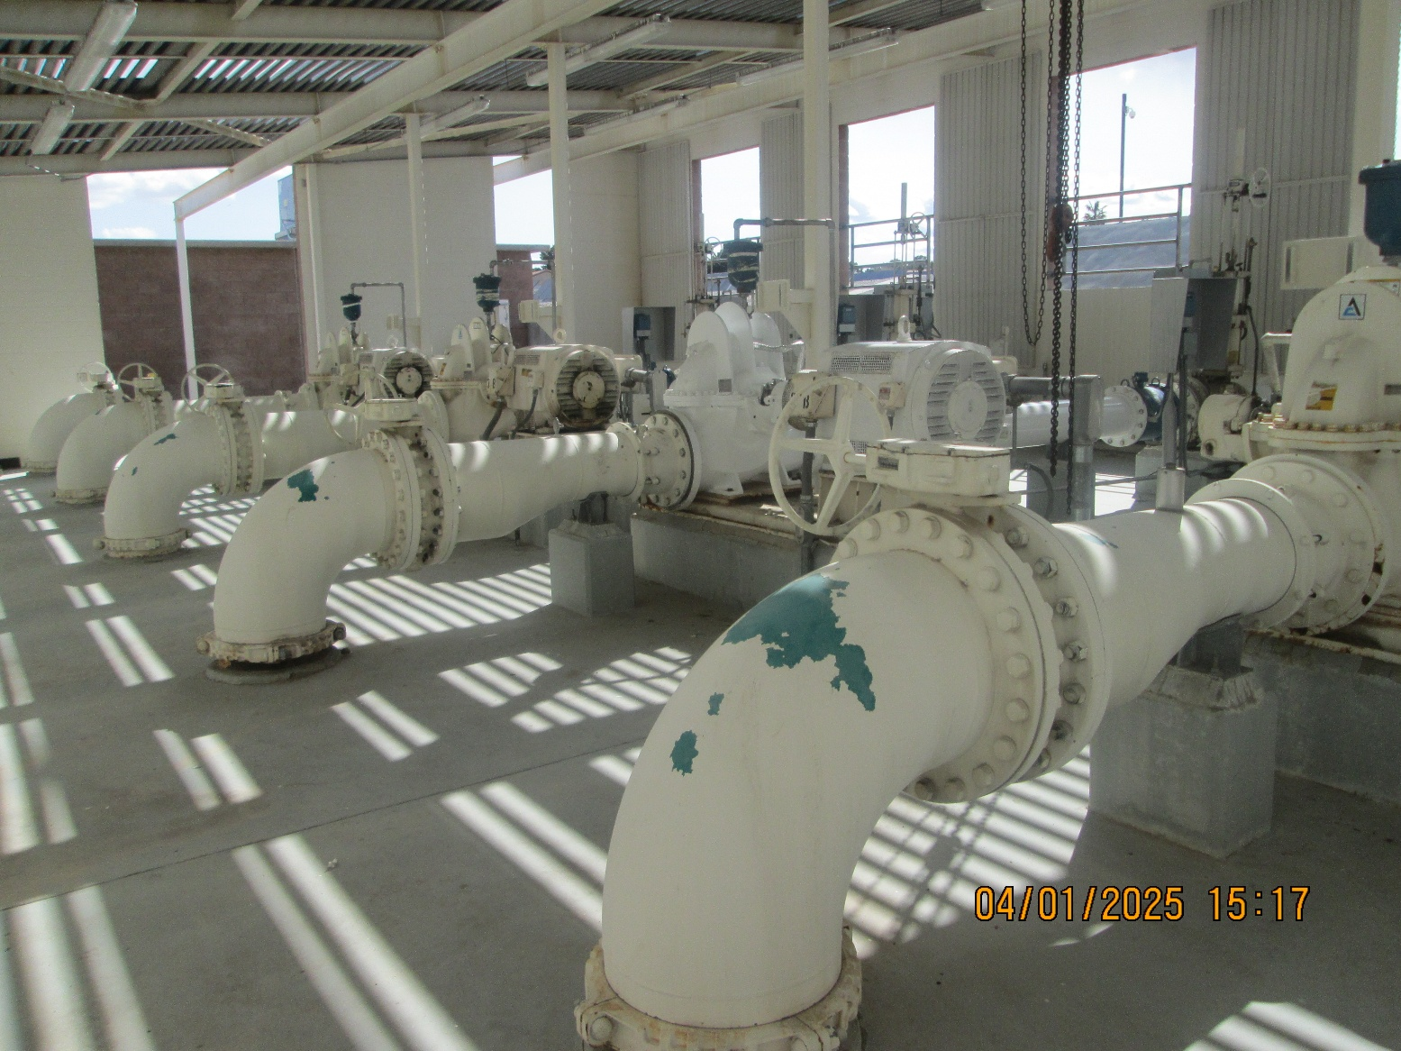
BSDW Mission
Our mission is to protect public health and the environment by providing oversight, guidance, and support, while fostering collaboration with safe drinking water partners.

Slide 4

NDEP / BSDW Overview
Photo taken and owned by NDCNR, permission granted to NDEP
NDEP
BSDW
12
Divisions & Programs
283
Employees
6
Branches
35
Employees
Notes:
NDEP numbers need verification..

Slide 5
Our AWOP Team
James Beckley
Karola Kennedy
Carlos Quiroz-Aguilera
Reggie Lang
Lab Cert
Engineering
OP Cert
Compliance

Slide 6
Drinking Water Optimization Program
The Area-Wide Optimization Program (AWOP) provides technical assistance via tools and approaches designed to help drinking water systems meet water quality optimization goals and provide an increased – and sustainable – level of public health protection to their consumers.
The program focuses on enhancing existing treatment and operations, which generally leads to improved operations at drinking water systems. For some systems (e.g., especially those with inadequate or aging water infrastructure) the program approach may identify needed capital improvements. Other systems may be able to meet optimization goals with their existing treatment and infrastructure.

Slide 7
Drinking Water Optimization Program
Adoption of the program’s monitoring and water quality goals and the application of the program approach can help improve drinking water compliance, as well as increase consumers’ confidence in their drinking water. The optimization goals are more stringent than EPA’s regulatory requirements and program participation is voluntary. Many states currently participate in multi-state optimization programs, which are organized by EPA Region(s), and the participating states often use recognition programs to highlight water systems that have met program goals. Historically, the program has involved the development of technical assistance approaches within drinking water primacy agencies (typically states), through training by EPA, which the states can then apply to their public water systems.

Slide 8
Approach
EPA designed AWOP to enhance public health protection by optimizing the performance of public water systems. A successful AWOP includes three key components:
Status - Enhanced surveillance of PWS performance, which helps determine the relative need of the water systems (based on water quality and anticipated public health risk) and target assistance to those most in need.
Targeted Performance Improvement - Targeting activities for improving drinking water quality to “optimum” levels that go beyond regulatory requirements; this training helps transfer water treatment skills to water system operators and sustain improvements in drinking water quality.
Maintenance - Ongoing improvement to sustain and enhance the program through collaboration with partners in the AWOP network and integration of optimization approaches into related drinking water programs (e.g., capacity development).

Slide 9
Benefits
Participants in Area-Wide Optimization Program (AWOP) have cited multiple benefits including:
Enhanced State Staff, TA-Provider Staff, and Water-System Staff Capability and Motivation
Training is provided to participants on optimization tools and approaches, which are demonstrated at drinking water systems as field-proven practical and implementable approaches to improving water quality.
Water system staff gain increased technical understanding, as well as priority-setting and problem-solving skills.
Relationships among participants (e.g., state compliance assistance staff, third-party TA providers, and the regulated water system community) are developed and enhanced.

Slide 10
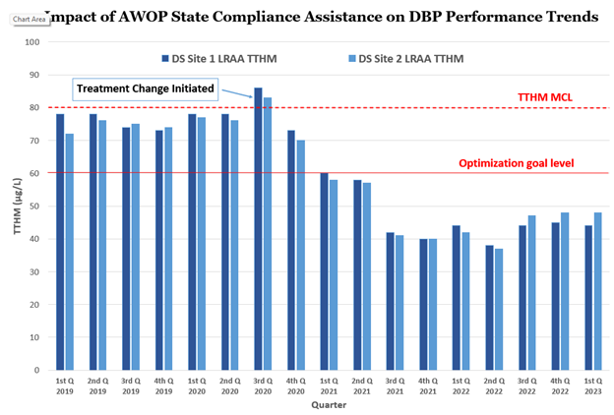
Benefits
Participants in Area-Wide Optimization Program (AWOP) have cited multiple benefits including:
Compliance Assistance for Small and Large Water Systems
Provides a cost-effective compliance assistance/improvement approach. For example:

Slide 11
Benefits
Participants in Area-Wide Optimization Program (AWOP) have cited multiple benefits including:
Compliance Assistance for Small and Large Water Systems
Provides a cost-effective compliance assistance/improvement approach.
Effective Use of State Resources
Resources allocated to systems based upon numerous factors, such as greatest need for water quality improvements and historical compliance violation vulnerability.
The correct technical assistance tools can be targeted for each system.
Improved Treatment Plant Performance and Distribution System Operations
Represents a long-term, sustainable, approach.
Fosters the enhanced capability of water system operators.
Documents the data-based, results-driven program.
Demonstrates improvement using plant-performance and water-quality trends.

Slide 12
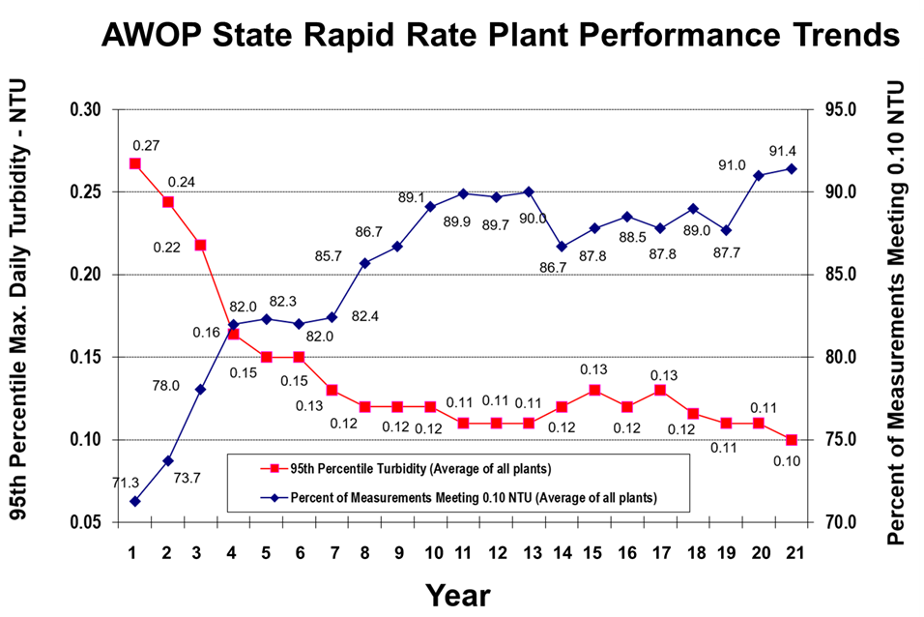
Average turbidity performance data from all of the rapid rate surface water treatment plants from an AWOP state. On the primary y-axis the maximum daily turbidity is plotted in units of NTU; on the secondary y-axis the percent of measurements meeting 0.1 NTU, which is the filtered water turbidity performance goal for this state. These data are shown over a 21-year period. Throughout this time the average maximum turbidity consistently decreased (starting at 0.27 NTU and dropping to 0.10 NTU). Additionally, the percent of the measurements meeting the AWOP goal consistently increased from 71.3 to 91.4%.
Benefits
https://www.epa.gov/sdwa/drinking-water-optimization-program

Slide 13
Nevada Program
Nevada began participating in AWOP implementation in early 2021 and began attending remote meetings. R8/9/10 and national.
This was followed by a series of 3 EPA trainings conducted with EPA’s contractor Process Applications Inc. (PAI):
Data integrity (turbidity) October 2023 TMWA.
Implementation and Distribution System data August 2024 KGID.
Comprehensive Performance Evaluation (CPE) July 2025 IVGID.

Slide 14
Turbidity Data Integrity
Data integrity (turbidity) October 30 - November 1, 2023 TMWA.
  3 days of training: classroom and field study at Chalk Bluff treatment plant.
  4 special studies at the plant
    Study A: Assessing Turbidity Sampling Location and Proximity of Sample Location to Turbidimeter (less than 1 minute desired)
    Study B: Online Turbidimeter O&M and Configuration (settings)
    Study C: Interpreting and Reporting Turbidity Data (including turbidity data quality control)
    Study D: Portable and Bench Turbidimeter Monitoring and Comparison to Online Turbidimeters

Slide 15
Turbidity Optimization Performance Goals
Individual Filter Effluent Goal:
Turbidity < 0.10 NTU 95%
Combined Filter Effluent Goal:
Max Turbidity < 0.10 NTU 95%
Notes:
For conventional and Direct filtration. Additional goals for settled water. Other filtration technologies.

Slide 16
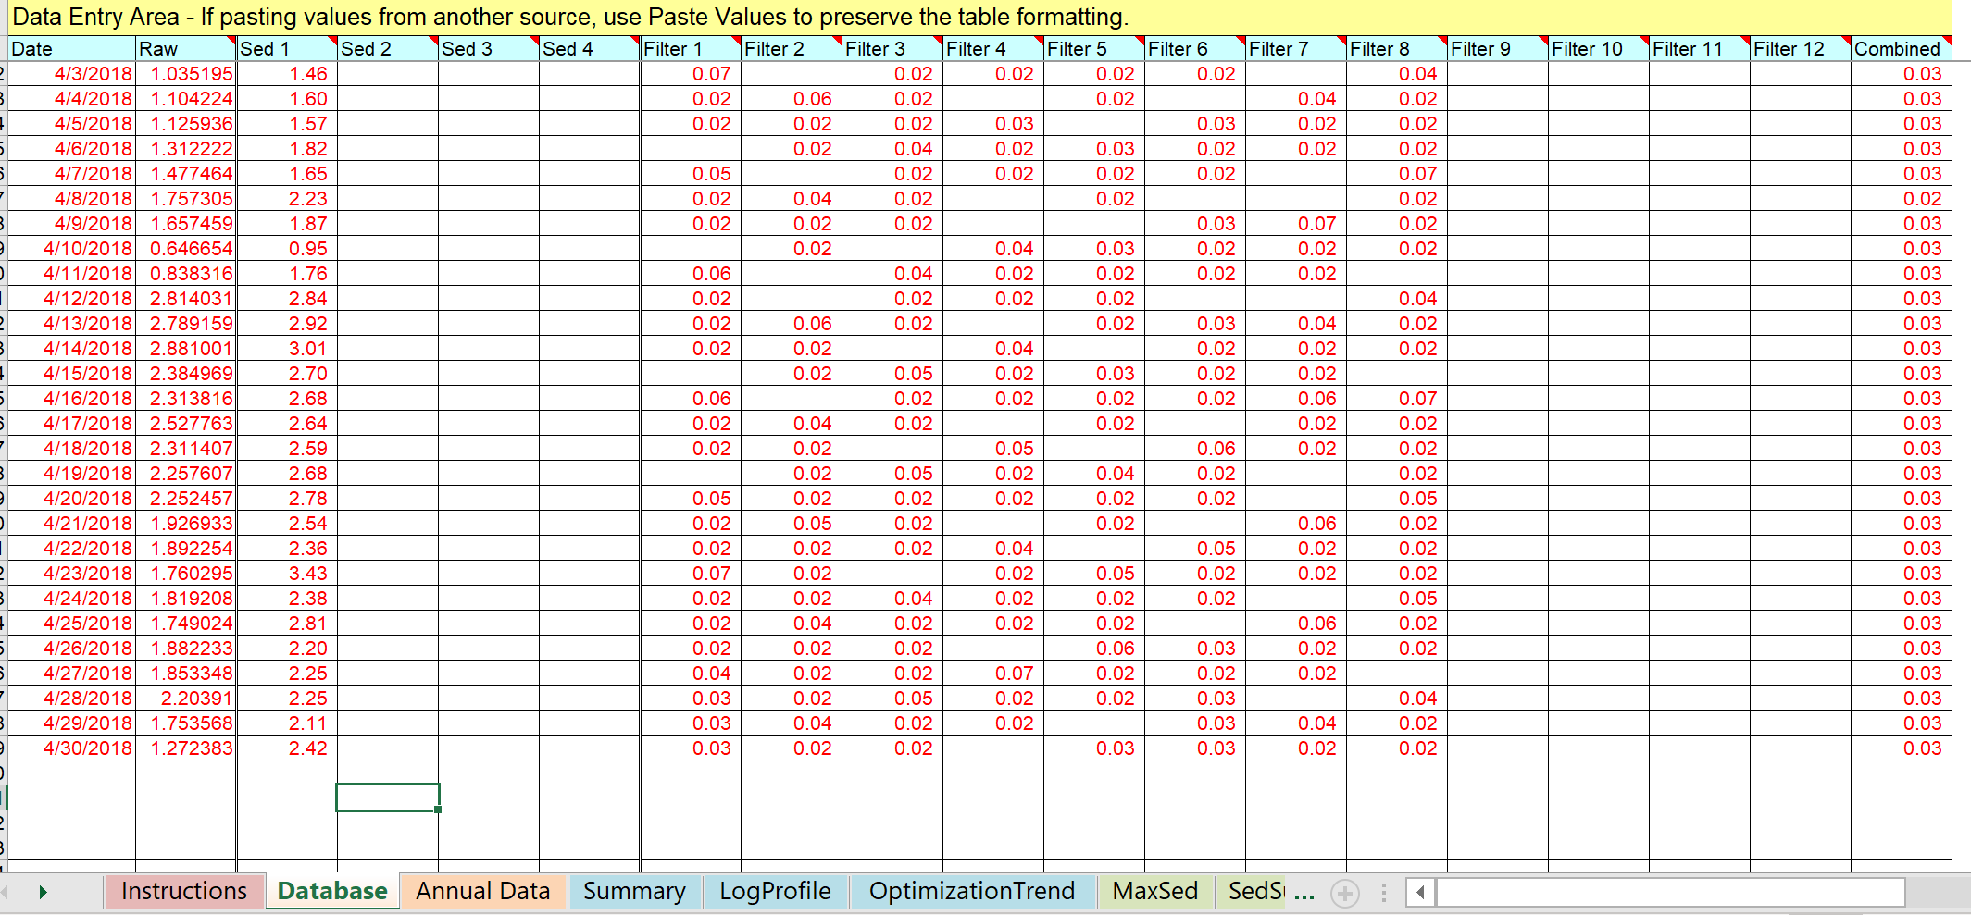
Turbidity Data Integrity
Process control, raw, settled, individual filters, combined filter effluent.
    Optimization Assessment Spreadsheet (OAS)
Notes:
Example of optimized rapid rate plant

Slide 17
Implementation & Distribution System Investigations
Implementation and Distribution System data August 2024 KGID.
  Chlorine Monitoring Data Integrity
  Free and total chlorine, Temperature and pH.
  Developing a Sampling Plan and Assessing Distribution System Water Quality Using Investigative Sampling
  Part 1 - Virtual Tour and Selecting Sample Locations
    Sources (Treatment plant / wells), pressure zones, pump stations, storage, booster chlorination,
  Part 2 – Selecting Investigative Sample Locations
    Select critical sites for field sampling.
    Part 3 – Field Sampling at Selected Sites using the Hydrant sampler

Slide 18
Distribution System Disinfection Optimization Performance Goal
Disinfection Goal:
Maintain ≥ 0.20 mg/L free chlorine OR 1.5 mg/L monochloramine at all monitoring sites in the distribution system, at all times.
Initial Focus Area
PWS >10 K, ~21 systems (GW, SW, SWP)
Chlorine Residual=0.5 mg/L throughout the distribution system if Legionella present in source water.

Slide 19
DBP Optimization Performance Goals
Individual Site LRAA Goal:
TTHM LRAA ≤ 70 ppb
HAA5 LRAA ≤ 50 ppb
At all sample sites in the distribution system.
Stage 2 D/DBP Rule MCL is 80 ppb for TTHM and
60 ppb for HAA5

Slide 20
Tools
Hydrant sampler

Slide 21
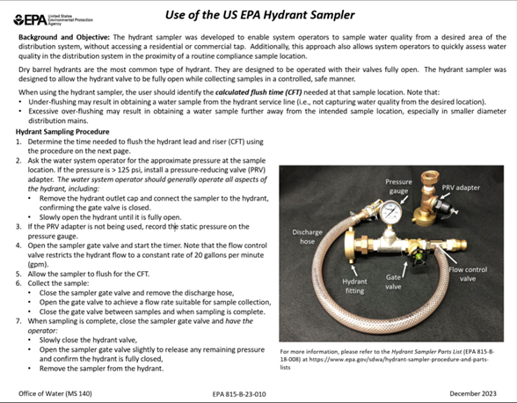
Tools
https://www.epa.gov/sdwa/hydrant-sampler-procedure-and-parts-lists

Slide 22
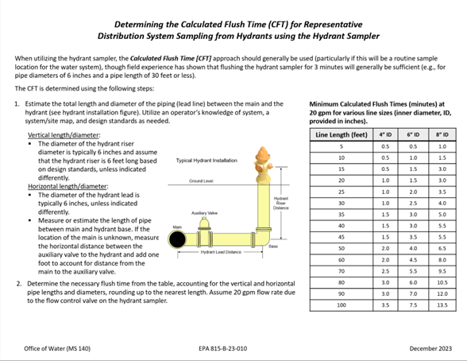
Tools

Slide 23
Tools
Calculated Flush Time (CFT) or Calculated Flush Volume (CFV) Approach for Representative Distribution System Chlorine and Disinfection Byproduct (DBP) Sample Collection from Building Taps
This guidance document provides details on best practices to consistently and accurately assess drinking water disinfectant residual and disinfection byproduct (DBP) concentrations in samples collected from building taps in order to characterize water quality in the distribution system main.
https://www.epa.gov/sdwa/drinking-water-optimization-program

Slide 24
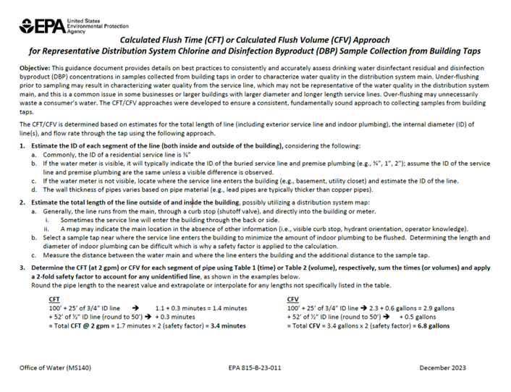
Tools
https://www.epa.gov/sdwa/calculated-flush-time-cft-or-calculated-flush-volume-cfv-approach-representative-distribution

Slide 25
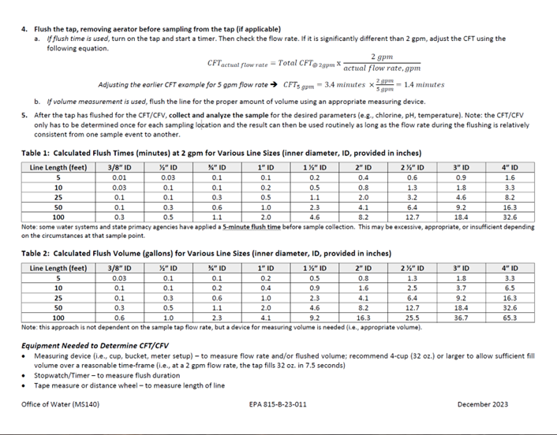
Tools

Slide 26
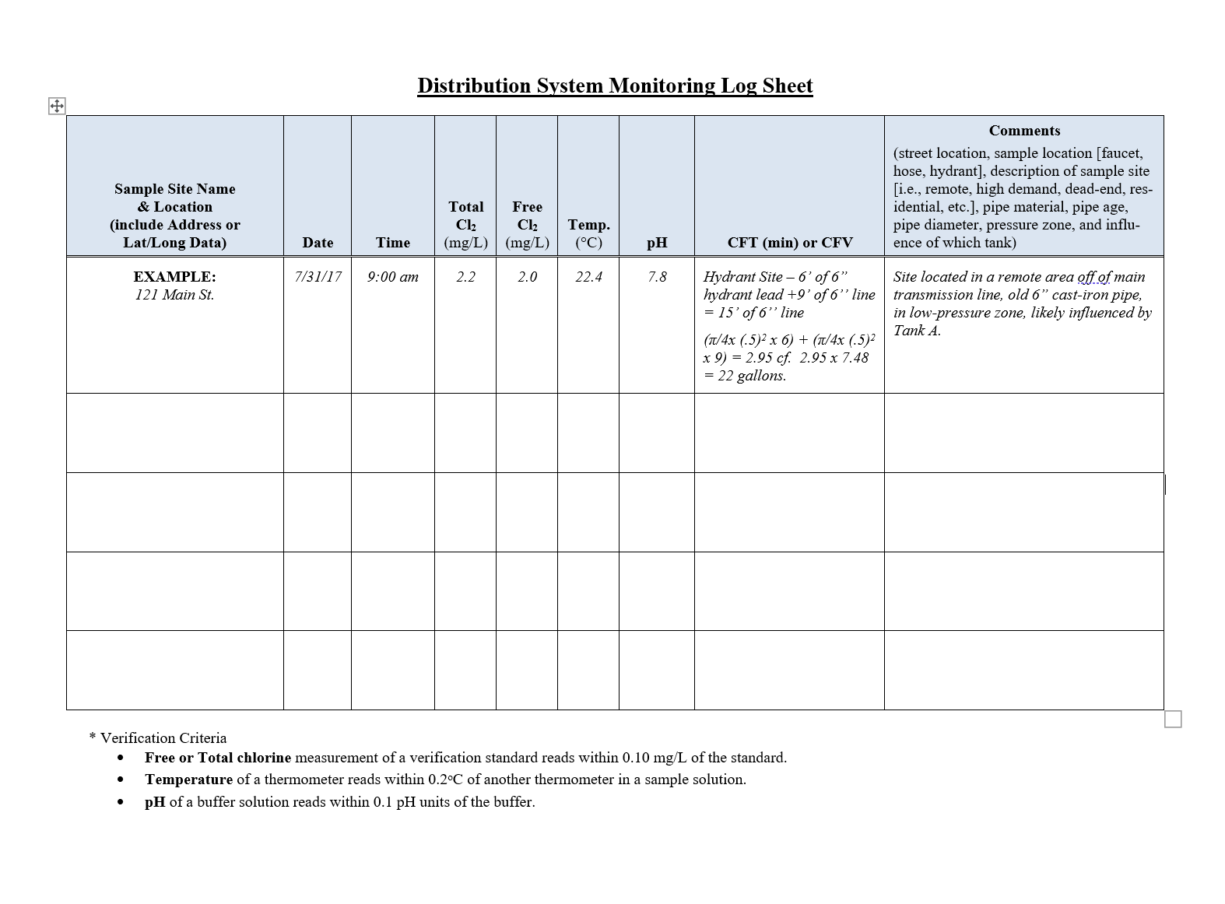
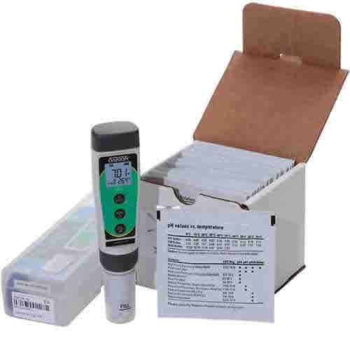
Special Study

Slide 27
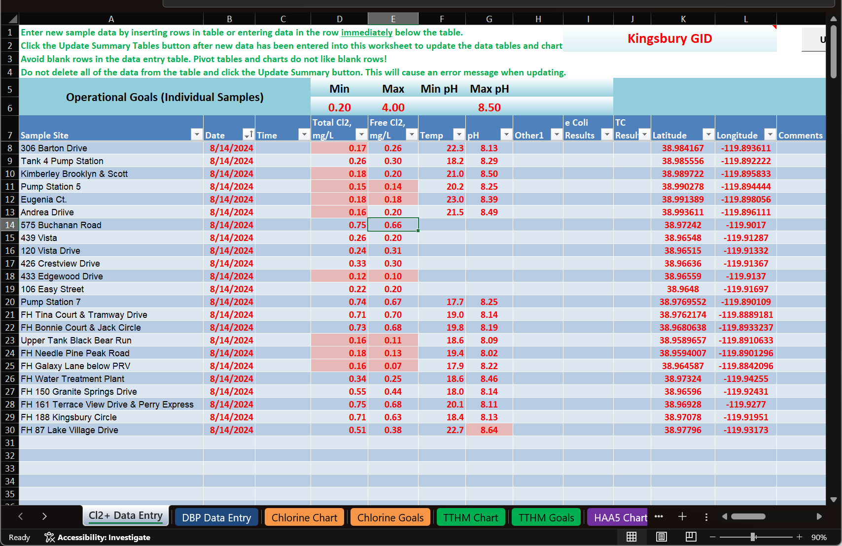
Special Study Results
Notes:
Results of investigatory sampling

Slide 28
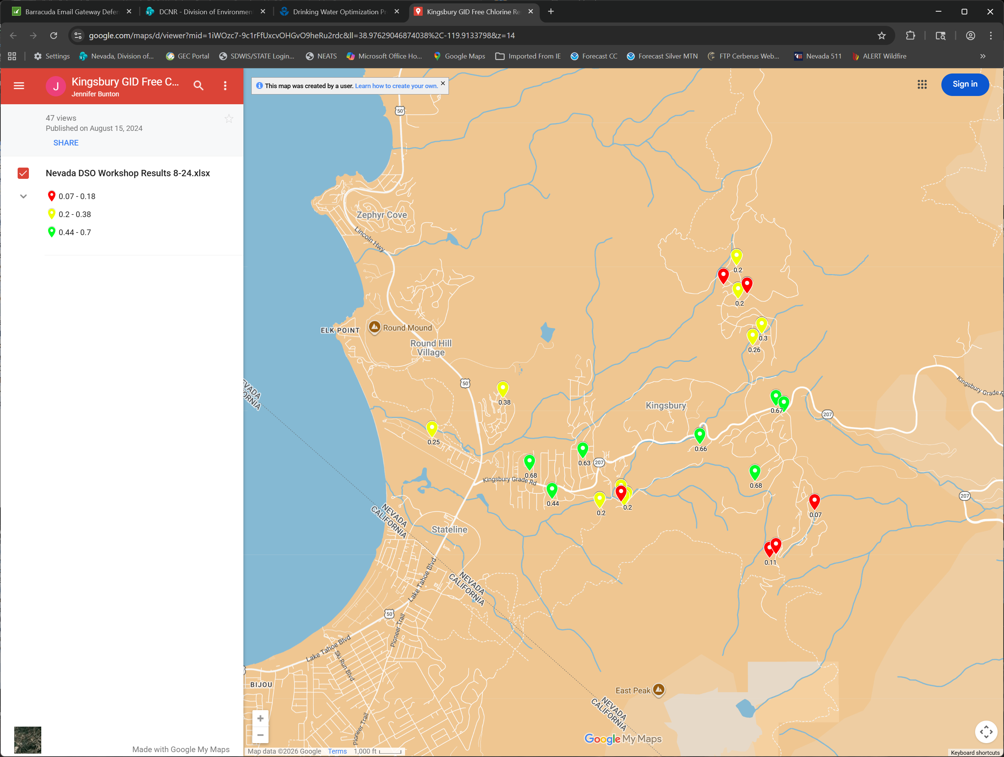
Special Study Results
Notes:
Google Mapping of results

Slide 29
Comprehensive Performance Evaluation (CPE) Distribution
Comprehensive Performance Evaluation (CPE) July 2025 Incline Village GID.
What is a CPE? A CPE is a thorough review of a treatment plant’s (or distribution system) performance-based capabilities (this includes design) and administrative, operation, and maintenance practices.​
“Central tendency” performance-limiting factors identified during CPEs:​
Administration​
Existing policies or the lack of policies discourage staff members from making required operational, maintenance, and management decisions to support plant performance and reliability.​
Complacency within utility resulting in “this would never happen to us” ​and acceptance of the status quo.​

Slide 30
Comprehensive Performance Evaluation (CPE) Distribution
Operation & Maintenance​:
  Staff do not apply concepts and testing to process control (e.g., inadequate monitoring, process control testing, performance trending, Special Studies, and operational guidelines).​
Design​:
  Lack of flexibility to feed chemicals at desired process locations.​
  Type or lack of controls limit operator’s ability to optimize process ​(e.g., automatic control valves).

Slide 31
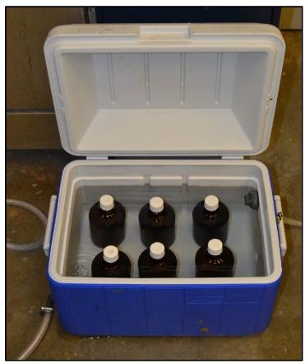
Additional Special Study Tools
Special Study 1: Plant Effluent Hold Study

Slide 32
Additional Special Study Tools
Special Study 2: Investigative Sampling Study

Slide 33
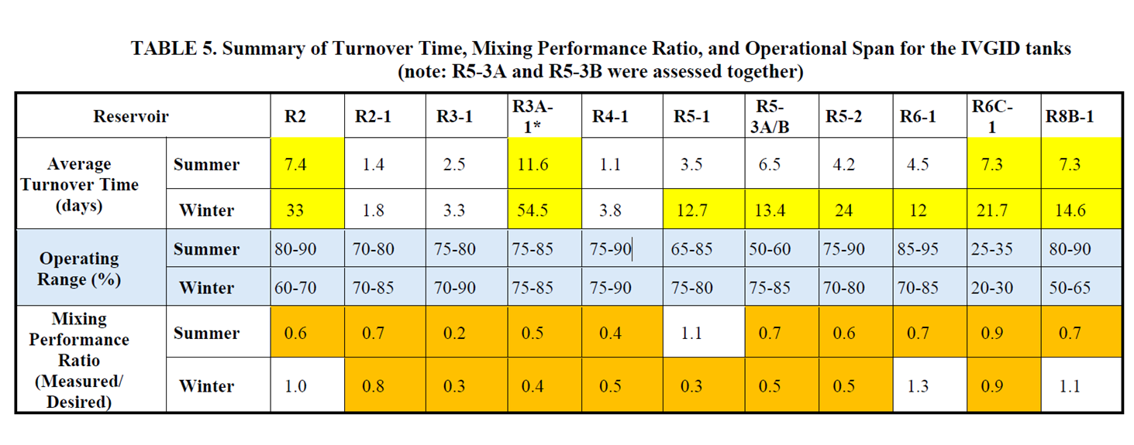
Additional Special Study Tools
Special Study 3: Storage Tank Turnover Time and Mixing Data Analysis (water age)
Notes:
Additional optimization spreadsheets

Slide 34
Additional Special Study Tools
Special Study 4: Storage Tank Depth Sampling Study on Tank 3A-1
Storage tank 3A-1 lower sample tap location.

Slide 35
Closing Remarks
The term optimization refers to voluntarily improving drinking water quality to the highest levels possible, which are normally above and beyond the minimum requirements of the U.S. Environmental Protection Agency (USEPA) and the State of Nevada Primary Drinking Water Regulations. Water systems that choose to voluntarily pursue optimization, versus simply meeting the regulatory requirements, believe that optimization will allow them to provide the highest levels of water quality to their customers.

Slide 36
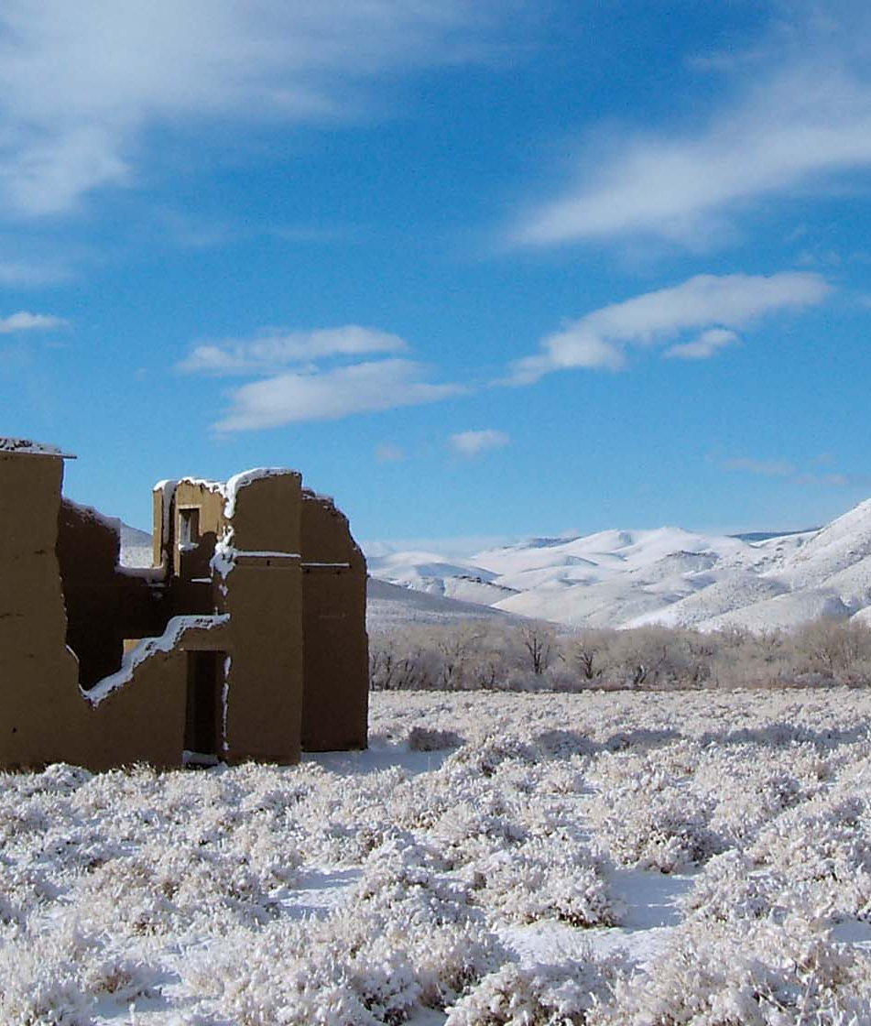
Thank You
Reginald C Lang III, PE
Nevada Division of Environmental Protection
Phone: 775-687-9528
Email: rlang@ndep.nv.gov

