Slide 1
Nevada Water Operator Exam Summaries 4th Quarter 2022
NDEP Bureau of Safe Drinking Water
Operator Certification Program

Slide 2
2022 4th Quarter - Distribution
Fourth Quarter 2022 Summary of Distribution OpCert Exams
Distribution | Date | Test | Total | Pass | Fail | % Pass | Low Grade | High Grade | Median | Most Missed
1 | Q4 | Agg | 46 | 28 | 18 | 60% | 48 | 93 | 76 | System Components/Disinfection MEA & Lab
2 | Q4 | Agg | 20 | 10 | 10 | 50% | 57 | 87 | 70 | Disinfection MEA & Lab/SSA & Public Interactions
3 | Q4 | Agg | 21 | 10 | 11 | 47% | 47 | 90 | 69 | Disinfection MEA & Lab/Equipment IOM
4 | Q4 | Agg | 7 | 3 | 4 | 42% | 52 | 88 | 69 | System Components/Disinfection MEA & Lab
 |  |  | 94 | 51 | 43 | 54%
DISTRIBUTION CATEGORIES:
System Information & Components
Equipment; Install, Operate and Maintain
Monitor, Evaluate & Adjust Disinfection & Lab
Security, Safety, Public Interaction & Administrative Procedures

Slide 3
2022 4th Quarter - Treatment
Fourth Quarter 2022 Summary of Treatment OpCert Exams
Treatment | Date | Test | Total | Pass | Fail | % Pass | Low Grade | High Grade | Median | Most Missed
1 | Q4 | Agg | 9 | 8 | 1 | 88% | 44 | 93 | 78 | Equipment O&M
2 | Q4 | Agg | 7 | 5 | 2 | 71% | 64 | 86 | 71 | Treatment
3 | Q4 | Agg | 3 | 2 | 1 | 67% | 64 | 91 | 70 | Treatment
4 | Q4 | Agg | 6 | 5 | 1 | 83% | 66 | 87 | 76.5 | Equipment O&M
 |  |  | 25 | 20 | 5 | 80%
TREATMENT CATEGORIES:
Treatment: Monitor, Evaluate and Adjust
Laboratory Analysis
Operate and Maintain Equipment
Evaluate Characteristics of Source Water
Perform Security, Safety & Administrative Procedures

Slide 4
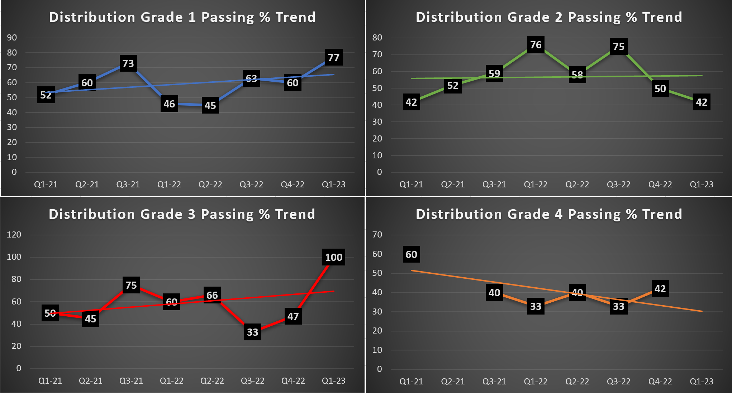
Passing Percentage Trend 2021-2023

Slide 5
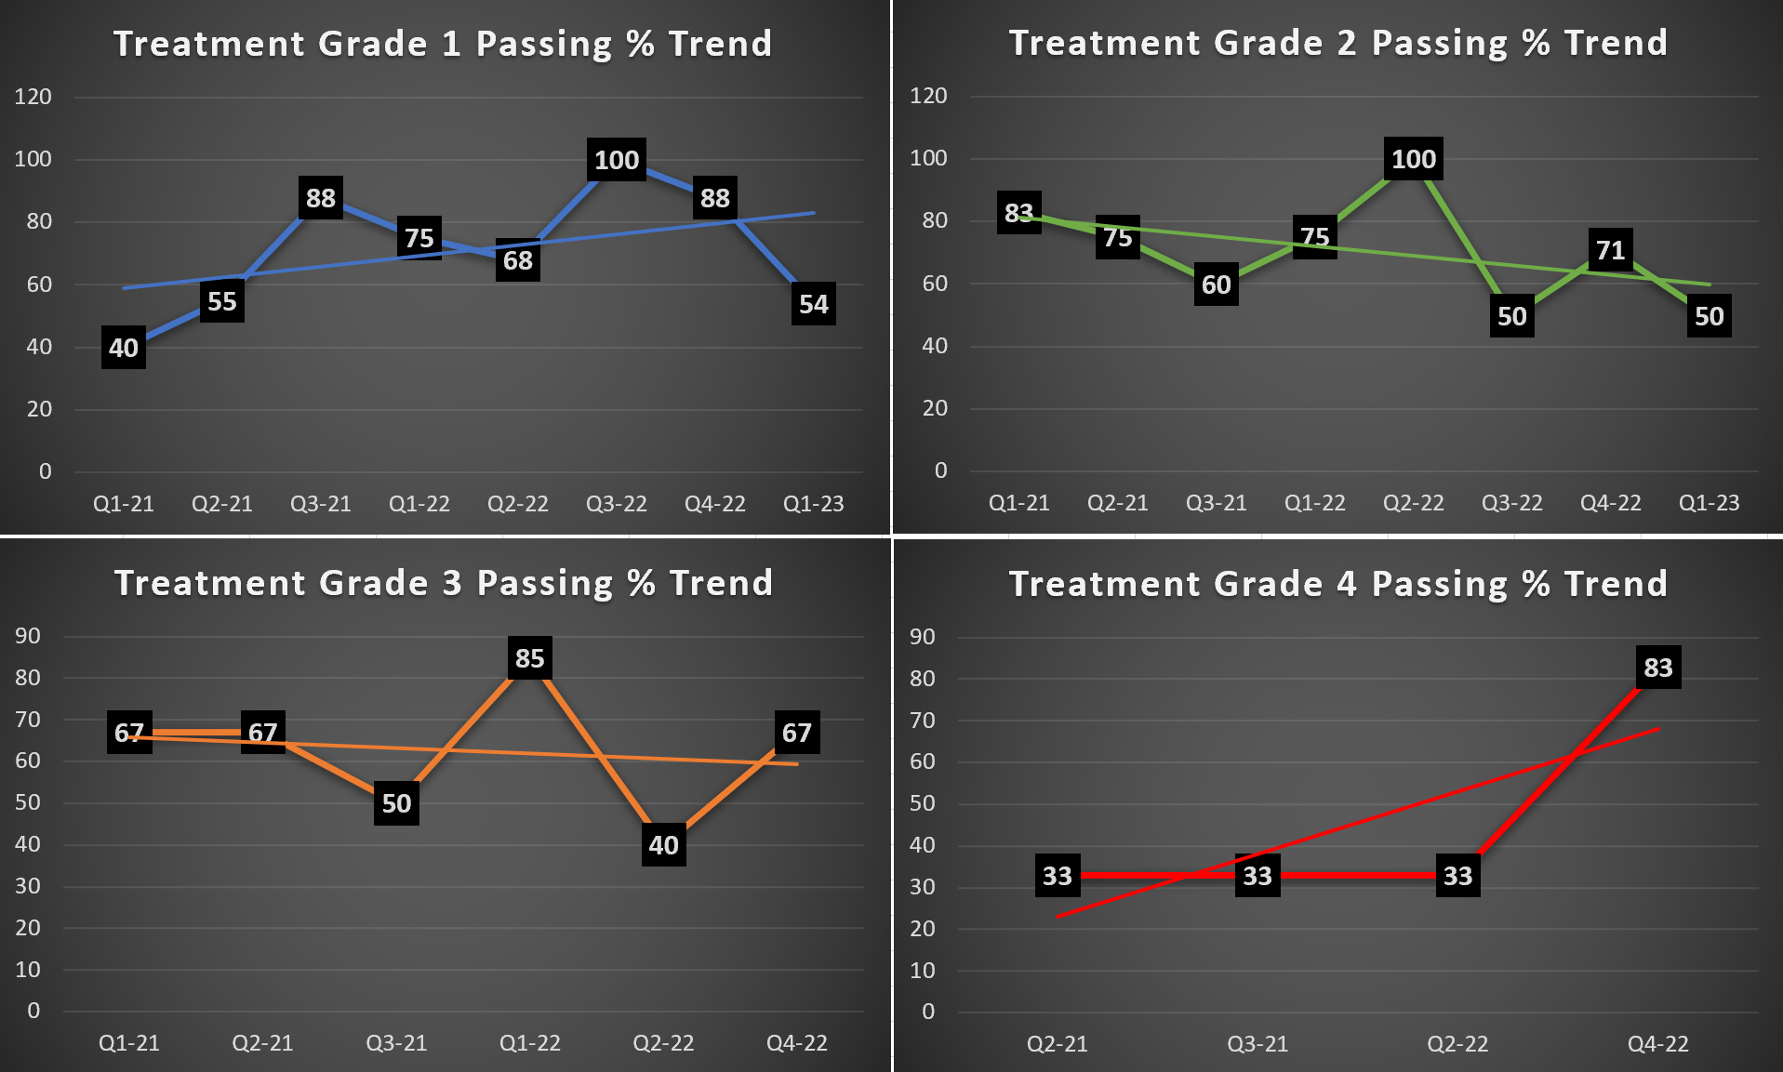
Passing Percentage Trend 2021-2023

