Slide 1
Nevada Water Operator Exam Summaries 2nd Quarter 2023
NDEP Bureau of Safe Drinking Water
Operator Certification Program

Slide 2
2023 2nd Quarter - Distribution
Second Quarter 2023 Summary of Distribution OpCert Exams
Distribution | Date | Test | Total | Pass | Fail | % Pass | Low Grade | High Grade | Median | Most Missed
1 | Q2 | Agg | 78 | 51 | 27 | 65% | 41 | 93 | 72 | System Components/Disinfection MEA & Lab
2 | Q2 | Agg | 45 | 20 | 25 | 44% | 55 | 92 | 67 | System Components/Disinfection MEA & Lab
3 | Q2 | Agg | 19 | 3 | 16 | 15% | 50 | 80 | 65 | Disinfection MEA & Lab/System Components
4 | Q2 | Agg | 10 | 3 | 7 | 30% | 56 | 87 | 65 | System Components/Equipment IOM
 |  |  | 152 | 77 | 75 | 51%
DISTRIBUTION CATEGORIES:
System Information & Components
Equipment; Install, Operate and Maintain
Monitor, Evaluate & Adjust Disinfection & Lab
Security, Safety, Public Interaction & Administrative Procedures

Slide 3
2023 2nd Quarter - Treatment
Second Quarter 2023 Summary of Treatment OpCert Exams
Treatment | Date | Test | Total | Pass | Fail | % Pass | Low Grade | High Grade | Median | Most Missed
1 | Q2 | Agg | 29 | 19 | 10 | 66% | 58 | 94 | 77 | Laboratory
2 | Q2 | Agg | 22 | 14 | 8 | 64% | 51 | 88 | 71 | Treatment/Laboratory
3 | Q2 | Agg | 4 | 4 | 0 | 100% | 73 | 87 | 81
4 | Q2 | Agg | 3 | 0 | 3 | 0% | 61 | 69 | 65 | Source Water/ Treatment
 |  |  | 58 | 37 | 21 | 64%
TREATMENT CATEGORIES:
Treatment: Monitor, Evaluate and Adjust
Laboratory Analysis
Operate and Maintain Equipment
Evaluate Characteristics of Source Water
Perform Security, Safety & Administrative Procedures

Slide 4
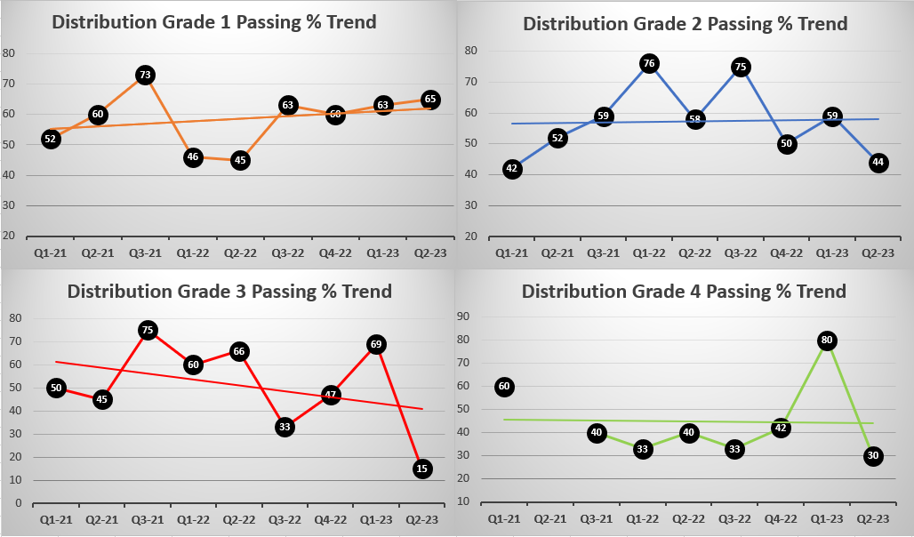
Passing Percentage Trend 2021-2023

Slide 5
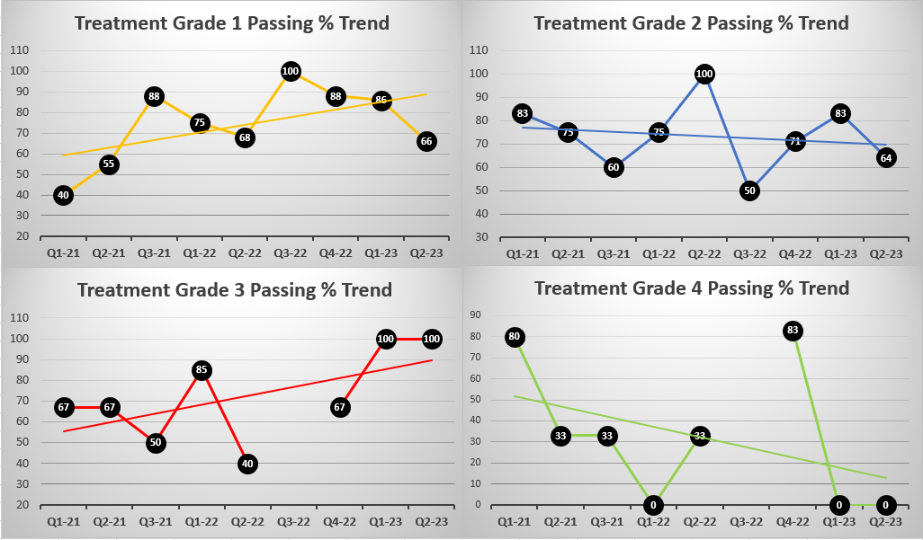
Passing Percentage Trend 2021-2023

Slide 6
NDEP Bureau of Safe Drinking Water
Operator Certification Program
Bureau Chief Andrea Seifert, P.E.
Data Mngmnt / OpCert Supervisor Linh Kieu
Program Manager Carlos Quiroz
Administrative Specialist Rachel Weingart

